Slide 1
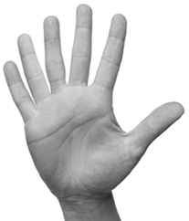

Inherited Conditions Question
The figure below shows the hand of a man with polydactyly. The man has an extra finger on each hand.
The man’s mother also has polydactyly but his father does not. The man is heterozygous for polydactyly. Explain how the information given above shows that the man is heterozygous for polydactyly.
Key things to include:
Where has the gene for polydactyly been inherited from
Why does the man have polydactyly
Answer
_______________________________________________________________________________________________________________________________________________________________________________________________________________________________________________________________________________________________________________________________________________________________________________________________________________________________________
Link to video

Slide 2
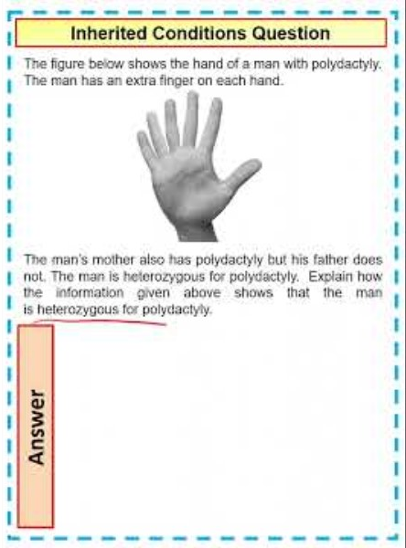
Inherited Conditions Question

Slide 3

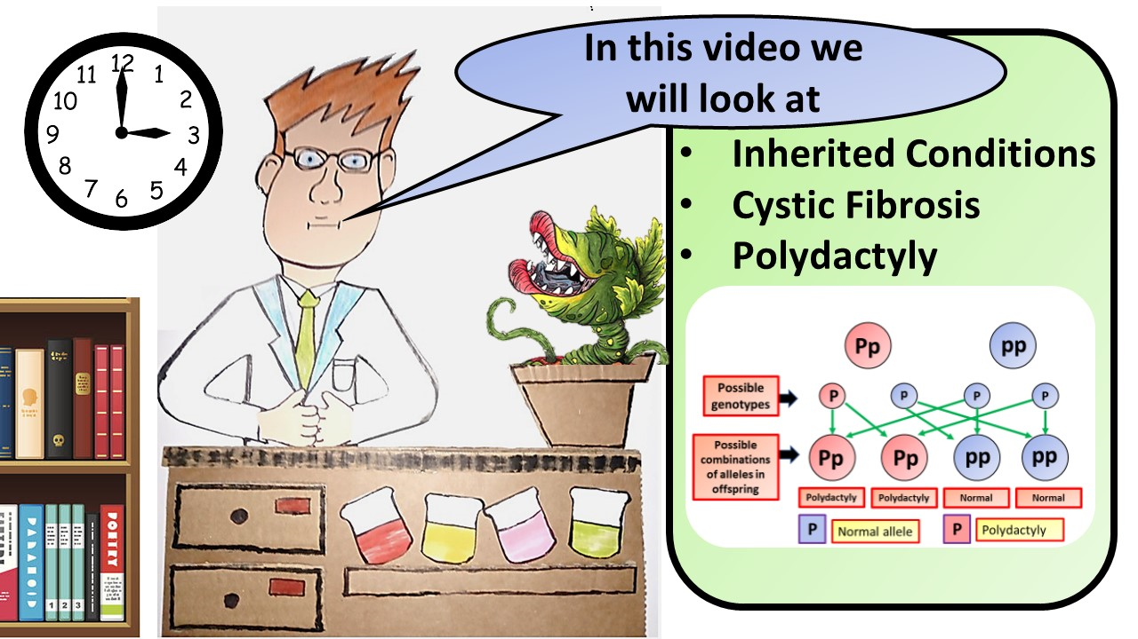


Click here to access my youtube videos
Resources that this activity would work well with
Lesson on TES
Lesson on TPT
Follow me on social media to stay in touch
Keep up to date with my new content:

