Slide 1
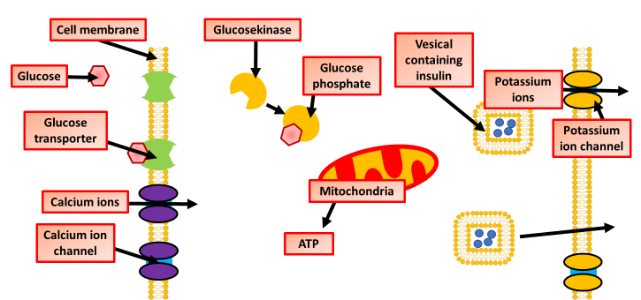
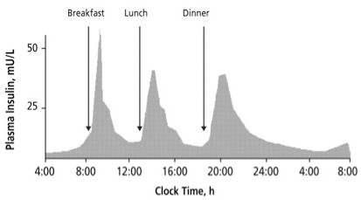
Insulin Production Question
Specification Link:
Hormonal Communication
Highlight key words in the information below:
At normal blood glucose concentration levels, potassium channels in the plasma membrane of β cells are open and potassium ions diffuse out of the cell. The inside of the cell is at a potential of —70mV with respect to the outside of the cell.
When blood glucose concentration rises, glucose enters the cell by a glucose transporter.
The glucose is metabolised inside the mitochondria, resulting in the production of ATP.
The ATP binds to potassium channels and causes them to close. They are known as ATP-sensitive potassium channels.
As potassium ions can no longer diffuse out of the cell, the potential difference reduces to around —30mV and depolarisation occurs.
Depolarisation causes the voltage-gated calcium channels to open.
Calcium ions enter the cell and cause secretory vesicles to release the insulin they contain by exocytosis.
What is the resting potential of the cell membrane?
________________________________________
What happens when blood glucose rises?
________________________________________
Inside the cell, what is increased by the presence of glucose?
________________________________________
What happens when potassium is no longer transported out of the cell?
________________________________________
What is the role of calcium ion channels?
________________________________________________________________________________
Describe exocytosis
________________________________________________________________________________________________________________________
Using the graph above, describe how the time of day affects the release of insulin by the pancreas
______________________________________________________________________________________________________________________________________________________________________________________________________________________________________________________________________________________________________________________________________________________
Describe how the release of insulin is controlled by blood glucose concentration
________________________________________________________________________________________________________________________________________________________________________________________________________________________________________________________________________________________________________________________________________________________________________

Slide 2
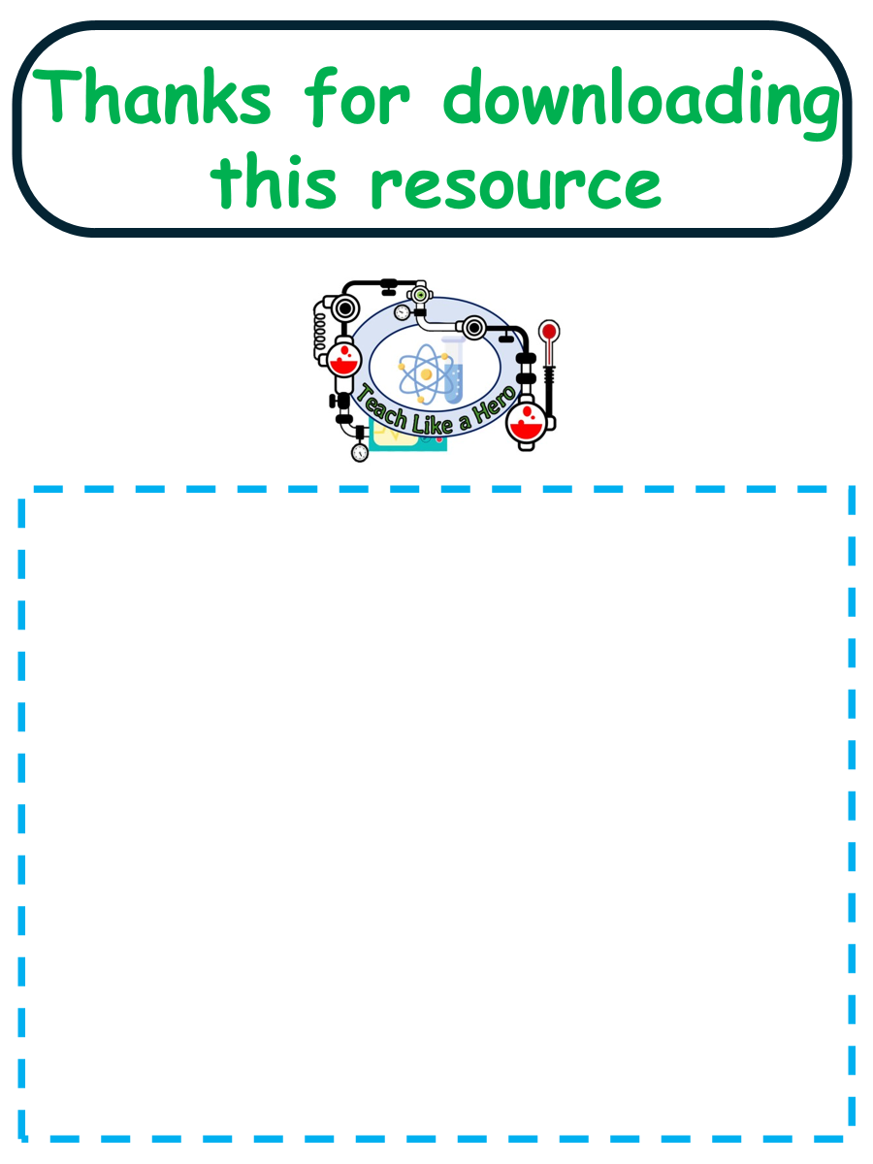
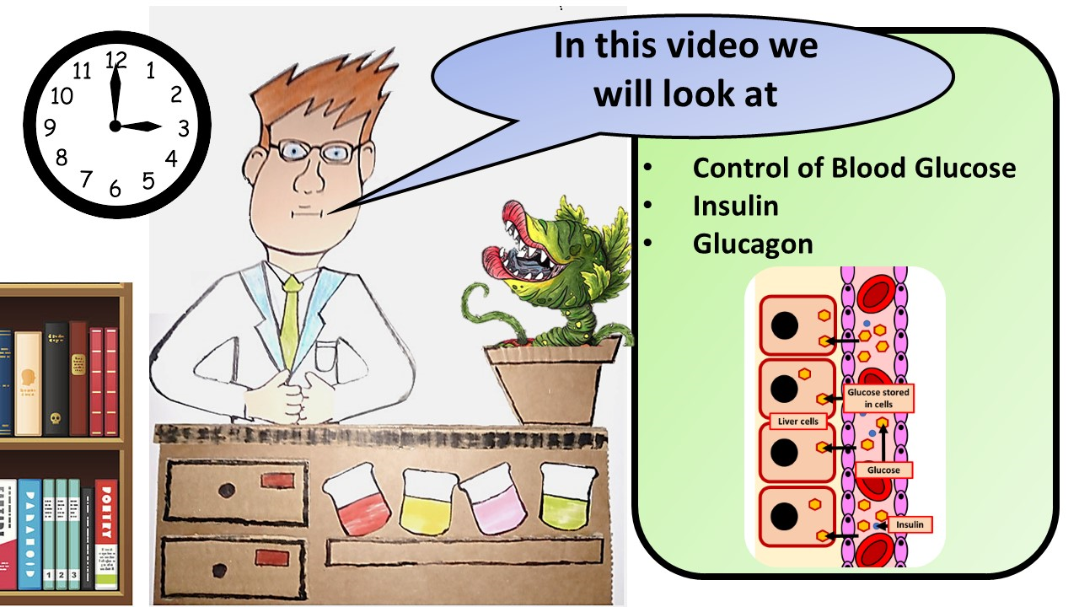


Click here to access my percentage composition youtube videos
Resources that this activity would work well with
Lesson on TES
Lesson on TPT
Follow me on social media to stay in touch
Keep up to date with my new content:

