Slide 1
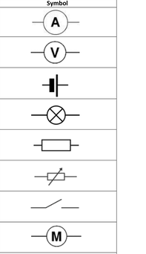

Fold & Glue
Series Circuits
Fold & Glue
Fold & Glue
Parallel Circuits

