Slide 1
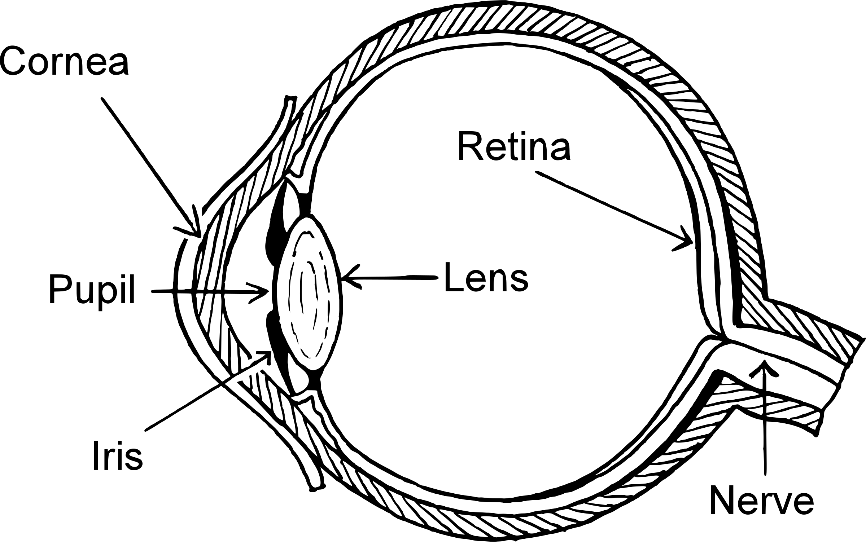
The eye works by:____________
________________________________________________________________________________________________________________________________________________________________________________________________________________________________________________________________________________

