Slide 1
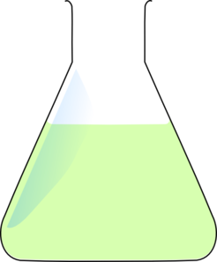
Surface Area
Concentration
Factors Effecting Rate of Reaction
Temperature
Catalyst

