Slide 1
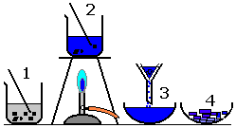
Fold & Glue
Copper(II) oxide is an insoluble base
Describe how you could make crystals of copper(II) sulfate from copper(II) oxide.
Fold & Glue
The salt called potassium chloride is made when potassium hydroxide solution reacts with hydrochloric acid.
Describe a method for making crystals of potassium chloride from potassium hydroxide solution and hydrochloric acid.
In this method you should:
describe how you will add the correct amount of the hydrochloric acid to neutralise the potassium hydroxide solution
describe how you will get crystals of potassium chloride.

