Slide 1
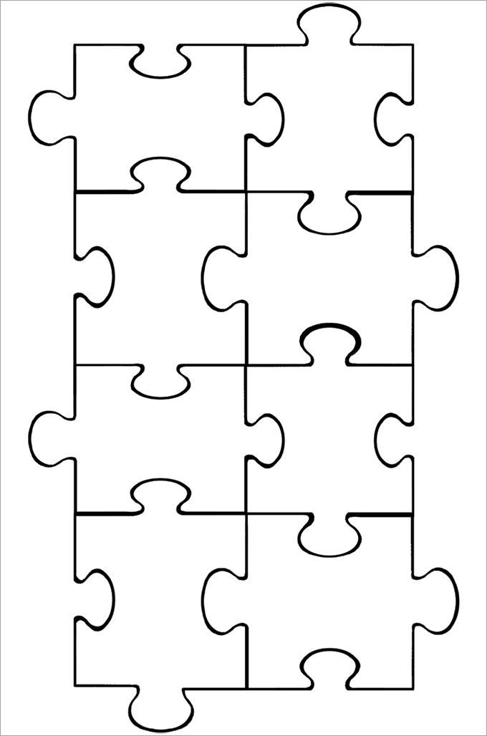
Vaccination
Malaria Life Cycle
Parts of the immune system
Plant Defences
Drug Development
Plant Diseases
Pathogens
Phagocytosis

