Slide 1
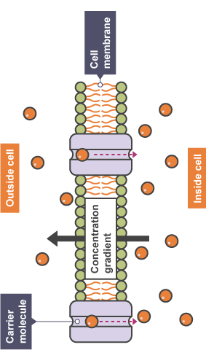
Active transport is: __________________________________________________________________________________________________________________________________________________________________________________________________________________________________________________________________________________________________________________________________________________________________________________________________________________________________________________________________
Active Transport

