Slide 1
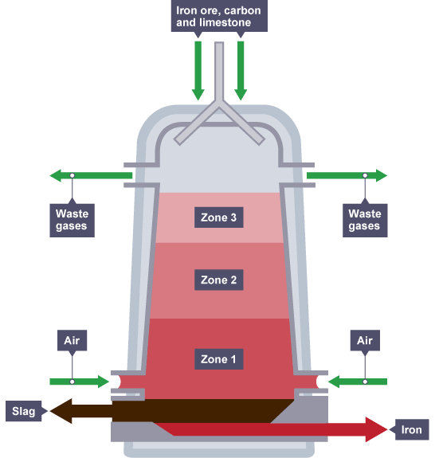
Iron is extracted from iron ore in a huge container called a blast furnace. Iron ores such as haematite contain iron(III) oxide, Fe2O3. The oxygen must be removed from the iron(III) oxide in order to leave the iron behind. Reactions in which oxygen is removed are called reduction reactions.
Iron Production in the Blast Furnace
Carbon is more reactive than iron, so it can displace iron from iron(III) oxide. Here are the equations for the reaction:
Iron(III) oxide + carbon → iron + carbon dioxide
2Fe2O3(s) + 3C(s) → 4Fe(l) + 3CO2(g)
In this reaction, the iron(III) oxide is reduced to iron, and the carbon is oxidised to carbon dioxide.
In the blast furnace, it is so hot that carbon monoxide can be used, in place of carbon, to reduce the iron(III) oxide:
iron(III) oxide + carbon monoxide → iron + carbon dioxide
Fe2O3(s) + 3CO(s) → 2Fe(l) + 3CO2(g)
Iron is extracted from iron ore in a huge container called a blast furnace. Iron ores such as haematite contain iron(III) oxide, Fe2O3. The oxygen must be removed from the iron(III) oxide in order to leave the iron behind. Reactions in which oxygen is removed are called reduction reactions.
Iron Production in the Blast Furnace
Carbon is more reactive than iron, so it can displace iron from iron(III) oxide. Here are the equations for the reaction:
Iron(III) oxide + carbon → iron + carbon dioxide
2Fe2O3(s) + 3C(s) → 4Fe(l) + 3CO2(g)
In this reaction, the iron(III) oxide is reduced to iron, and the carbon is oxidised to carbon dioxide.
In the blast furnace, it is so hot that carbon monoxide can be used, in place of carbon, to reduce the iron(III) oxide:
iron(III) oxide + carbon monoxide → iron + carbon dioxide
Fe2O3(s) + 3CO(s) → 2Fe(l) + 3CO2(g)

