Slide 1
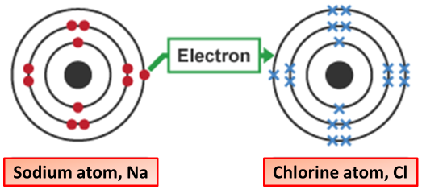
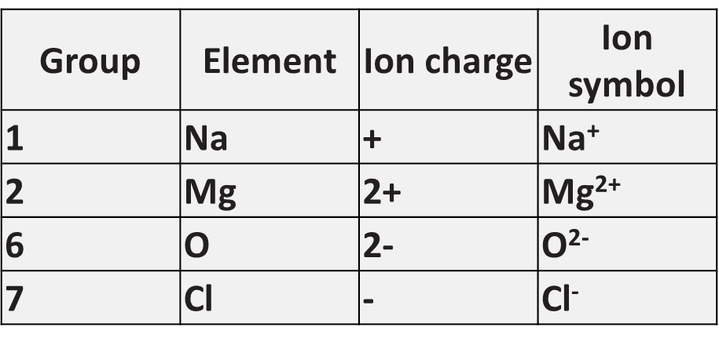
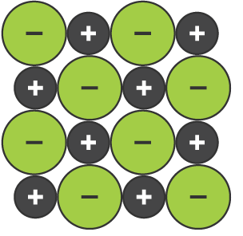
Ionic Bonding
Specification Link:
Bonding
Highlight key words in the information below:
Ionic bonding is the complete transfer of valence electron(s) between atoms. It is a type of chemical bond that generates two oppositely charged ions. In ionic bonds, the metal loses electrons to become a positively charged cation, whereas the nonmetal accepts those electrons to become a negatively charged anion.
Describe how an ionic bond forms
__________________________________________________________________________________________________________________________________________________________________________________________________________________________________________________________________________________________
Describe the formation of magnesium chloride in terms of numbers of atoms and charge
____________________________________________________________________________________________________________________________________________________________________________________________________________
Some ionic compounds have different numbers of cations and anions. ... Most of the elements that make ionic compounds form an ion that has a characteristic charge. For example, sodium makes ionic compounds in which the sodium ion always has a 1+ charge.
An ionic compound is a giant structure of ions. The ions have a regular, repeating arrangement called an ionic lattice. The lattice is formed because the ions attract each other and form a regular pattern with oppositely charged ions next to each other..
Describe the properties of a giant ionic compound
____________________________________________________________________________________________________________________________________________________________________________________________________________________________________
Magnesium chloride contains magnesium ions (Mg2+) and chloride ions (Cl⁻).
Describe, in terms of electrons, what happens when a magnesium atom reacts with chlorine atoms to produce magnesium chloride.
______________________________________________________________________________________________________________________________________________________________________________________________________________________________________________________________________________________________________________________________________________________________________________________________________________________________________________________________________________________________________________________________

Slide 2
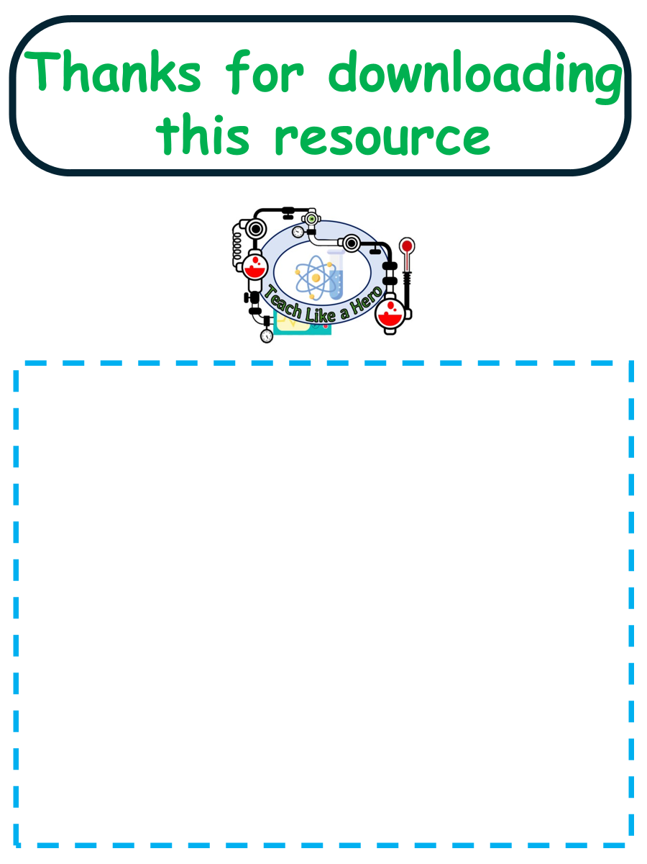
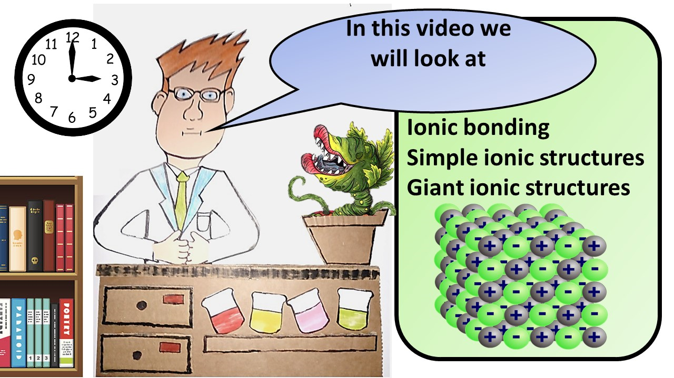


Click here to access my youtube videos
Resources that this activity would work well with
Lesson on TES
Lesson on TPT
Follow me on social media to stay in touch
Keep up to date with my new content:

