Slide 1
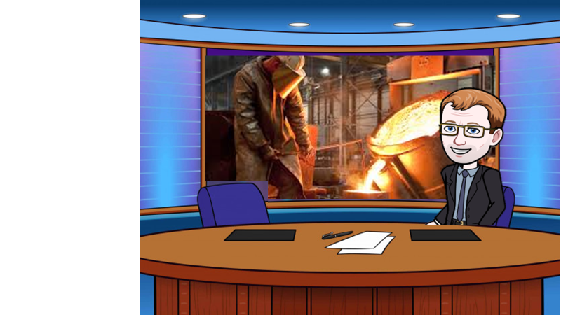
In a world were we are using more iron, lets have a look how it’s produced

Slide 2

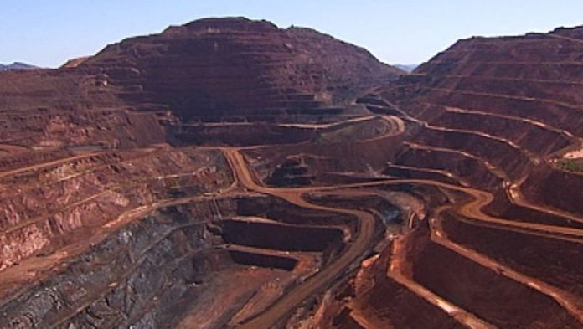

Iron ore is mined and then purified on site
Key questions
How large do you think a mine could be?
What problems could be caused by the mine?

Slide 3
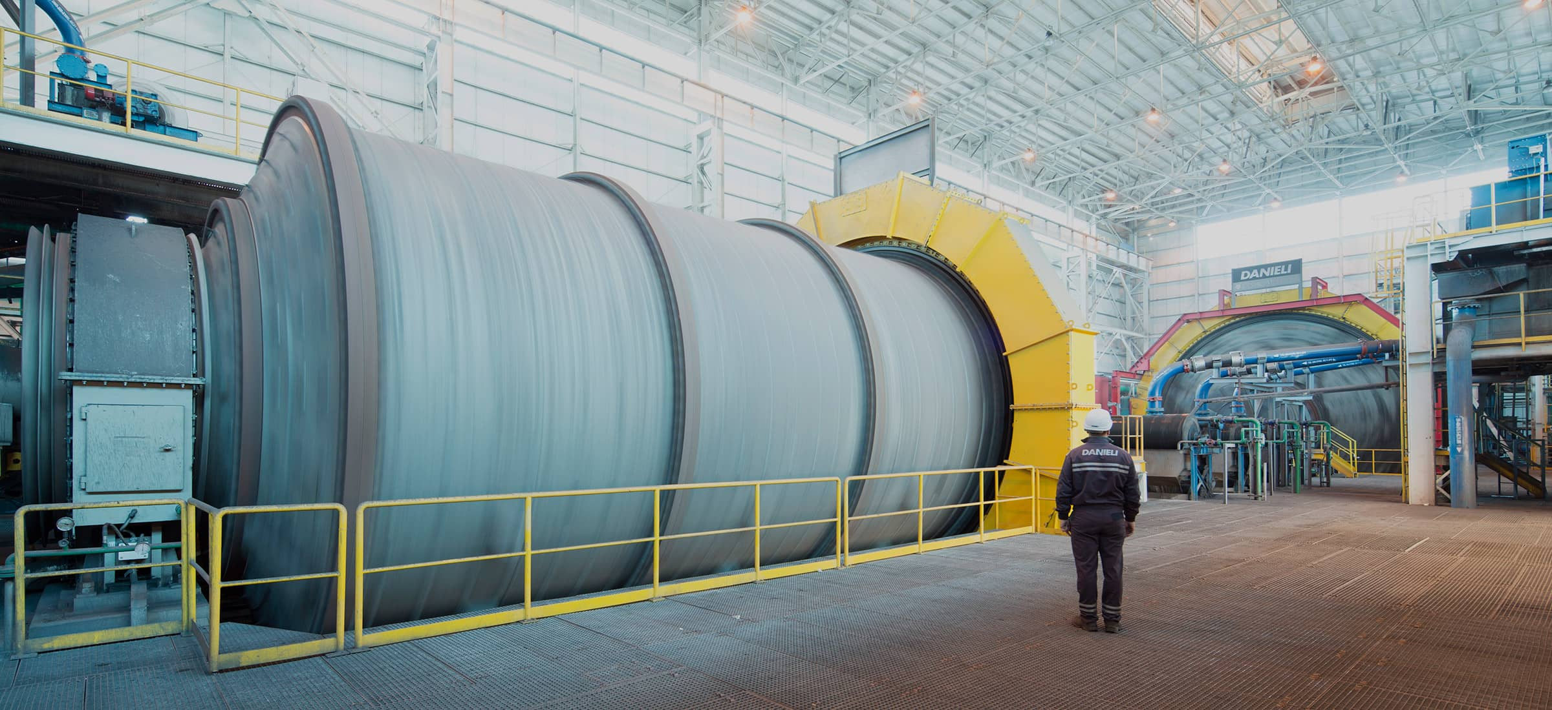
The large chunks or iron ore are ground to a powder in large rotating barrals

Slide 4
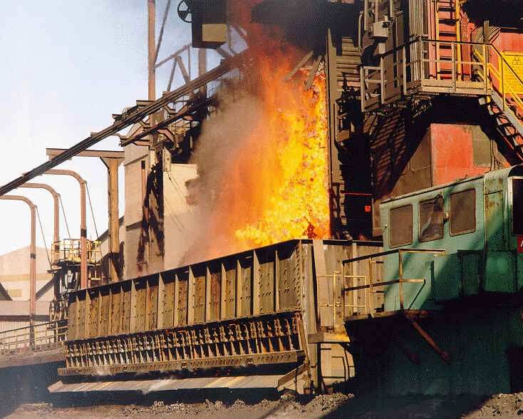

Coke is produced from carefully selected grades of coal. The coal is heated, or ‘carbonised’ in the ovens until it becomes coke
Key questions
What gas is given off during this process?
What problems could they cause?
Why don’t we just use coal?

Slide 5
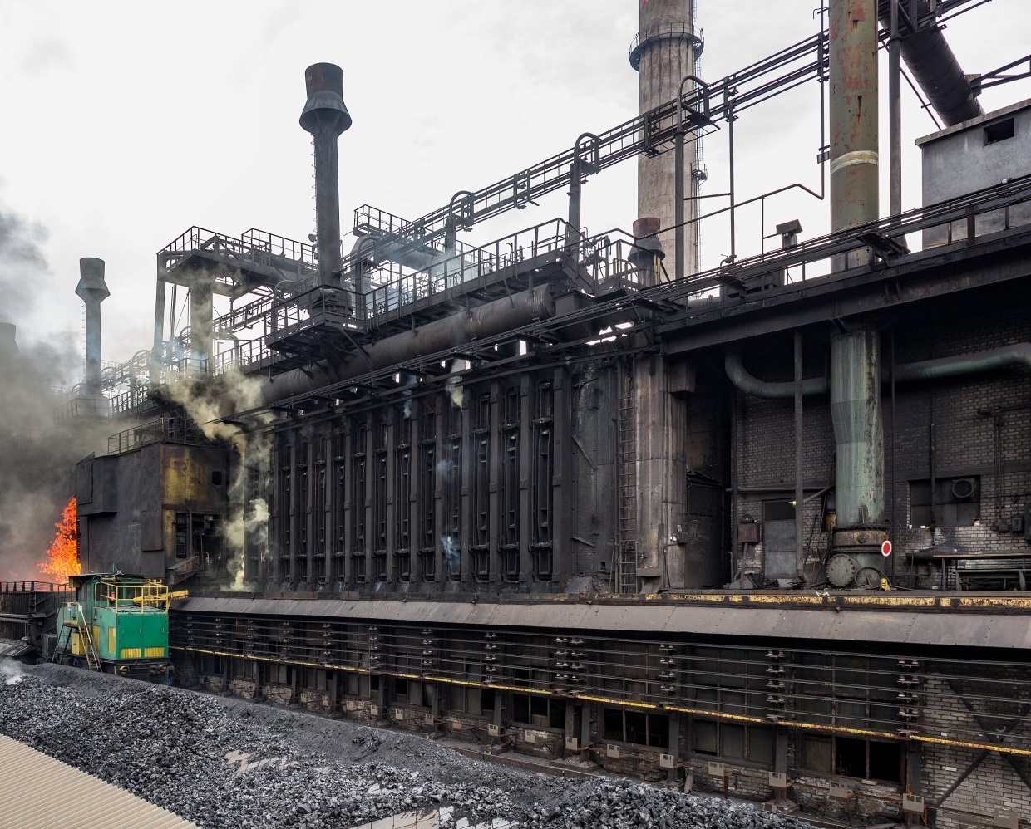
The coke is then transported to the top of the blast furnace

Slide 6
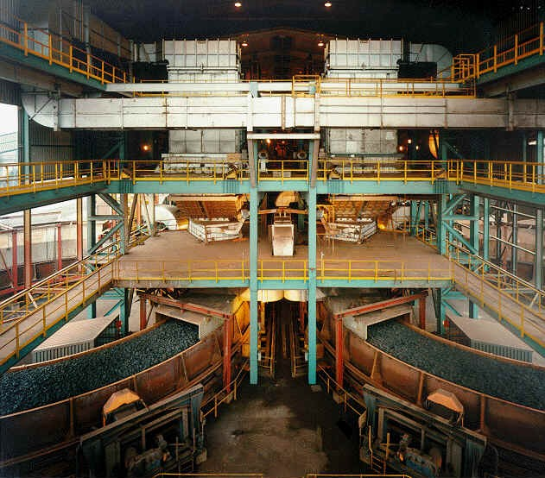
Coke, ore and sinter are fed, or ‘charged’, into the top of the blast furnace, together with limestone.
Key questions
Why is lime stone added?
What is coke?
What do you think is going to happen in the furnace?

Slide 7
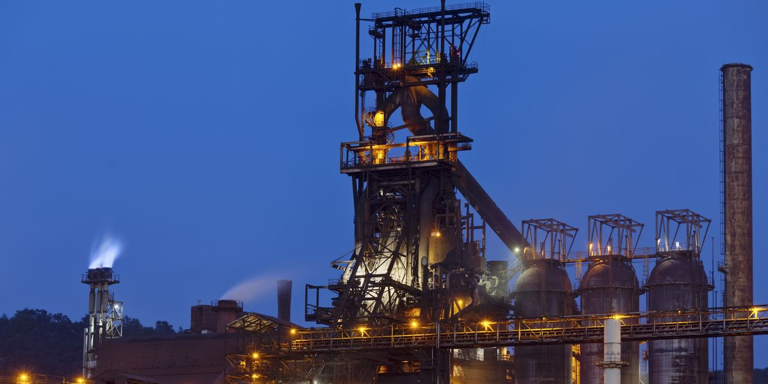

The reactants are transported to the top of the blast furnace

Slide 8

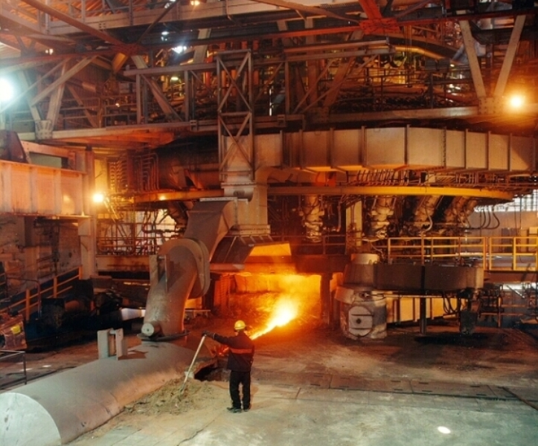
A blast air is injected to provide additional heat and reduce coke requirements. This helps produce pig iron
Key questions
What reaction takes place between oxygen and coke?
What reaction takes place between the iron ore and carbon monoxide?

Slide 9
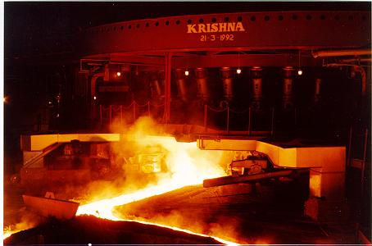
The bottom of the blast furnace is tapped to allow the products to flow out

Slide 10
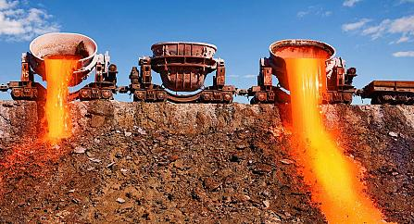
Impurities in the iron ore combine with the lime stone to form slag
Key questions
What is slag?
What are some of the uses of slag by other industries?

Slide 11
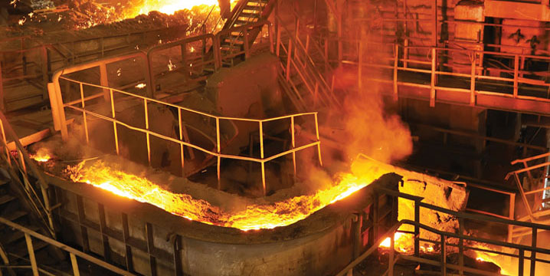

Impure iron is cast into ingots to be further processed.
Key questions
Why is pig iron not pure?
What impurities might it contain?
What effects on the iron’s properties would impurities cause?

Slide 12

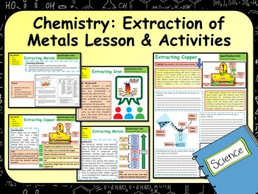
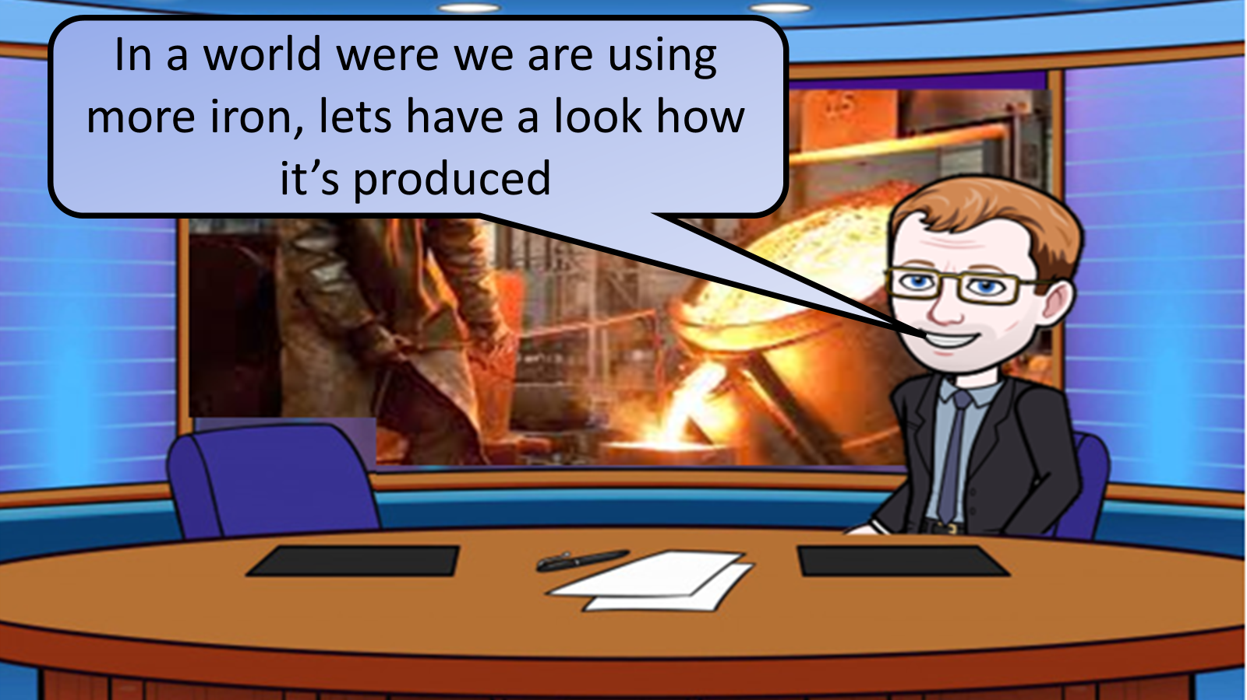


Click on the links below for lessons this resource can be used with
TPT lesson on extracting metals
TES lesson on extracting metals
Follow this link for a video running through this activity
Youtube video link
Follow me on social media to stay in touch
Keep up to date with my new content:

