Slide 1
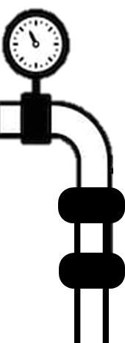
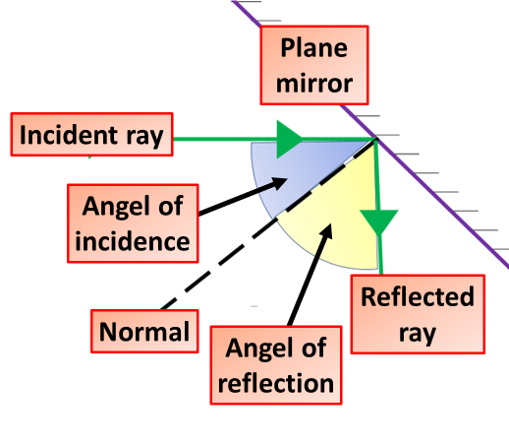
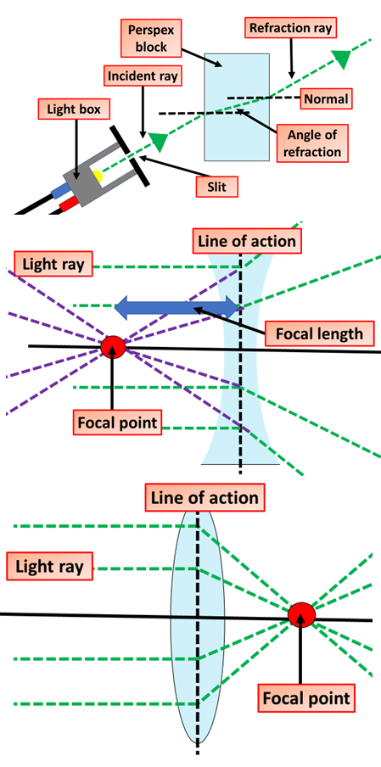
Light Revision Notes
Light travels in straight lines from a source. Light travels as transverse waves. It travels much faster than sound, and does not need a substance to travel through. Light travels through transparent objects but not through opaque objects. Shadows are made when light is blocked by an object.
One useful tool that is frequently used to depict this idea is known as a ray diagram. A ray diagram is a diagram that traces the path that light takes in order for a person to view a point on the image of an object. On the diagram, rays (lines with arrows) are drawn for the incident ray and the reflected ray.
Reflection
All waves will reflect off different surfaces. This means that instead of just passing into another medium, the waves bounce back. You should be familiar with the idea of light reflecting off a flat (plane) mirror: The incoming ray of light is called the incident ray.
Refraction
We have learned that refraction occurs as light passes across the boundary between two media. Refraction is merely one of several possible boundary behaviors by which a light wave could behave when it encounters a new medium or an obstacle in its path
Ray Diagrams
One useful tool that is frequently used to depict this idea is known as a ray diagram. A ray diagram is a diagram that traces the path that light takes in order for a person to view a point on the image of an object. On the diagram, rays (lines with arrows) are drawn for the incident ray and the reflected ray.
Concave Lens
Concave lens is thinner in the middle than it is at the edges. This causes parallel rays to diverge. They separate but appear to come from a principle focus on the other side of the lens.
In a ray diagram, a concave lens is drawn as a vertical line with inward facing
Convex Lens
A convex lens is thicker in the middle than it is at the edges. Parallel light rays that enter the lens converge. They come together at a point called the principal focus. In a ray diagram, a convex lens is drawn as a vertical line with outward facing arrows to indicate the shape of the lens. The distance from the lens to the principal focus is called the focal length.

