Slide 1
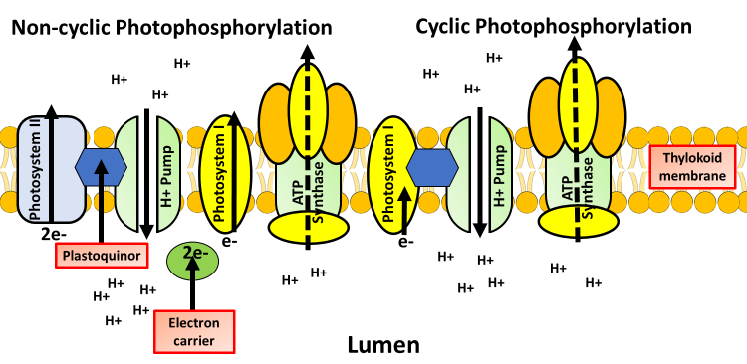
Light Dependent Photosynthesis Question
Specification Link:
Energy for Biological Processes
Highlight key words in the information below:
What is made in the light dependent reaction?
__________________________________________________________________________________
The overall function of light-dependent reactions, the first stage of photosynthesis, is to convert solar energy into chemical energy in the form of NADPH and ATP, which are used in light-independent reactions and fuel the assembly of sugar molecules. Light-dependent reactions, which take place in the thylakoid membrane, use light energy to make ATP and NADPH.
Where does the light dependent reaction take place?
__________________________________________________________________________________
What are the products of the light dependent reaction used for?
__________________________________________________________________________________
The diagram below shows what happens during light dependent photosynthesis:
What raises the energy levels of electrons?
________________________________________________
What ions move?
________________________________________________
How is ATP formed?
________________________________________________
Cyclic Photophosphorylation is the process, in which systems (like prokaryotes), just accomplishes the ADP to ATP for immediate energy for the cells. This type of photophosphorylation usually occurs in the thylakoid membrane. The electron begins in a pigment complex called photosystem I in cyclic electron flow.
Non-Cyclic Photophosphorylation is the photophosphorylation process which results in the movement of the electrons in a non-cyclic manner for synthesizing ATP molecules using the energy from excited electrons provided by photosystem II is called as non-cyclic photophosphorylation..
Describe the difference between cyclic and non-cyclic photophosphorylation.
______________________________________________________________________________________________________________________________________________________________________________________________________________________________________________________________________________________________________________________________________________________
Explain the process of light dependent photosynthesis
____________________________________________________________________________________________________________________________________________________________________________________________________________________________________________________________________________________________________________________________________________________________________________________________________________________________________

Slide 2



Click here to access my percentage composition youtube videos
Resources that this activity would work well with
Lesson on TES
Lesson on TPT
Follow me on social media to stay in touch
Keep up to date with my new content:

