Slide 1
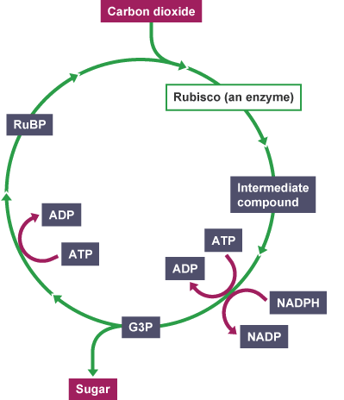
Light Independent Photosynthesis Question
Specification Link:
Energy for Biological Processes
Highlight key words in the information below:
What is the Calvin cycle?
__________________________________________________________________________________
The Calvin cycle (also known as the Benson-Calvin cycle) is the set of chemical reactions that take place in chloroplasts during photosynthesis. The cycle is light-independent because it takes place after the energy has been captured from sunlight. The Calvin cycle has four main steps: carbon fixation, reduction phase, carbohydrate formation, and regeneration phase. Energy to fuel chemical reactions in this sugar-generating process is provided by ATP and NADPH, chemical compounds which contain the energy plants have captured from sunlight.
What is produced during the Calvin cycle?
__________________________________________________________________________________
What does the Calvin cycle need to be provided with?
__________________________________________________________________________________
What are the main stages in the Calvin cycle?
__________________________________________________________________________________
Where does the carbon source come from?
________________________________________________________________________________________
What is the role of RuBP?
________________________________________________________________________________________
How is RuBP regenerated?
________________________________________________________________________________________
How is TP formed?
________________________________________________________________________________________
How is GTP formed?
________________________________________________________________________________________
Describe in detail the light independent reaction
____________________________________________________________________________________________________________________________________________________________________________________________________________________________________________________________________________________________________________________________________________________________________________________________________________________________________________________________________________________________________________________________________________________________________________________________________________

Slide 2
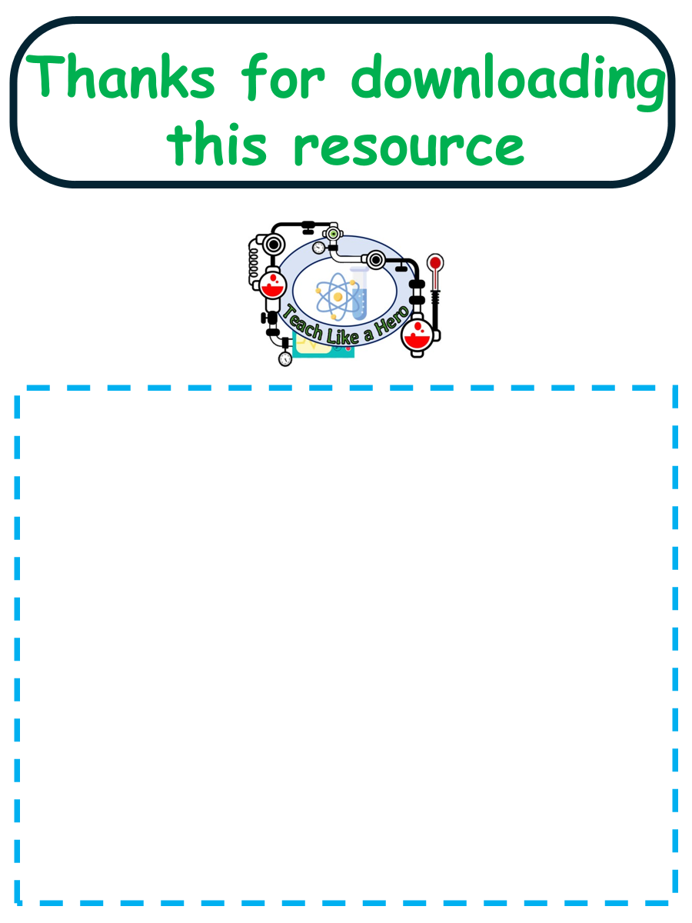
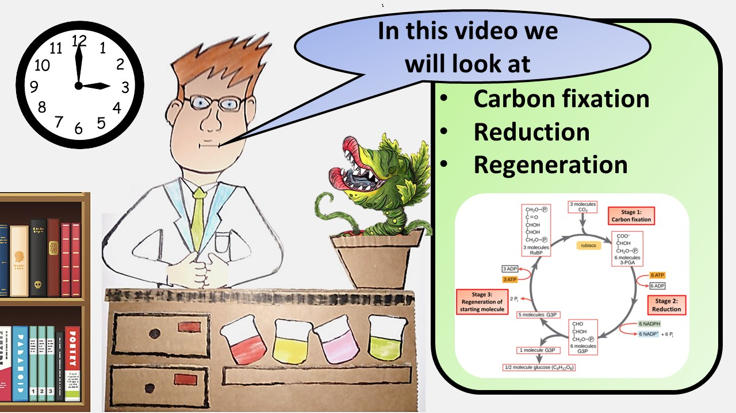
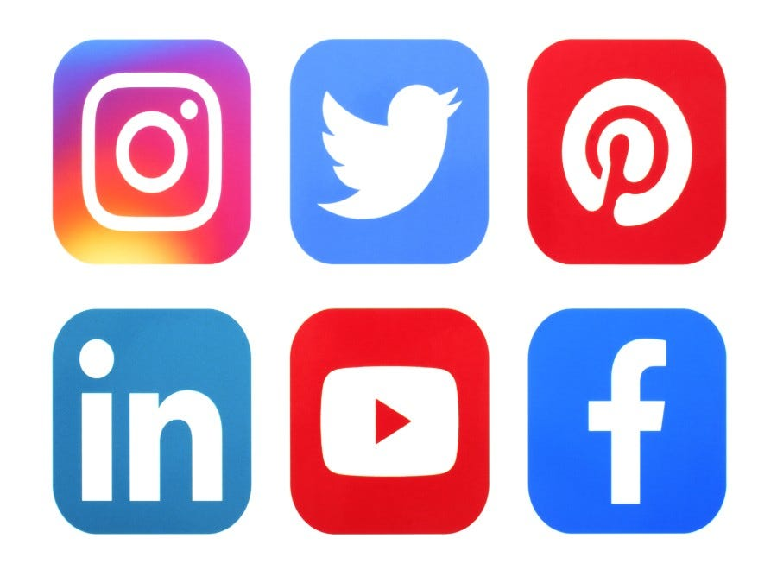

Click here to access my percentage composition youtube videos
Resources that this activity would work well with
Lesson on TES
Lesson on TPT
Follow me on social media to stay in touch
Keep up to date with my new content:

