Slide 1
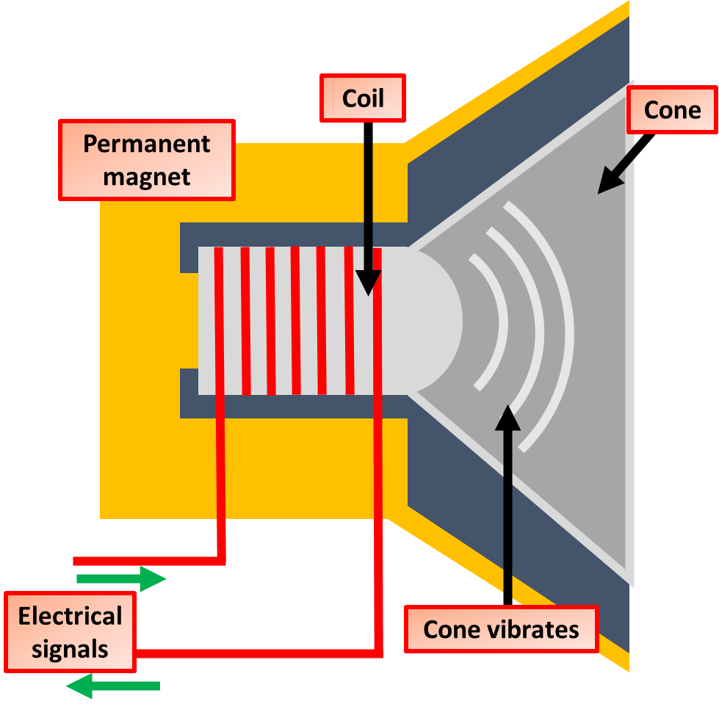
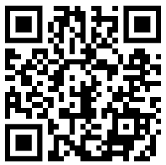
Loudspeaker Practice Question
Explain how a moving-coil loudspeaker produces a sound wave.
Key things to include:
How does an alternating current generate a magnetic field
How does that magnetic field interact with a permanent magnet
Answer
________________________________________________________________________________________________________________________________________________________________________________________________________________________________________________________________________________________________________________________________________________________________________________________
Link to video

Slide 2
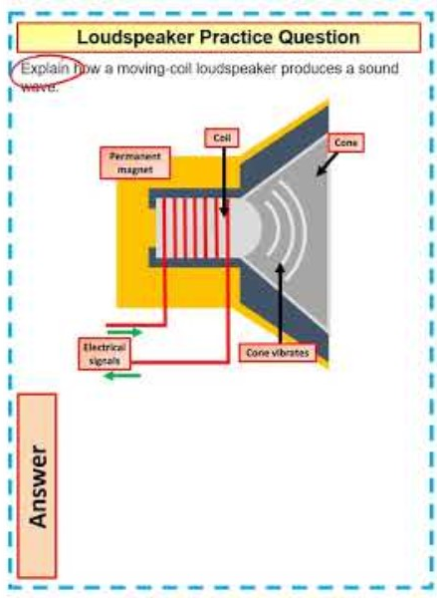
Loudspeaker Practice Question

Slide 3

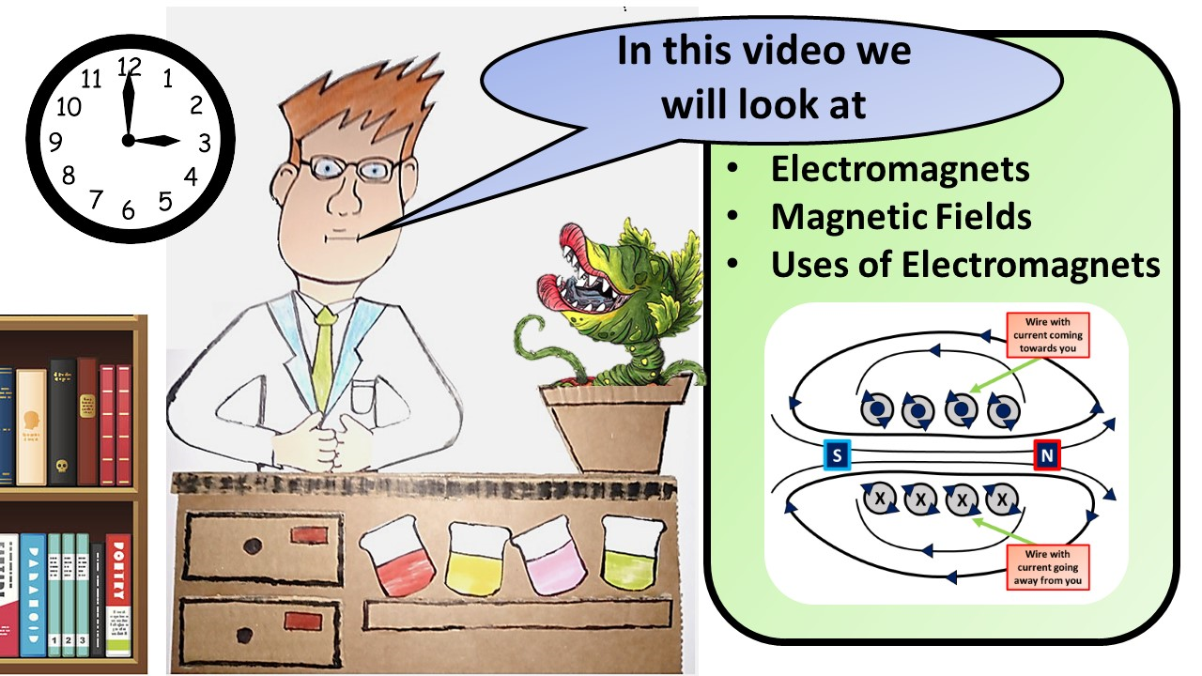


Click here to access my youtube videos
Resources that this activity would work well with
Lesson on TES
Lesson on TPT
Follow me on social media to stay in touch
Keep up to date with my new content:

