Slide 1
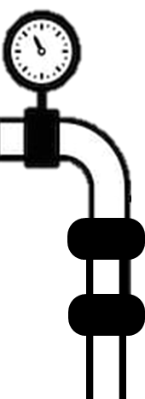
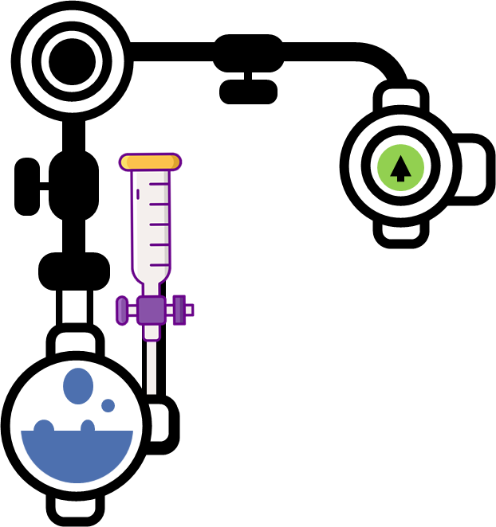
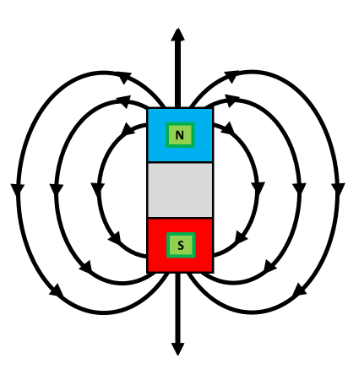
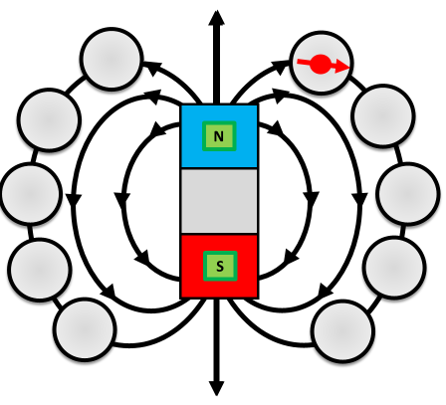
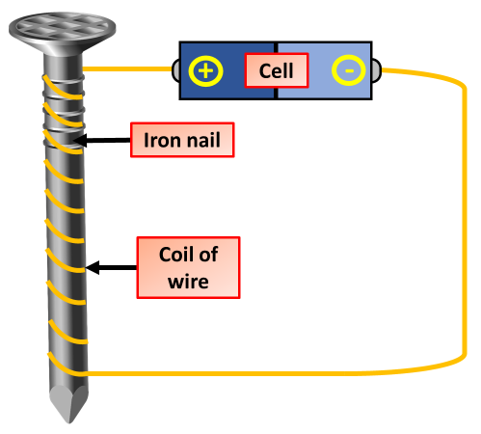
Magnetism Notes
Magnets repel and attract other magnets, and attract magnetic substances. Magnetic fields can be shown using field lines. Magnetism is induced in some materials when placed in a magnetic field
A magnetic domain is region in which the magnetic fields of atoms are grouped together and aligned. In the experiment below, the magnetic domains are indicated by the arrows in the metal material. You can think of magnetic domains as miniature magnets within a material.
A magnetic field is invisible, but it can be detected using a magnetic compass. A compass contains a small bar magnet on a pivot so that it can rotate. The compass needle points in the direction of the Earth's magnetic field, or the magnetic field of a magnet. The diagram shows these key features:
the magnetic field lines never cross each other
the closer the lines, the stronger the magnetic field
the lines have arrowheads to show the direction of the force exerted by a magnetic north pole
the arrowheads point from the north pole of the magnet to its south pole
The opposite poles of two magnets attract. Therefore, when the red end of a magnet or compass is pointing north, it is because it is being attracted in that direction by the south end of another magnet (often coloured blue) – this is the imaginary magnet inside the Earth. The opposite poles of two magnets attract. Therefore, when the red end of a magnet or compass is pointing north, it is because it is being attracted in that direction by the south end of another magnet (often coloured blue) – this is the imaginary magnet inside the Earth.
Magnetic fields can be mapped out using small plotting compasses:
place the plotting compass near the magnet on a piece of paper
mark the direction the compass needle points
move the plotting compass to many different positions in the magnetic field, marking the needle direction each time
join the points to show the field lines.
When an electric current flows in a wire it creates a magnetic field around the wire. By winding the wire into a coil we can strengthen the magnetic field. Electromagnets are made from coils like this.
We can make an electromagnet stronger by:
wrapping the coil around an iron core
adding more turns to the coil
increasing the current flowing through the coil
A permanent magnet can:
attract or repel another permanent magnet
attract a magnetic material (but not repel it)
This means that you can only show that an object is a permanent magnet by checking if it repels another magnet.

Slide 2
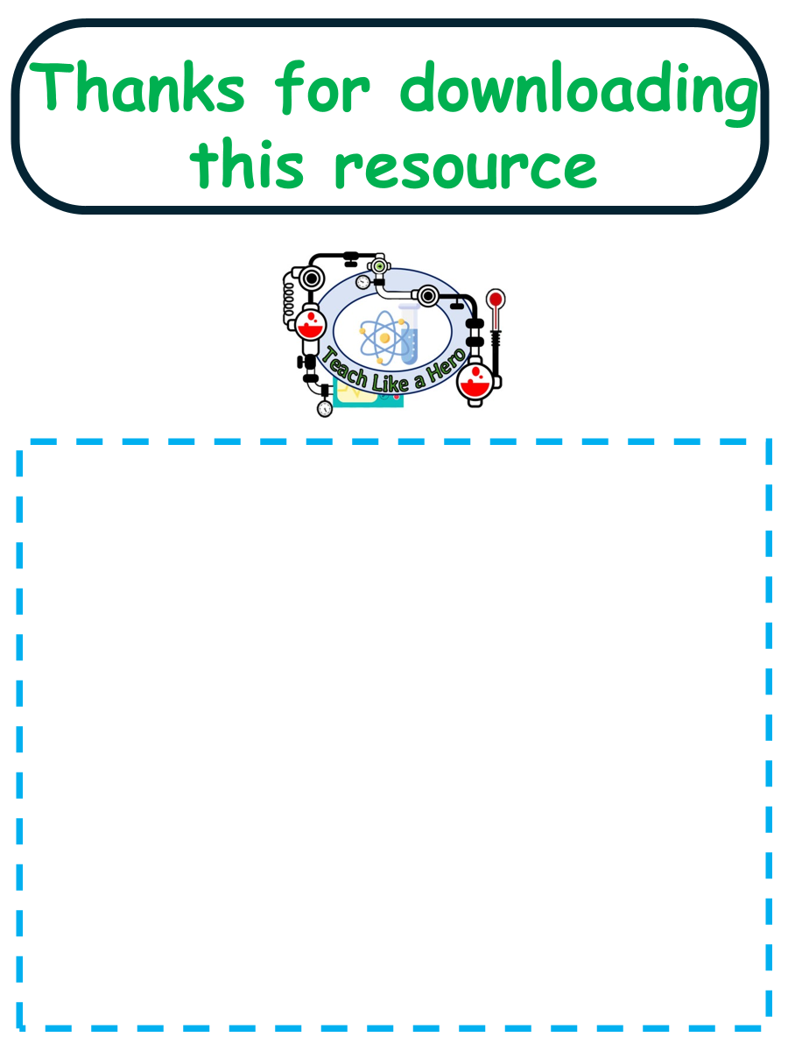
Click here to access my waves youtube videos
Resources that this activity would work well with
Lesson on TES
Lessons on TPT
Follow me on social media to stay in touch
Keep up to date with my new content:

