Slide 1
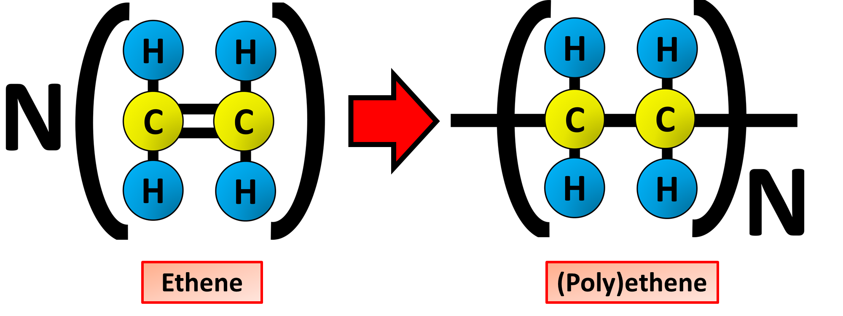
Making Polymers Practice Question
Ethene is used to make poly(ethene). This process is called polymerisation. Explain what is meant by polymerisation and how ethene is polymerised into polyethene.
Ethene is an alkene with the formula C2H4 The double bond makes it reactive
The ethene is heated and the double bond is broken
Another ethene monomer bonds to the first one
This is called additional polymerization
Answer
The polymer chain grows as more ethene monomers bond together
Branching occurs at high temperatures & pressures if a catalyst is not used
The polymerization reaction continues and polyethene is formed

Slide 2
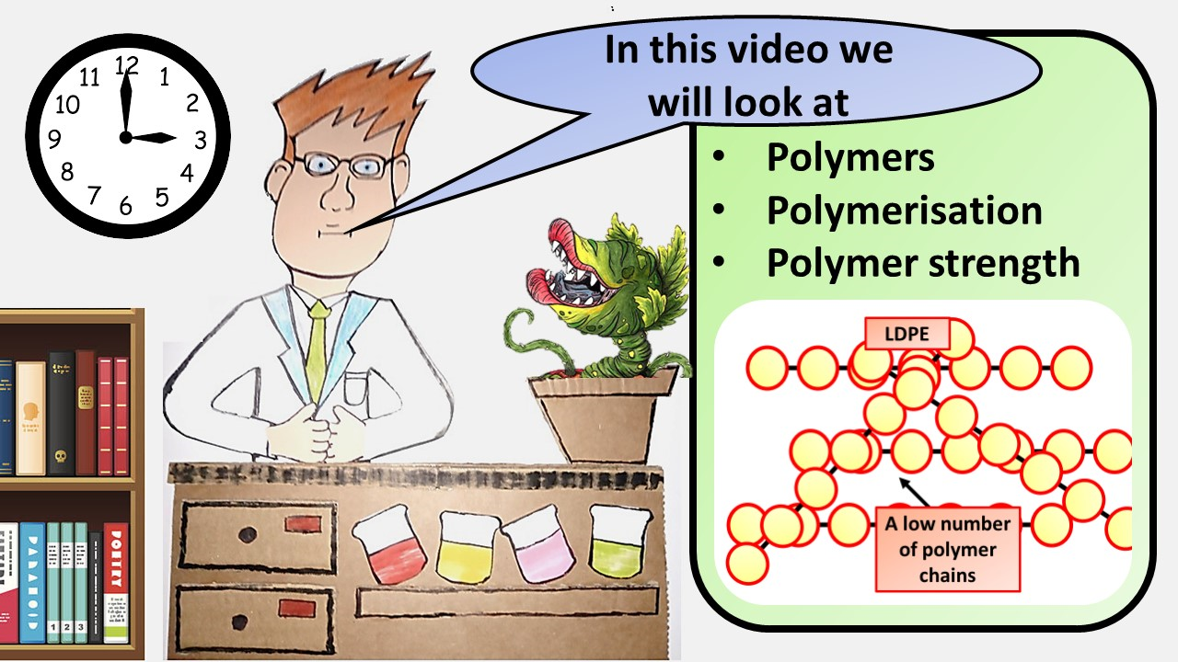
Click here to access my youtube videos
Resources that this activity would work well with
Lesson on TES
Lesson on TPT
Follow me on social media to stay in touch
Keep up to date with my new content:

