Slide 1
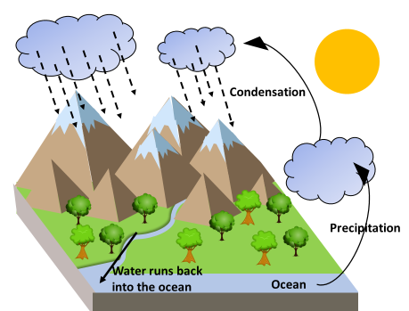
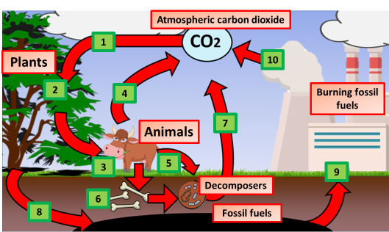
Materials Cycling
Specification Link
Ecology:
Highlight key words in the information below:
How do plants give off water?
__________________________________________________________________________________
The water cycle is the process by which water is continuously transferred between the surface of the earth and the atmosphere. In the atmosphere, we can see liquid water droplets in clouds and we can also see ice crystals as clouds too, but these are usually much higher up.
What are the major processes of Water Cycle?
__________________________________________________________________________________
What does Evaporation change water to?
__________________________________________________________________________________
What produces water vapor from plants?
__________________________________________________________________________________
Using the diagram, describe the water cycle:
_____________________________________________________________________________________________________________________________________________________________________________________________________________
Describe how living things are involved in the constant cycling of carbon.:
____________________________________________________________________________________________________________________________________________________________________________________________________________________________________________________________________________________________________________________________________________________________________________________________________________________________________________________________________________________________________________________________________________________________________________________________________________________________________________________________________________________________________________________________________________________________________________________________________________
Highlight key words in the information below:
The carbon cycle is the process in which carbon travels from the atmosphere into organisms and the Earth and then back into the atmosphere. Plants take carbon dioxide from the air and use it to make food. Animals then eat the food and carbon is stored in their bodies or released as CO2 through respiration

Slide 2
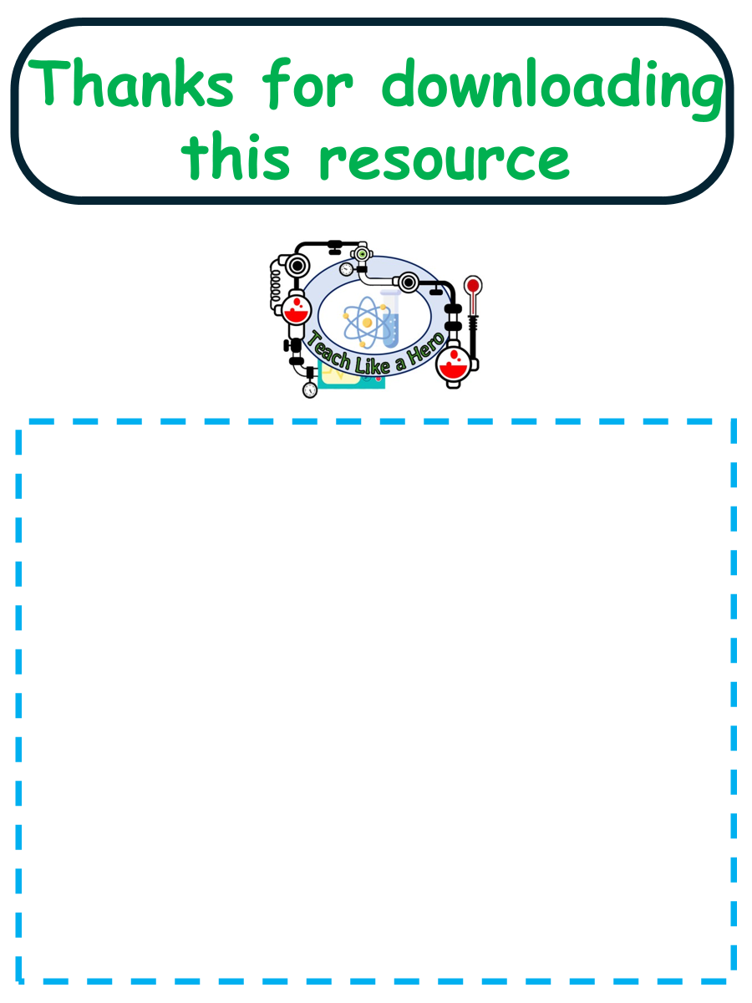
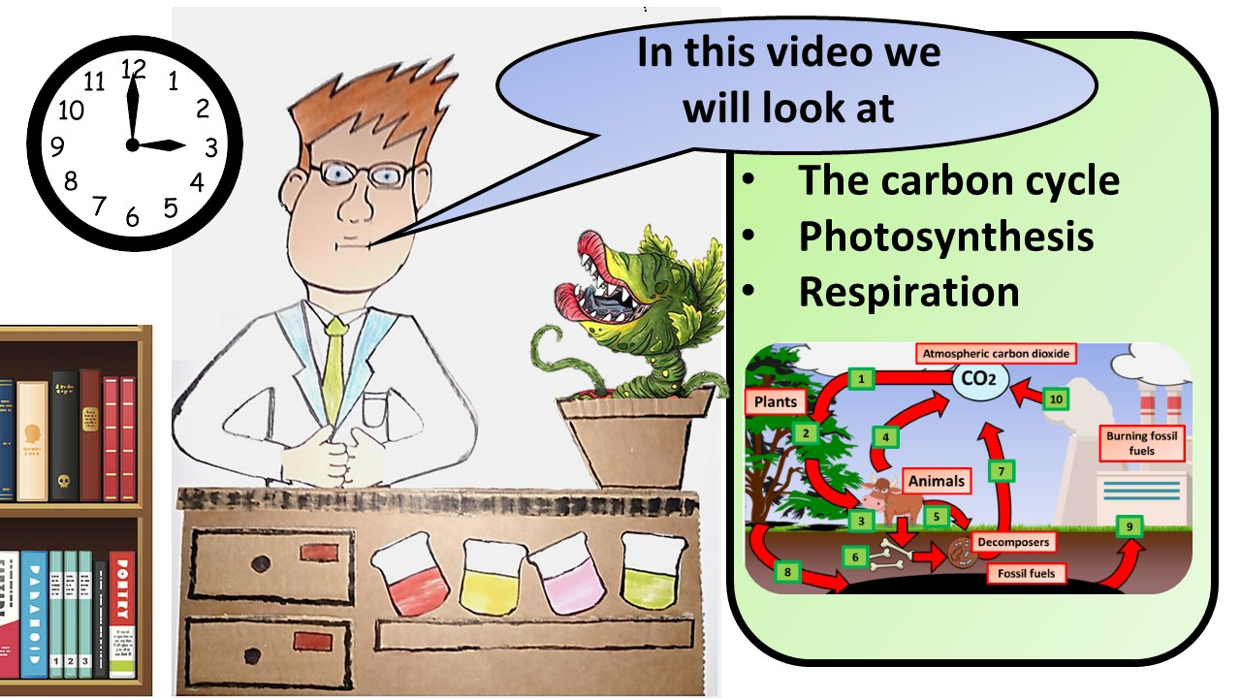


Click here to access my youtube videos
Resources that this activity would work well with
Lesson on TES
Lesson on TPT
Follow me on social media to stay in touch
Keep up to date with my new content:

