Slide 1



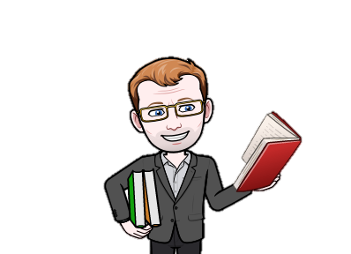
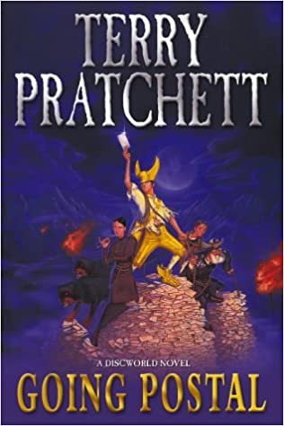


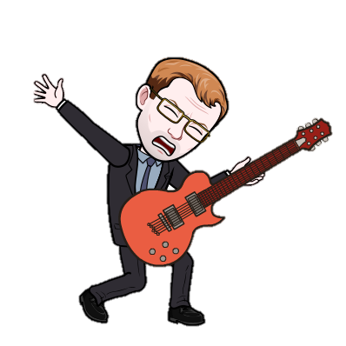







I teach Science
You can find me in Lab 3
My school email address is xxxxxxxxxxxxxxxxxx
Mr Chalk
Favourite Book
Welcome back
Going Postal is a fantasy novel by British writer Terry Pratchett, the 33rd book in his Discworld series
Given the circumstances I hope you are enjoying a wonderful summer. I also hope you are relaxed, recharged and ready to start a new school year. I look forward to seeing your future progress
Favourite Songs
Teenage Dirtbag
Every Me, Every You
If You Like Pina Colada
I’ve been on holiday to Prague, Canada
Mexico,
Morocco
Favourite movie
Big Trouble in Little China
Favourite TV Shows
The Big Bang Theory
Dr Who
Knightmare
Bones
Taskmaster

Slide 2
I teach
You can find me in
My school email address is
Mr Chalk
Favourite Book
Welcome back
Favourite Song
I’ve been on holiday to
Favourite movie
Favourite TV Shows

