Slide 1

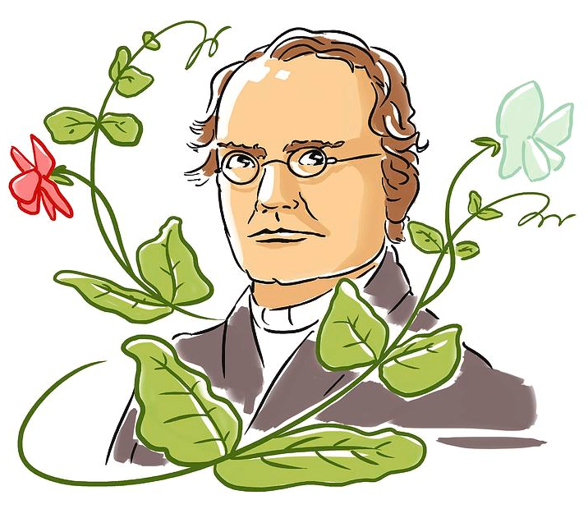
Mendel Article
In the heart of the 19th century, a humble Augustinian monk, Gregor Mendel, embarked on a scientific journey that would forever change our understanding of inheritance. Born in 1822 in what is now the Czech Republic, Mendel dedicated his life to unraveling the mysteries of heredity through meticulous experimentation with pea plants in the monastery garden.
Mendel's groundbreaking work laid the foundation for modern genetics, as he meticulously tracked the inheritance patterns of pea plant traits such as seed shape, color, and height. Through carefully designed experiments and astute observations, Mendel uncovered fundamental principles of inheritance that remain central to biology today.
His pioneering experiments revealed the existence of discrete units of inheritance, now known as genes, and elucidated the principles of dominance, segregation, and independent assortment. Mendel's laws, including the law of segregation and the law of independent assortment, provided a framework for understanding how traits are passed from one generation to the next.
Despite initial indifference from the scientific community, Mendel's work gained recognition posthumously, thanks to the efforts of pioneering geneticists such as Hugo de Vries, Carl Correns, and Erich von Tschermak. Today, Mendel's discoveries serve as the cornerstone of modern genetics, informing research across diverse fields, from agriculture to medicine.
As we marvel at the complexities of the genetic code and the diversity of life on Earth, let us not forget the humble monk whose curiosity and perseverance unlocked the secrets of heredity, forever changing the course of science and our understanding of the natural world.
Questions
Where did Mendel come from?
What did Mendel's work lay the groundwork for?
What laws were developed by Mendel?
When was Mendel’s work recognised?
What job did Mendel have?

