Slide 1
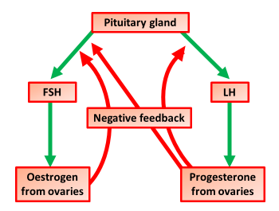
Menstrual Cycle Question
Describe how hormones control the menstrual cycle.
FSH (release from pituitary) stimulates maturation of egg / ovum / follicle
oestrogen (release from ovary) inhibits FSH production and stimulates LH production
Answer
LH (release from pituitary) stimulates ovulation
progesterone (release from ovary) inhibits FSH and LH production
oestrogen and progesterone maintain the uterus lining

Slide 2
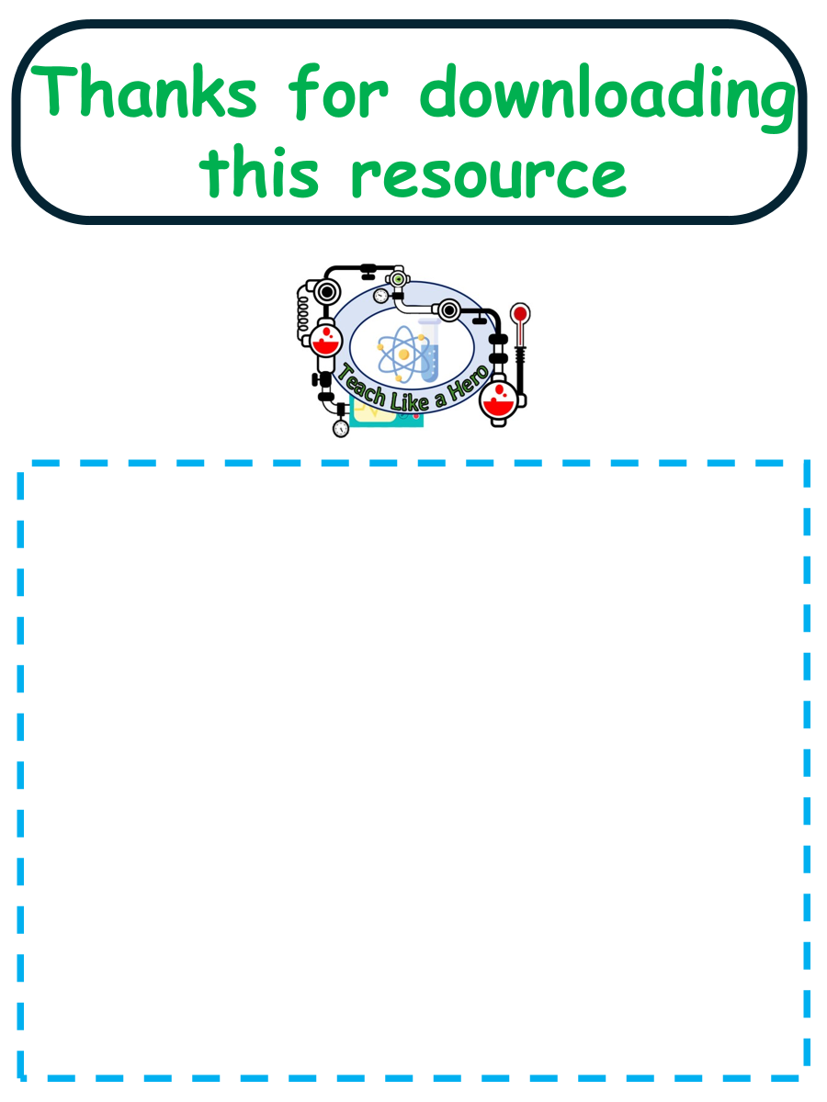
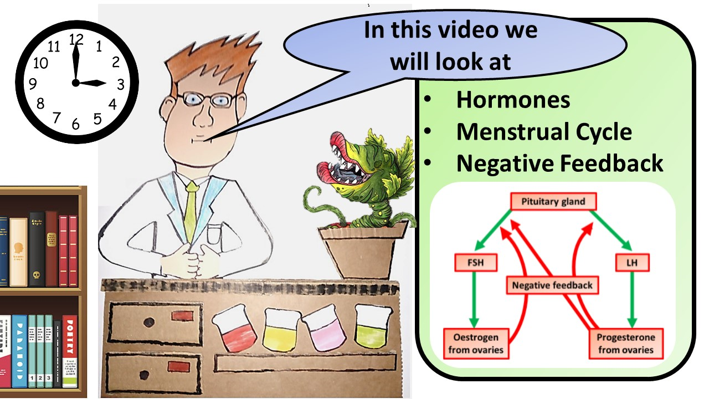


Click here to access my youtube videos
Resources that this activity would work well with
Lesson on TES
Lesson on TPT
Follow me on social media to stay in touch
Keep up to date with my new content:

