Slide 1
Menstrual Cycle
Specification Link:
NA Yellow Box
Highlight key words in the information below:
Reading the question activity:
What is a hormone?
__________________________________________________________________________
Where are hormones produced?
__________________________________________________________________________
What do hormones effect?
_____________________________________
How long do hormones act for?
__________________________________________________________________________
A hormone is a chemical substance, produced by a gland and carried in the bloodstream, which alters the activity of specific target organs. An example of this is the release of the hormone adrenaline, which is released by the adrenal gland. One of its target organs is the heart, where it increases the heart rate.
Once a hormone has been used, it is destroyed by the liver.
Hormones can control the body, and the effects are much slower than the nervous system, but they last for longer.
Describe what hormones are and how they effect target organs:
_____________________________________________________________________________________________________________________________________________________________________________________________________________________________________________________________________________________________________________
Several hormones are involved in the menstrual cycle of a woman:
follicle stimulating hormone (FSH) causes the maturation of an egg in the ovary
luteinising hormone (LH) stimulates the release of the egg
oestrogen is involved in repairing and thickening the uterus lining, progesterone maintains it
Draw a diagram showing the stages in the menstrual cycle
Describe how the hormones FSH, oestrogen and LH are involved in the control of the menstrual cycle:
__________________________________________________________________________________________________________________________________________________________________________________________________________________________________________________________________________________________________________________________________________________________________________________________________________________________________________________________________________________________________________________________________________________________________________________________________________________________________________________________________________________________

Slide 2
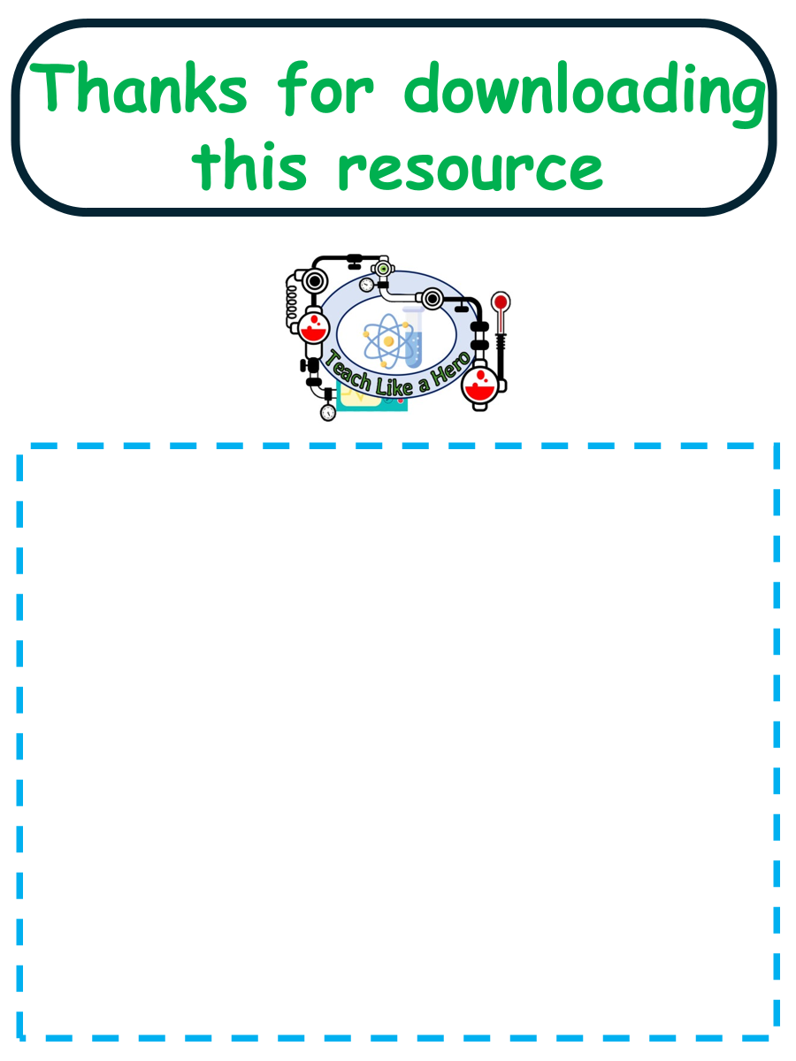
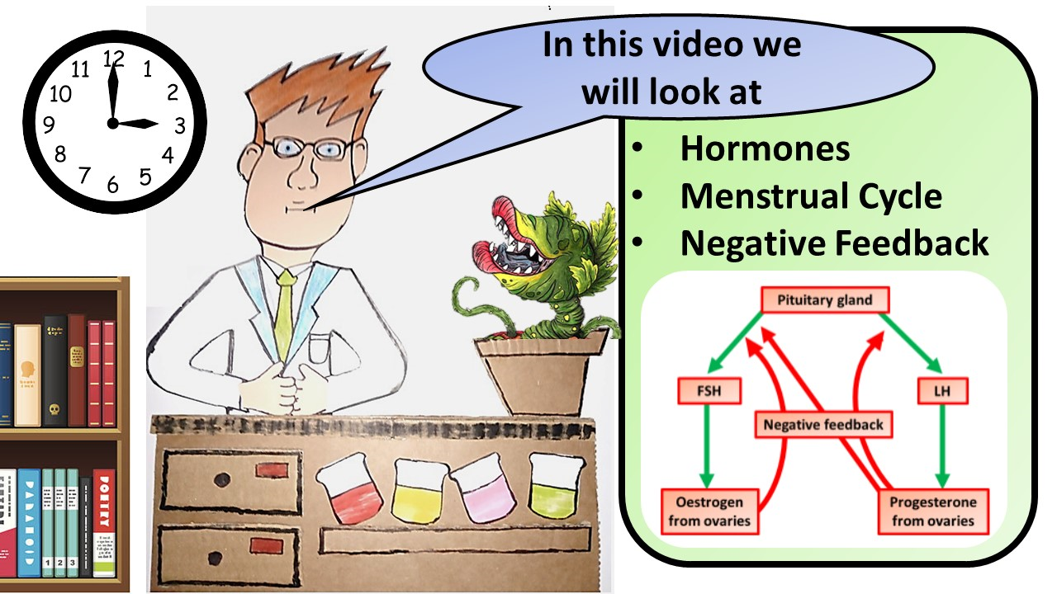


Click here to access my youtube videos
Resources that this activity would work well with
Lesson on TES
Lesson on TPT
Follow me on social media to stay in touch
Keep up to date with my new content:

