Slide 1
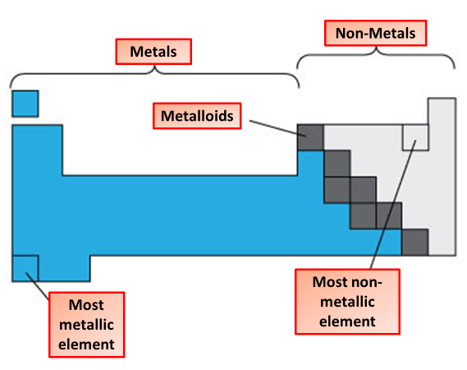
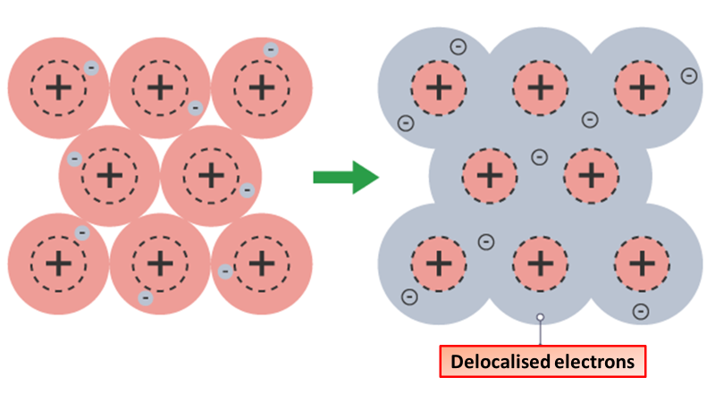

Metallic Bonding
Specification Link:
Bonding
Highlight key words in the information below:
The elements can be classified as metals, nonmetals, or metalloids. Metals are good conductors of heat and electricity, and are malleable (they can be hammered into sheets) and ductile (they can be drawn into wire).
Describe the main differences between metals and non metals
________________________________________________________________________________________________________________________________________________________________________________
Metals form giant structures in which electrons in the outer shells of the metal atoms are free to move. The metallic bond is the force of attraction between these free electrons and metal ions. Metallic bonds are strong, so metals can maintain a regular structure and usually have high melting and boiling points.
Describe how metallic bonds are formed
__________________________________________________________________________________________________________________________________________________________________________________________________________________________________________________________________________________________________________________________________________________________________________________________________________________________________________________________________
What happens to the outer shell of electrons in metallic bonding?
______________________________________________________________________________
What charge do electrons have?
_______________________________________
What charge do metal ions have?
_______________________________________
Describe the properties of metals
___________________________________________________________________________________________________________________________________________________________________________________________________________________________________________________________________________________________________________________________________________________________________________________________________

Slide 2

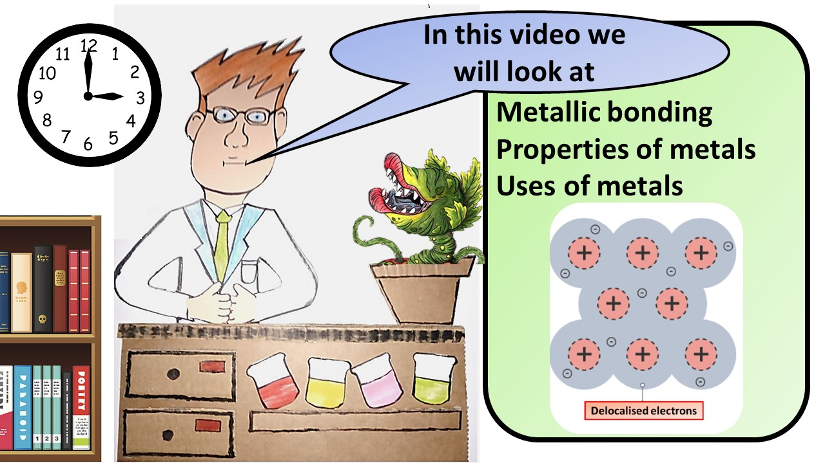


Click here to access my youtube videos
Resources that this activity would work well with
Lesson on TES
Lesson on TPT
Follow me on social media to stay in touch
Keep up to date with my new content:

