Slide 1
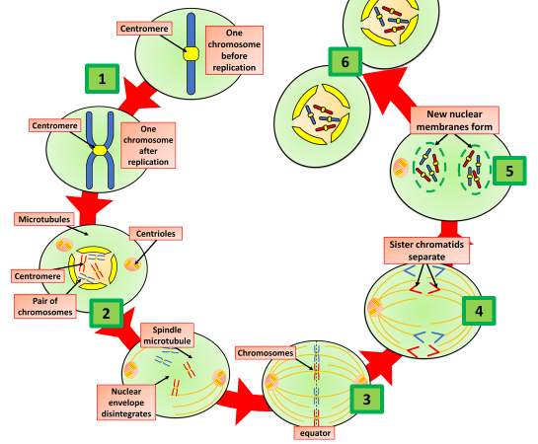
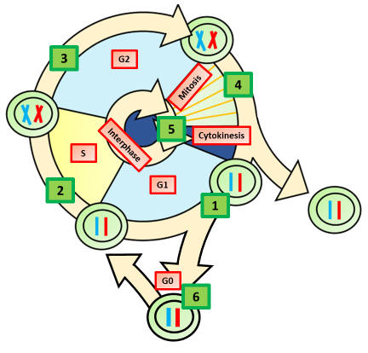
Mitosis & the Cell Cycle
Specification Link:
Cells: 4.7.1.2
Highlight key words in the information below
Mitosis is a type of cell division. Mitosis occurs wherever more cells are needed. It produces two new cells that are identical to each other, and to the parent cell. The process of growth and division is called the cell cycle.
The cycle starts as the number of organelles - the different parts of the cell - increases. This is to ensure that each of the two new cells receives copies of all the organelles.
Using the mitosis diagram, describe the process, trying to break it up into stages
________________________________________________________________________________________________________________________________________________________________________________________________________________________________________________________________________________________________________________________________________________________________________________________________________________________________________________________________________________________________
The cell cycle. A growing and dividing cell goes through a series of stages called the cell cycle . The first stages of the cell cycle involve cell growth, then synthesis of DNA . The single strand of DNA that makes up each chromosome produces an exact copy of itself.
Explain why the cell must increase in size before it splits:
___________________________________________________________________________________________________________________________
Explain why the cell must double it’s chromosomes before it splits:
___________________________________________________________________________________________________________________________
Describe what happens in the cell cycle:
________________________________________________________________________________________________________________________________________________________________________________________________________________________________________________________________________________________________________________________________________________
Describe how the equipment to the left could be used to measure the rate of photosynthesis:
_______________________________________________________________________________________________________________________________________________________________________________________________________________________________________________________________

