Slide 1
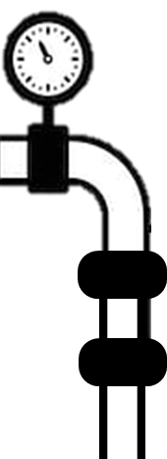
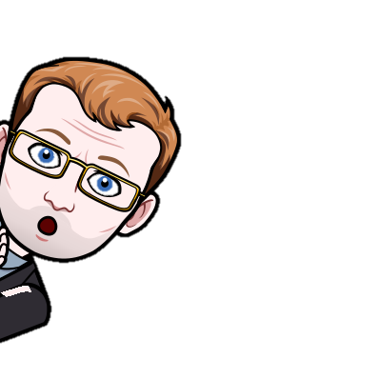
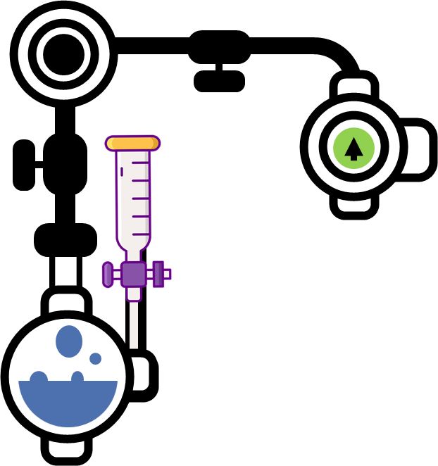
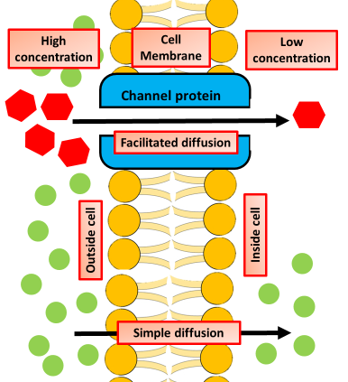

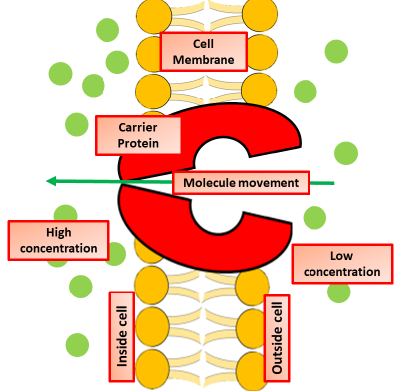
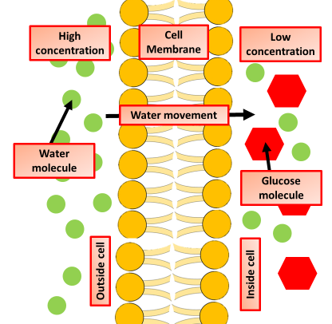
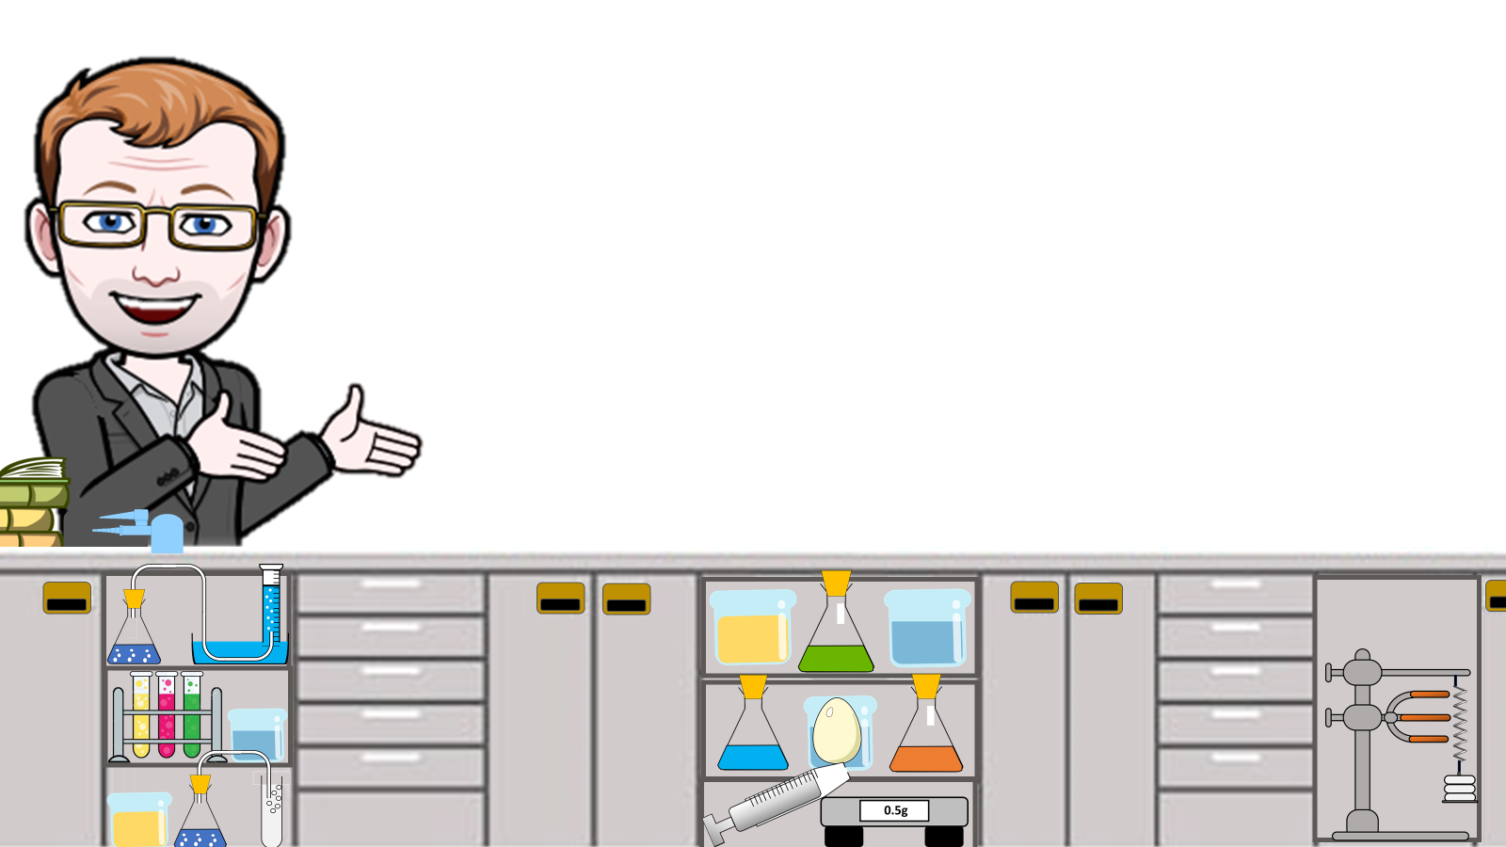

Molecule Movement Notes
Water passes through the membrane in a diffusion process called osmosis. During active transport, energy is expended to assist material movement across the membrane in a direction against their concentration gradient. Active transport may take place with the help of protein pumps or through the use of vesicles.
Diffusion is the movement of molecules from a higher concentration to a lower concentration without the use of energy
In the cell, this can occur when small molecules diffuse through the pore of a cell membrane, or when substances move within the cytosol.
Diffusion occurs when the concentration of a particular molecule is greater in one area than another, establishing a concentration gradient.
The diffusion of molecules across a concentration gradient does not require a transport protein, and is an example of passive transport.
During diffusion, molecules move from a higher to a lower concentration until the concentrations are equal between the spaces
Simple diffusion is the process by which solutes are moved along a concentration gradient in a solution or across a semipermeable membrane.
Active transport across a cell membrane requires a transporter protein and a supply of energy for the transport of molecules the membrane. Its requirement for energy distinguishes it from passive transport. This process is very important to transport molecules across the cell membrane which are present at a very low concentration in the extracellular environment.
Osmosis is a term describing the movement of water from across a selectively permeable membrane as a result of a concentration gradient. I.e. it is a special type of diffusion concerned only with water.
Place 5 eggs in acid for 24 hours to dissolve the egg shell.
Measure and record the mass of each egg.
Place each egg into a separate beaker containing 200 cm3 of distilled water.
After 20 minutes, remove the eggs from the beakers and dry them gently with a paper towel.
Measure and record the mass of each egg.
Osmosis Investigation

Slide 2
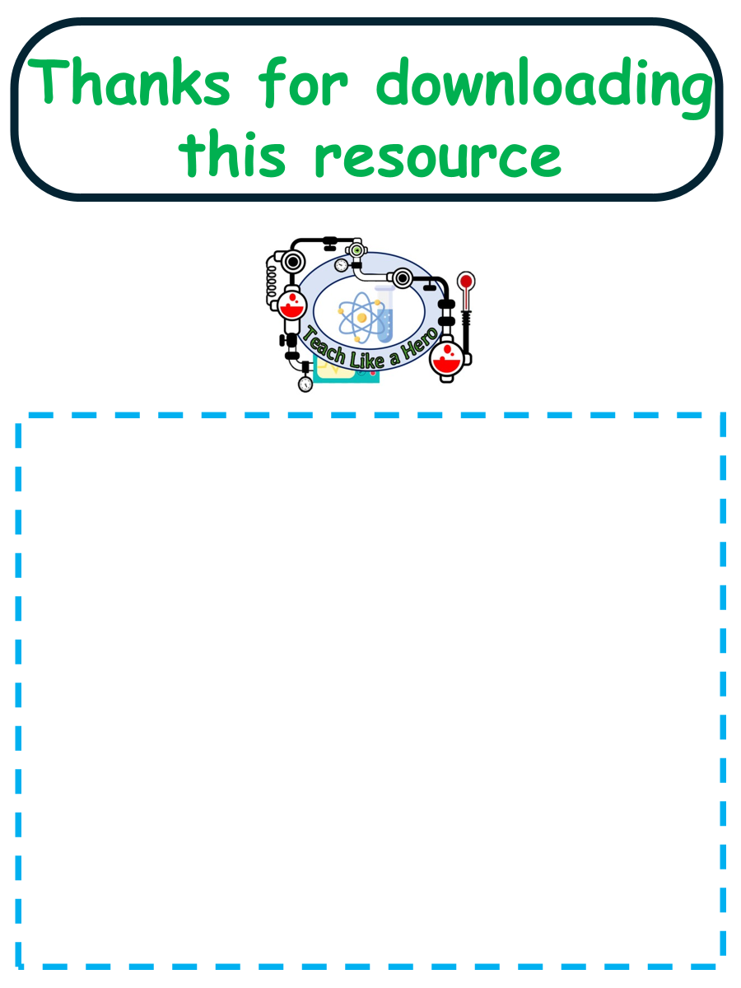
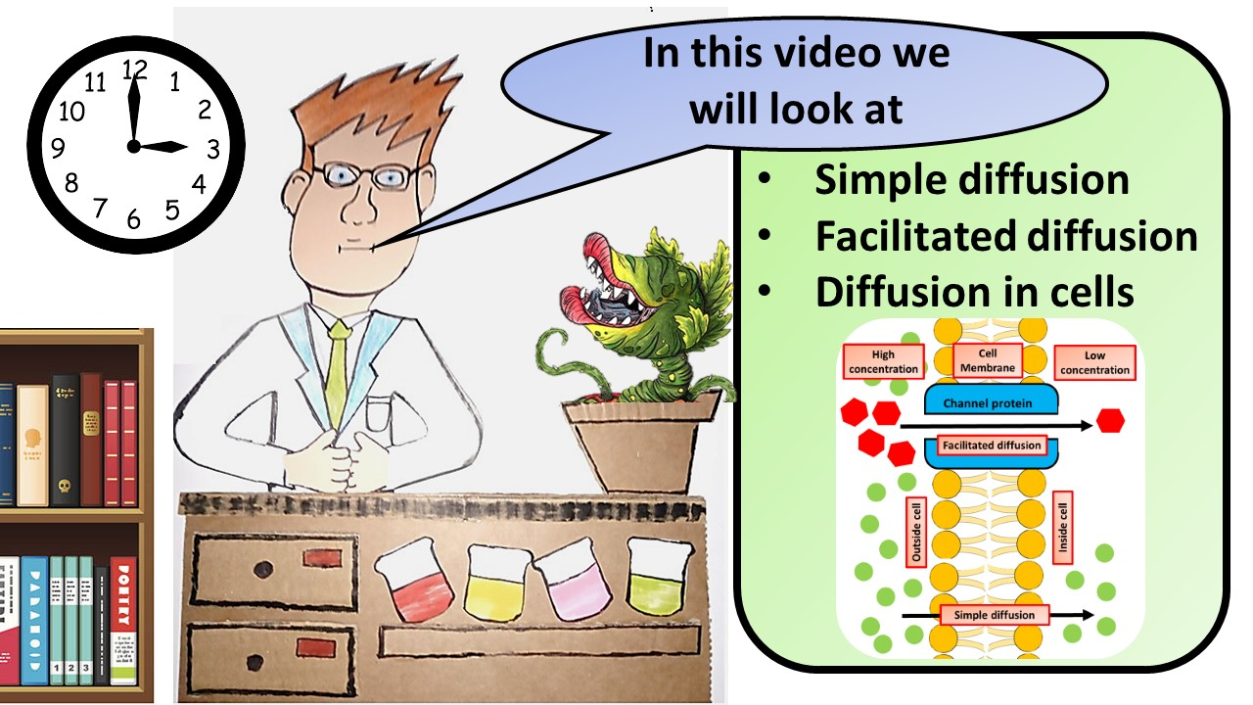


Click here to access my youtube videos
Resources that this activity would work well with
Lesson on TES
Lesson on TPT
Follow me on social media to stay in touch
Keep up to date with my new content:

