Slide 1
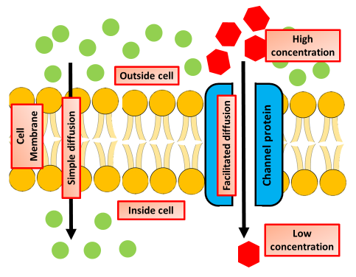
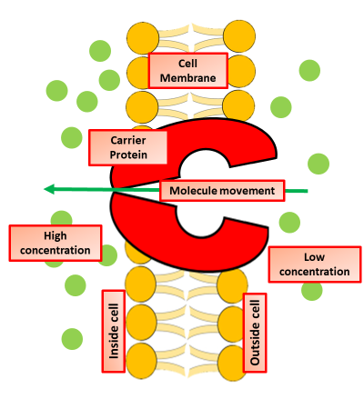
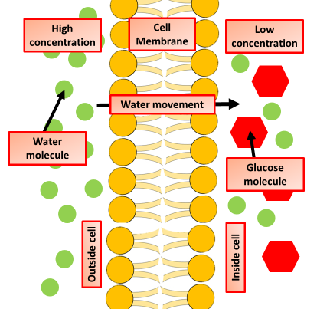
Movement of Molecules
Specification Link:
Cell Biology
Highlight key words in the question below:
Diffusion is the movement of a substance from an area of high concentration to an area of low concentration. Diffusion happens in liquids and gases because their particles move randomly from place to place. Diffusion is an important process for living things; it is how substances move in and out of cells.
Describe how the rate of diffusion across a membrane can be increased:
________________________________________________________________________________________________________________________________________________________________________________________________________________________________________________________________________________________________________________________________________________________
Give examples of molecules that diffuse across cell membranes:
__________________________________________________________________________
Describe facilitated diffusion:
__________________________________________________________________________
In cellular biology, active transport is the movement of molecules across a membrane from a region of their lower concentration to a region of their higher concentration—against the concentration gradient. Active transport requires cellular energy to achieve this movement.
What is active transport?
_________________________________________________________________________________________________________________________________________________________
Where in the body does active transport occur?
_________________________________________________________
Osmosis is the spontaneous net movement of solvent molecules through a selectively permeable membrane into a region of higher solute concentration, in the direction that tends to equalize the solute concentrations on the two sides.
Describe what osmosis is and the effect changing water concentration has on it’s rate
________________________________________________________________________________________________________________________________________________________________________________________________________________________

Slide 2

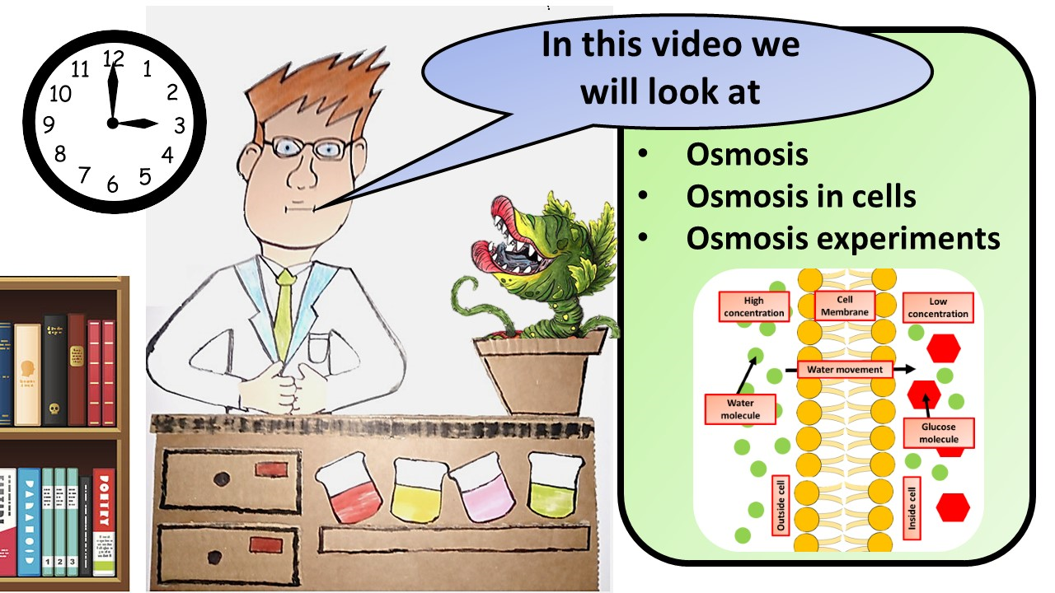


Click here to access my youtube videos
Resources that this activity would work well with
Lesson on TES
Lesson on TPT
Follow me on social media to stay in touch
Keep up to date with my new content:

