Slide 1
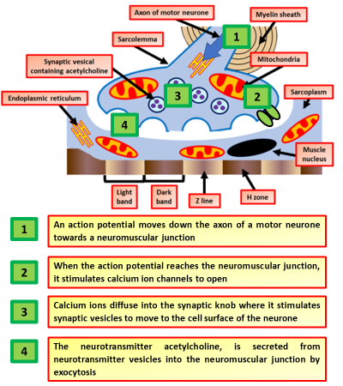
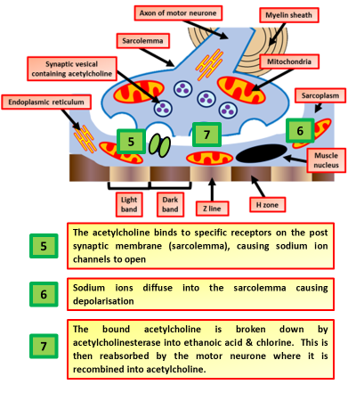
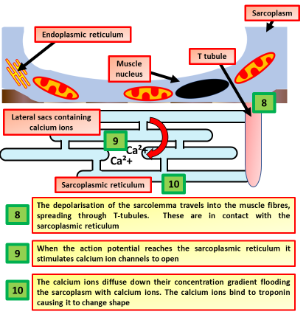
Muscle Contraction Question
Specification Link:
Neuronal Communication
Describe the process that lead to the release of acetylcholine into the neuromuscular junction
________________________________________________________________________________________________________________________________________________________________________________________________________________________________________________________________________________________
What ions are involved, and what roles do they play
___________________________________________________________________________________________________________________________
Describe the role of T tubules in muscle contraction
________________________________________________________________________________________________________________________________________________________________________________________________________________________________________________________________________________________________________________________________________________________________________________________________________________

Slide 2

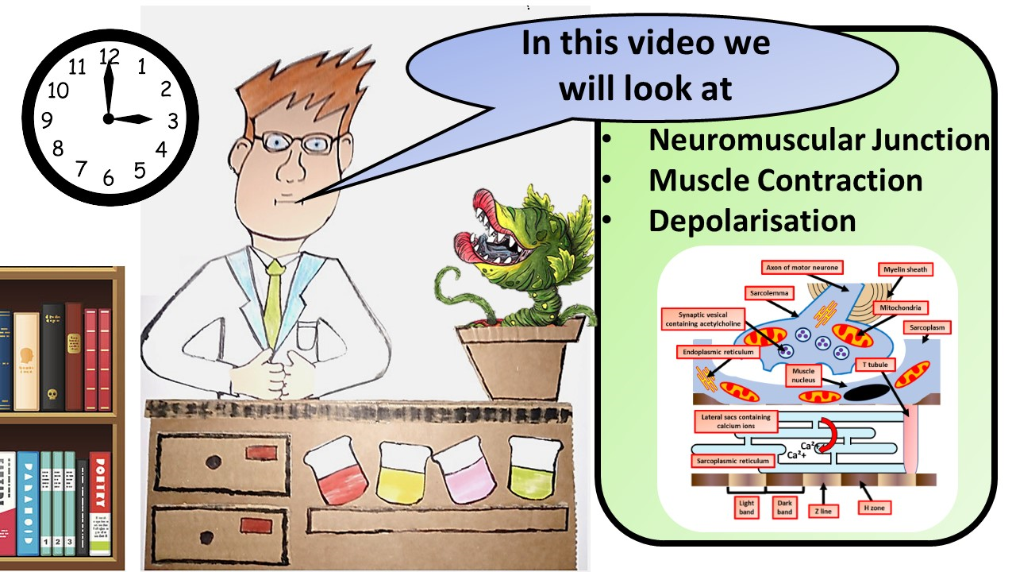


Click here to access my percentage composition youtube videos
Resources that this activity would work well with
Lesson on TES
Lesson on TPT
Follow me on social media to stay in touch
Keep up to date with my new content:

