Slide 1
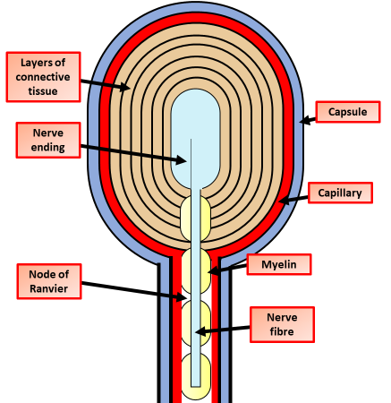
Describe the general structure of nerve cells
Describe the Pacinian corpuscles
Key information to include:
The general structure of a nerve cell
How nerve cells are adapted to their job
List the different types of nerve cell
Key information to include:
What is the Pacinian corpuscle
What is the function of Pacinian corpuscles
What role is played by the many layers of connective tissue
In what sort of cells do we find them
Describe how a generator potential is produced in the end of a nerve
Describe how a resting potential is maintained
Key information to include:
What is the function of the sodium ion pump
Which ion channels remain open
What happens to the concentration of ions
What is the resting potential
Key information to include:
What effect does pressure have on stretch mediated channels
What ions move
How does the movement of ions cause depolarisation

Slide 2
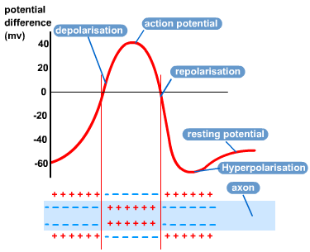
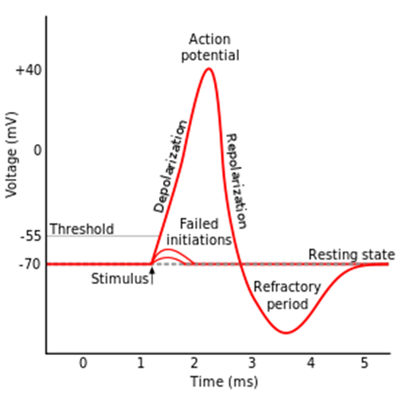
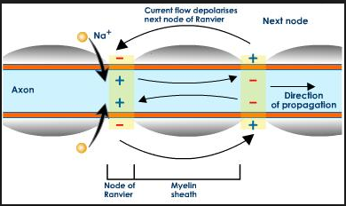
What is the difference between the resting and action potential?
Describe what happens when a nerve cell is stimulated
Key information to include:
What is a resting potential
What is an action potential
How does the charge on the membrane change
Key information to include:
What happens when the sodium channel closes?
How does the concentration of ions change
What effect does that have on charge
Describe the process of an action potential using the diagram above
Describe saltatory conduction
Key information to include:
What is saltatory conduction
What is a node of ranvier
How does saltatory conduction speed up nervous impulses
Key information to include:
What is the resting potential
What is the threshold
What is depolarisation
What is repolarisation
What is the action potential
What is the refractory period

Slide 3
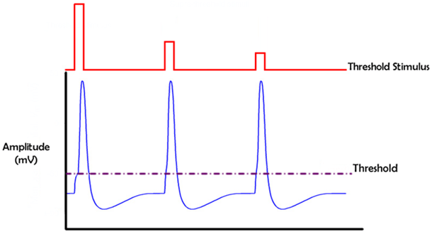
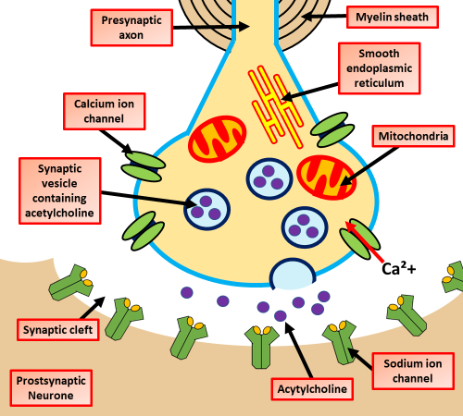
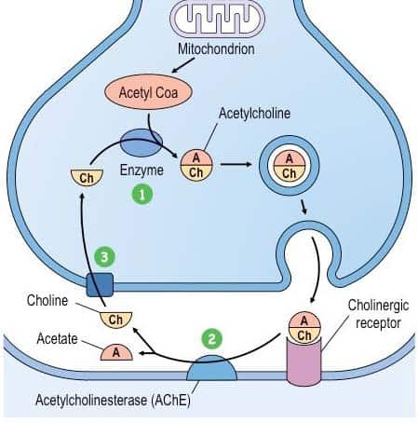
Describe in detail how an action potential is propagated
Explain the role of the all or nothing principle on the transmission of nerve impulses
Key information to include:
What happens to the sodium channels
What happens to the potassium channels
Describe how the depolarisation travels along the neural membrane
Key information to include:
What is the threshold level
How is an action potential produced when the threshold level is exceeded
Explain the role of acetylcholine in the transmission of nerve impulses:
Describe what happens at the synapse
Key information to include:
What happens to the neuronal membrane
What role is played by calcium ions
How is neurotransmitter released
What happens at the post synaptic membrane
Key information to include:
What is acetylcholine
What effect does it have on the post synaptic membrane
How is it re-uptaken

Slide 4
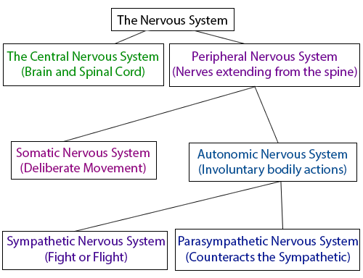
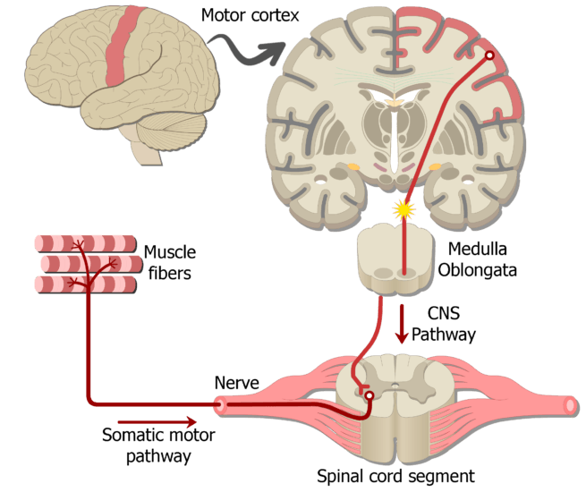
Describe the process of spatial summation in the transmission of nervous impulses
Describe the process of temporal summation in the transmission of nervous impulses
Key information to include:
Summarise what temporal summation is
How many nerve cells are involved
What is required for a action potential to be generated in the post synaptic neurone
Key information to include:
Summarise what spatial summation is
How many nerve cells are involved
What is required for a action potential to be generated in the post synaptic neurone
Describe autonomic nervous system
Describe The somatic system
Key information to include:
What is the autonomic nervous system
What are the functions of the autonomic nervous system
Key information to include:
What is the somatic nervous system
What are the functions of the somatic nervous system

Slide 5
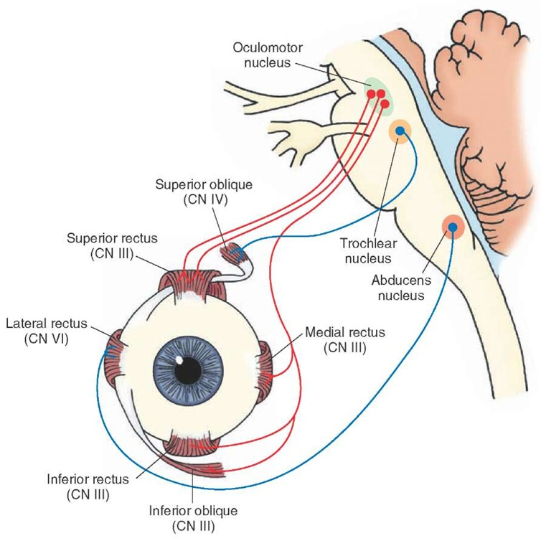
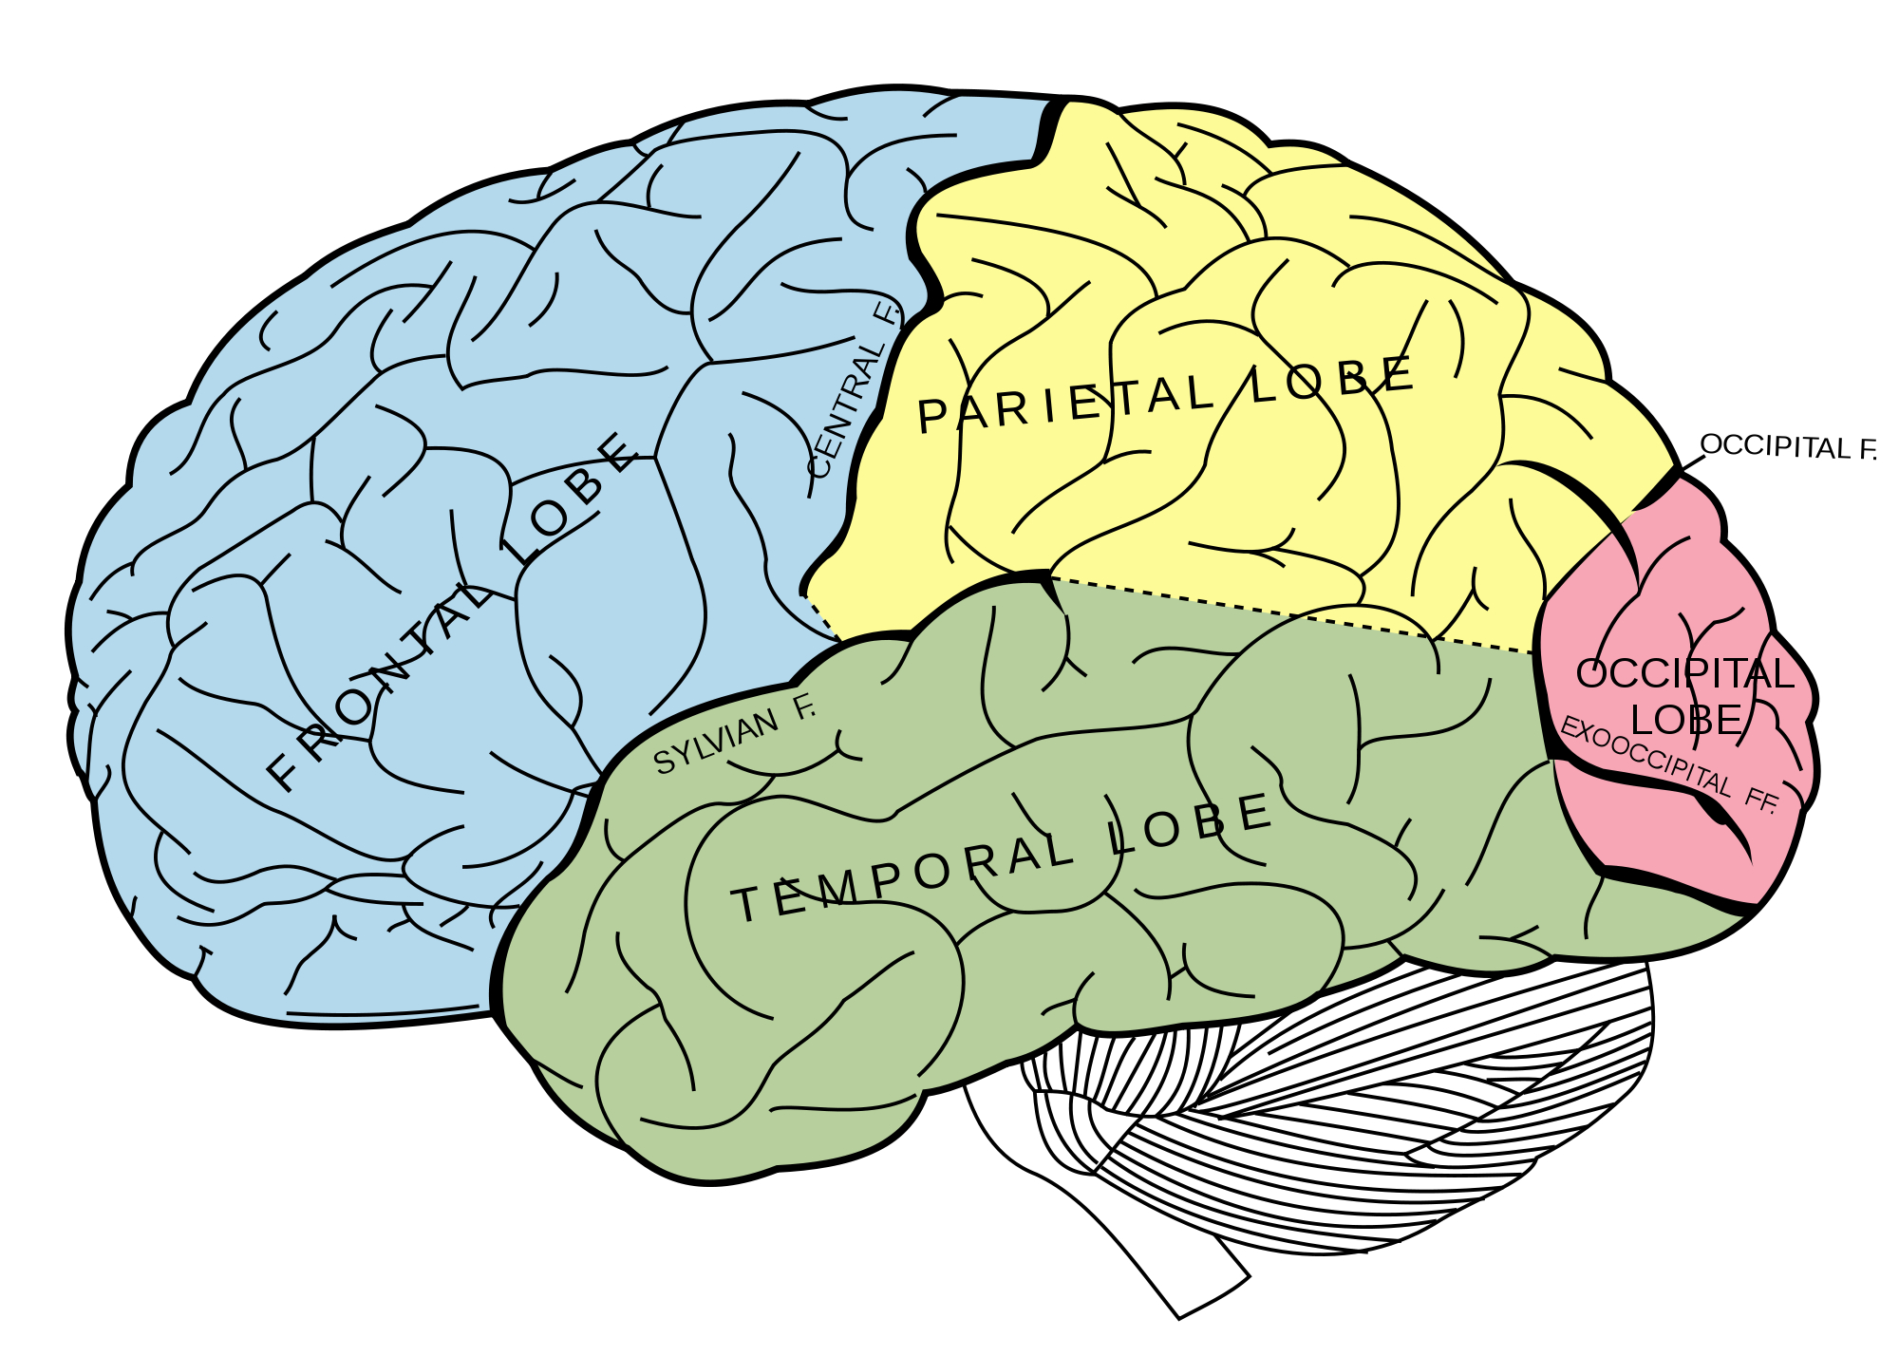
Describe the structure of the brain
Describe the blink reflex
Key information to include:
What is the general function of the brain
What are the different areas of the brain
What does each part of the brain do
Key information to include:
What is a blink reflex
What is the stimulus
How does the nerve impulse travel
What happens at the effector
Describe the knee jerk reflex
Describe the process that lead to the release of acetylcholine into the neuromuscular junction
Key information to include:
What is a knee jerk reflex
What is the stimulus
How does the nerve impulse travel
What happens at the effector
Key information to include:
What is a neuromuscular junction
What happens when a nerve impulse reaches the neuromuscular junction
What happens at the post junction membrane

Slide 6
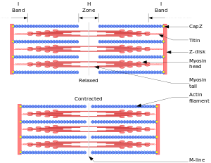
Describe the role of T tubules in muscle contraction
Describe and explain how myosin moves actin filaments along
Key information to include:
How does the impulse travel down the T tubule
How does it interact with the sarcoplasmic reticulum
What ions are released
Key information to include:
How does myosin interact with actin
What effect do calcium ions have
How do the 2 filaments move over each other
Describe what the sliding filament model shows
Key information to include:
What is actin
What is myosin
What is the B band
What is the I band
What is the H zone
What is the Z line

Slide 7
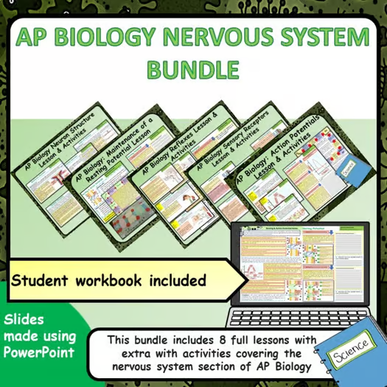
Click on the links below for lessons this resource can be used with
TPT lessons on the nervous system
TES lessons on the nervous system
Follow this link for a videos running that can be used with students on cells
Youtube video link
Follow me on social media to stay in touch
Keep up to date with my new content:

