Slide 1
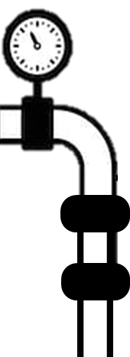

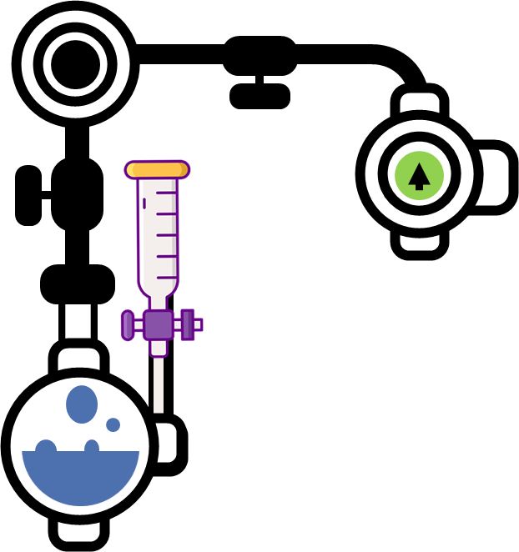

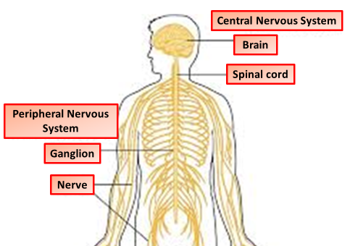
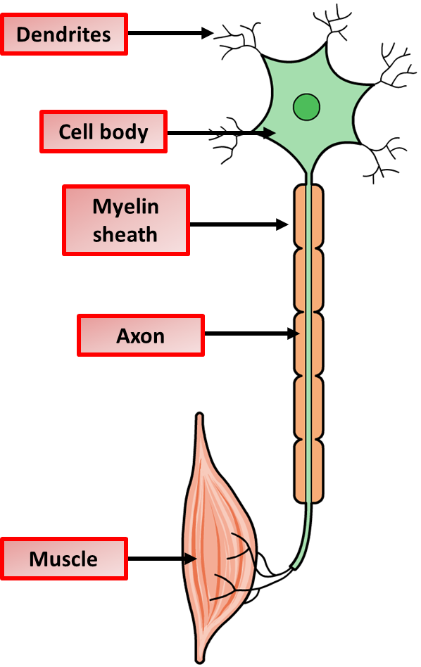
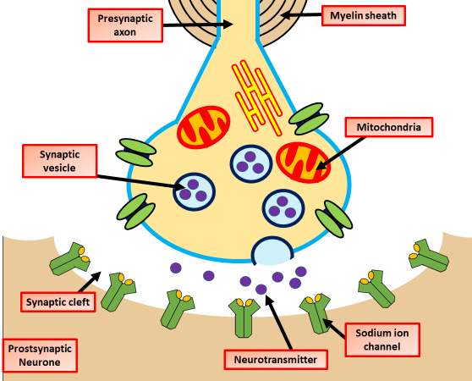
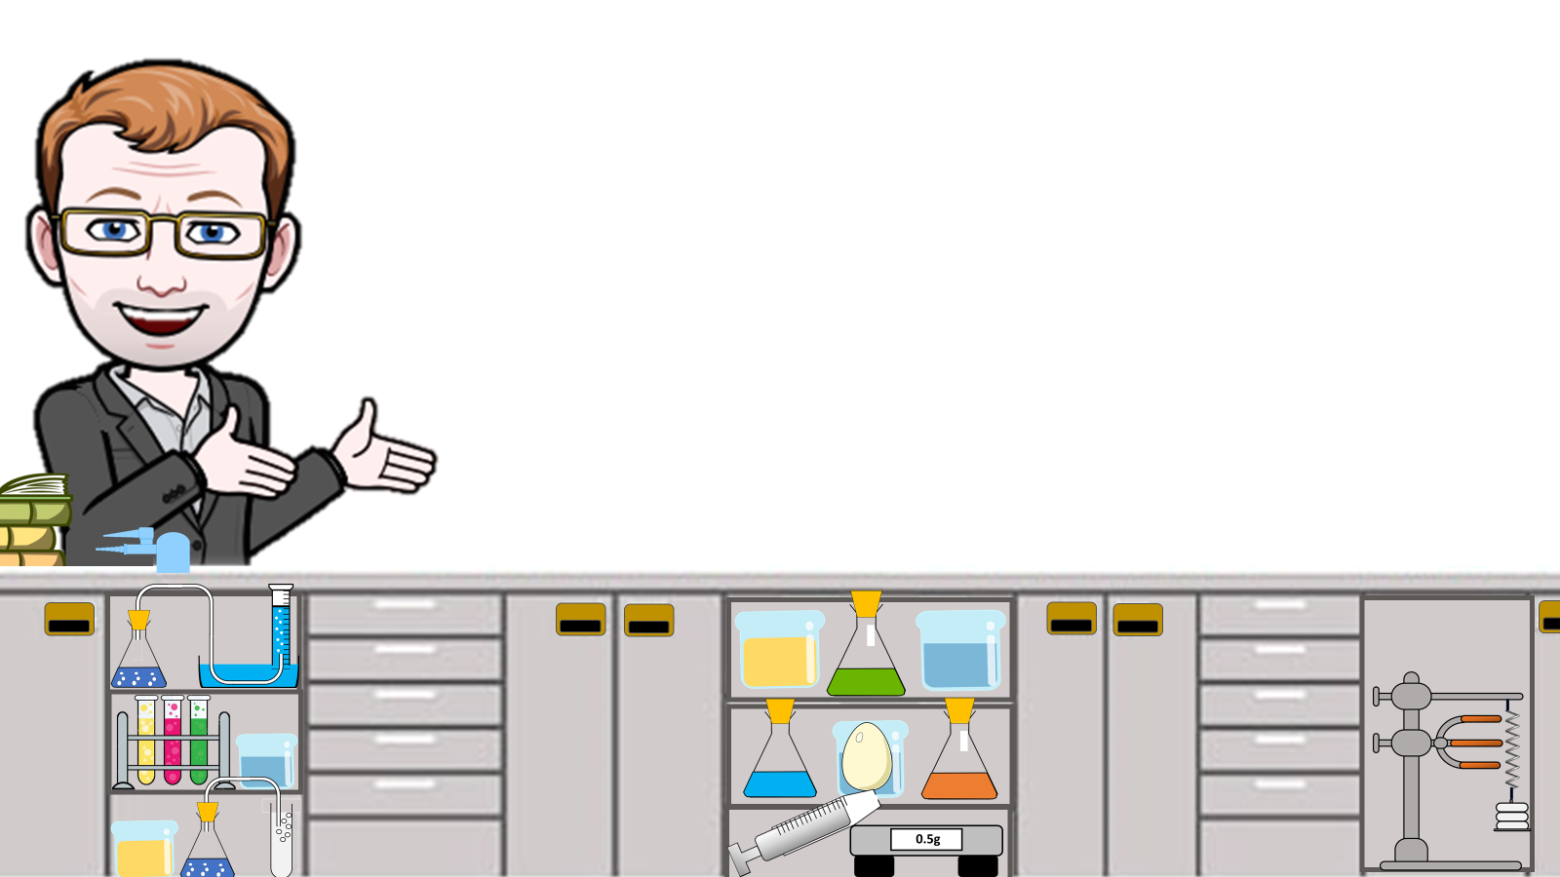

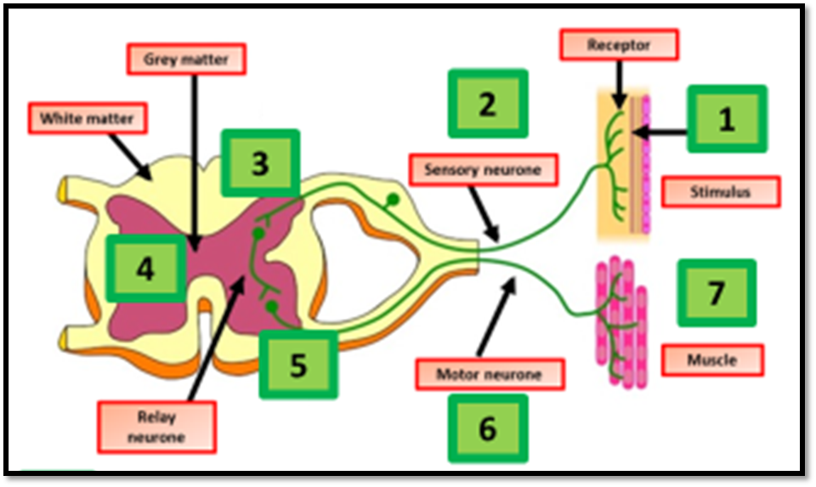
Nervous System Notes
The nervous system includes the central and peripheral nervous systems. The sense organs, including the eye, contain receptors that are sensitive to stimuli and respond with reflex actions.
.
The human nervous system consists of:
the central nervous system (CNS) – the brain and spinal cord
the peripheral nervous system – nerve cells that carry information to or from the CNS
The central nervous system (CNS) in humans consists of the brain and spinal cord. When a receptor is stimulated, it sends a signal along the nerve cells - neurones - to the brain. The brain then co-ordinates the response.
Receptors are groups of specialised cells. They can detect changes in the environment, which are called stimuli, and turn them into electrical impulses. Receptors are often located in the sense organs, such as the ear, eye and skin. Each organ has receptors sensitive to particular kinds of stimulus.
sensory neurones carry signals from receptors to the spinal cord and brain
relay neurones carry messages from one part of the CNS to another
motor neurones carry signals from the CNS to effectors.
The Synapse
Where two neurones meet, there is a tiny gap called a synapse. Signals cross this gap using chemicals released by a neurone. The chemical diffuses across the gap makes the next neurone transmit an electrical signal.
An electrical impulse travels along an axon
This triggers the nerve-ending of a neuron to release chemical messengers called neurotransmitters.
These chemicals diffuse across the synapse (the gap) and bind with receptor molecules on the membrane of the next neuron.
The receptor molecules on the second neuron bind only to the specific chemicals released from the first neuron. This stimulates the second neuron to transmit the electrical impulse
Receptor in the skin detects a stimulus (the change in temperature).
Sensory neurone sends impulses to relay neurone.
Motor neurone sends impulses to effector.
Effector produces a response (muscle contracts to move hand away).
Reflexes

Slide 2
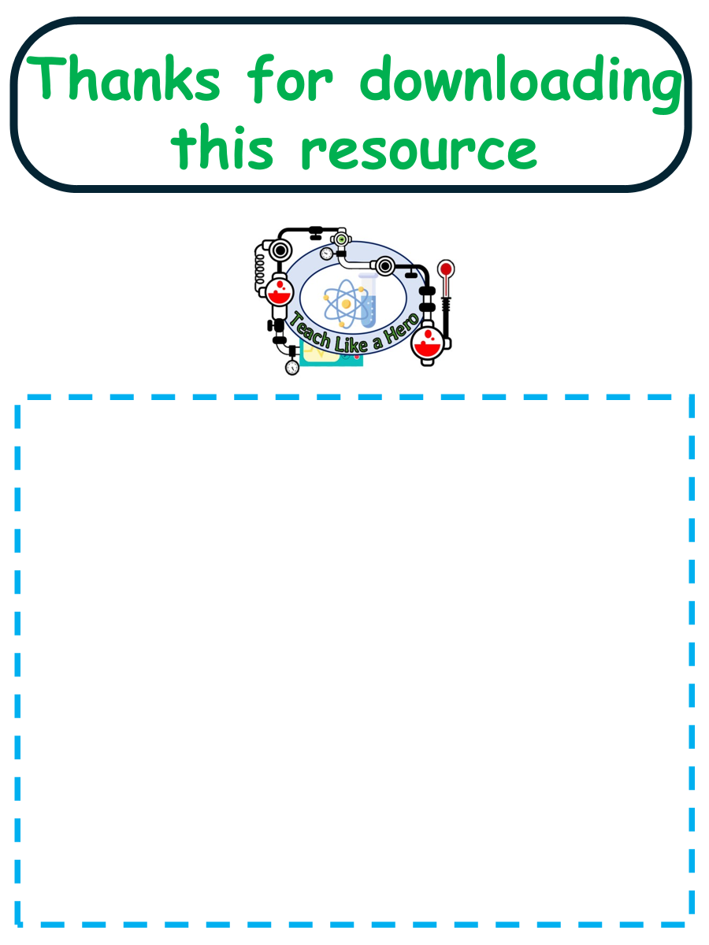
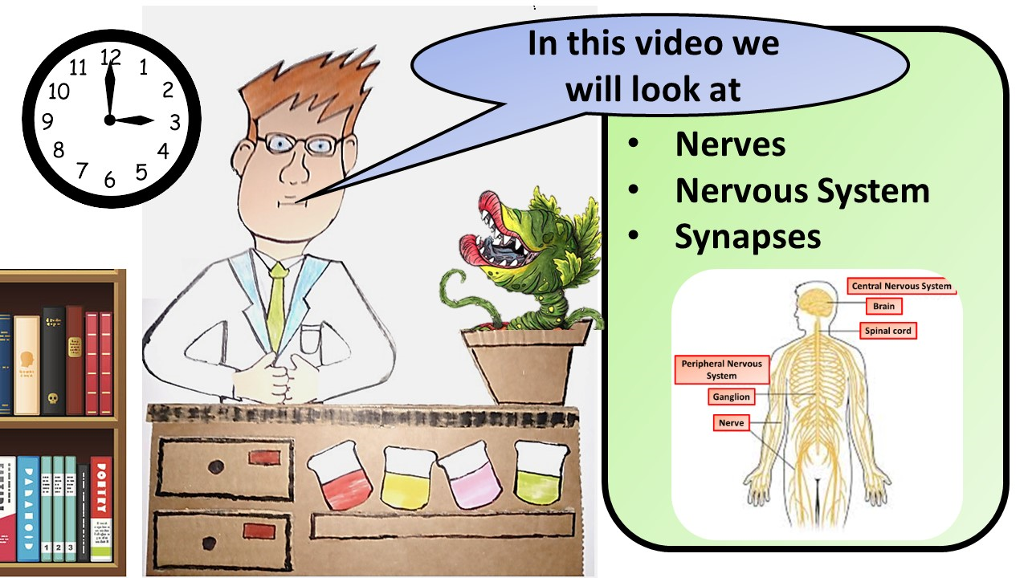


Click here to access my nervous system videos
Resources that this activity would work well with
Lessons on TES
Lessons on TPT
Follow me on social media to stay in touch
Keep up to date with my new content:

