Slide 1
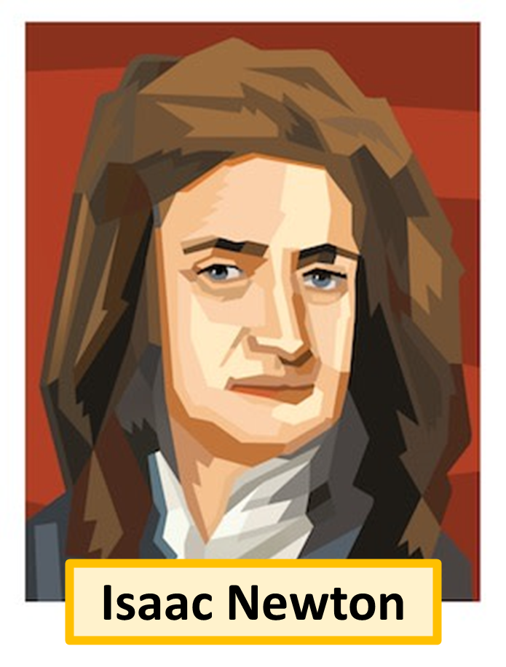
Newton Article
Sir Isaac Newton was a famous scientist who made many important discoveries that have greatly influenced our understanding of the world. One of his most famous discoveries is the law of gravity, which explains why objects fall to the ground and how planets orbit the sun. Newton realized that the same force that makes an apple fall from a tree also keeps the moon in orbit around the Earth.
He also developed three laws of motion, which describe how objects move and interact with forces. These laws help us understand everything from how a football flies through the air to how rockets travel into space. Additionally, Newton made significant contributions to mathematics by developing a new type of math called calculus, which is used to solve complex problems in science and engineering.
Another of Newton's discoveries is his work with light and optics. He showed that white light is made up of different colours by using a prism to split sunlight into a rainbow. These groundbreaking discoveries have made Newton one of the most important figures in the history of science.
Questions
What was Newton’s most famous discovery?
What fell on Newton’s head?
What type of maths did Newton invent?
What did Newton discover about light?

