Slide 1
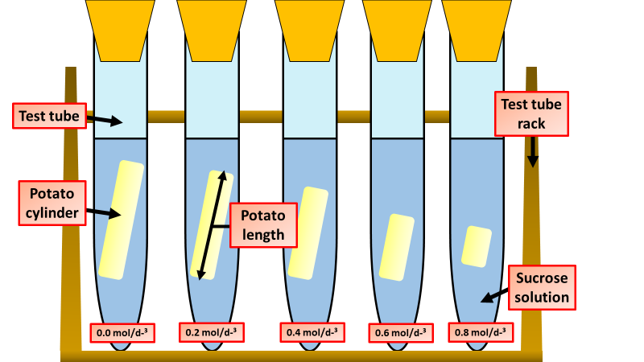
Osmosis Investigation
Specification Link:
Organisation
Independent variable – the variable that is altered during a scientific experiment.
Dependent variable – the variable being tested or measured during a scientific experiment.
Controlled variable – a variable that is kept the same during a scientific experiment. Any change in a controlled variable would invalidate the results.
The diagram shows the apparatus a student used to investigate osmosis in potatoes
What is the independent variable?
____________________________________
What is the dependent variable?
____________________________________
Osmosis
Osmosis is the movement of water molecules, across a partially permeable membrane, from a region of high concentration of water to a low concentration of water molecules. It allows plants to take in water through their roots.
What do the results above show?
____________________________________________________________________________________________________________________________________
How could the results above be made more accurate?
________________________________________________________________________________________
The table below shows the results:
Sugar solution in mol dm⁻³ | Starting mass in g | Final mass in g | Change of mass in g | (%) change
0.0 | 1.30 | 1.51 | 0.21 | 16.2
0.2 | 1.35 | 1.50 | 0.15 | X
0.4 | 1.30 | 1.35 | 0.05 | 3.8
0.6 | 1.34 | 1.28 | −0.06 | −4.5
0.8 | 1.22 | 1.11 | −0.11 | −9.0
Calculate the value of X
______________________________________________________________
Why did the student calculate the percentage change in mass as well as the change in grams?
_____________________________________________________________________________________________
Explain why the percentage change results are positive and negative.
____________________________________________________________________________________________________________________________
Suggest two possible sources of error?
___________________________________________________________________________________________________________________________________________________

Slide 2
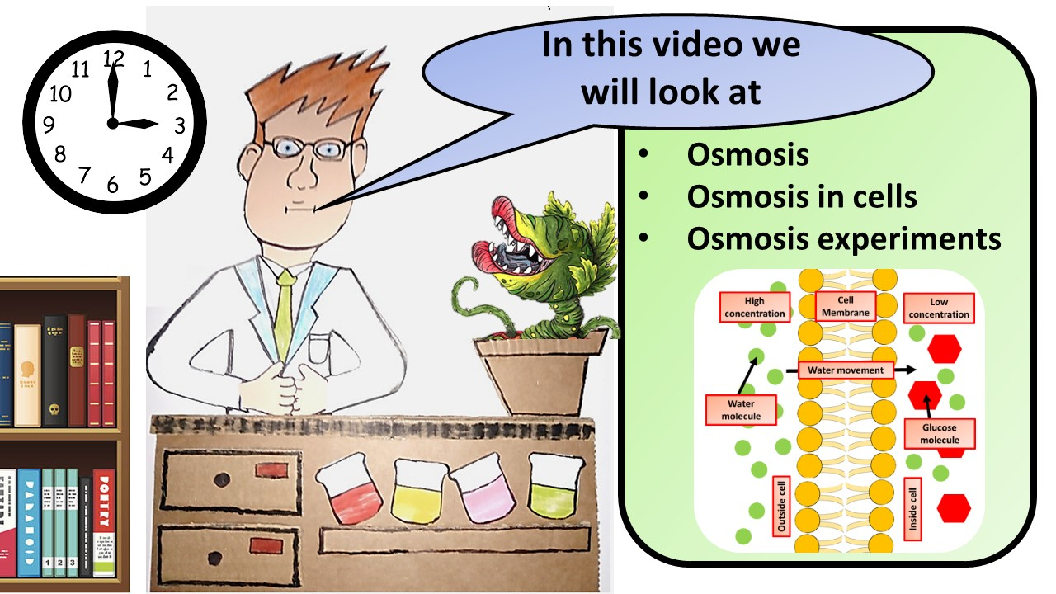
Click here to access my youtube videos
Resources that this activity would work well with
Lesson on TES
Lesson on TPT
Follow me on social media to stay in touch
Keep up to date with my new content:

