Slide 1





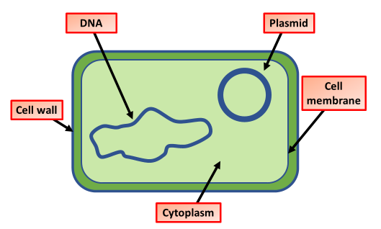
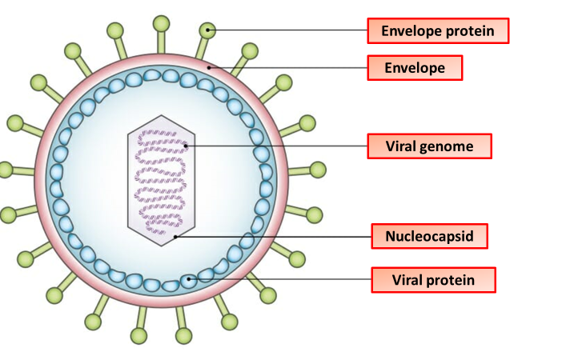
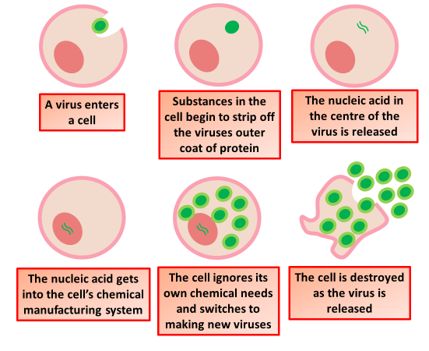
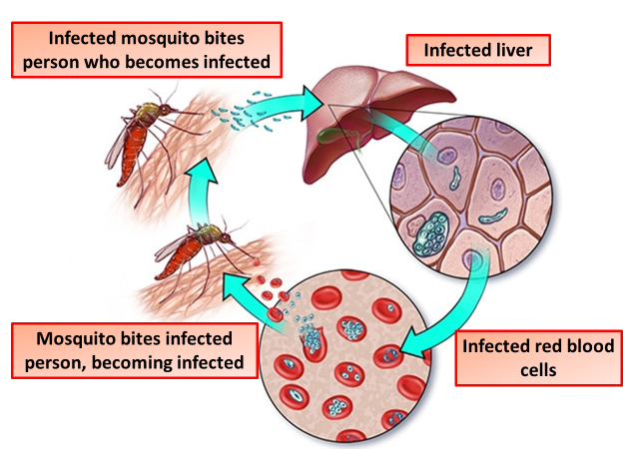
Pathogens & Disease Notes
A pathogen or infectious agent is a biological agent that causes disease or illness to its host. The term is most often used for agents that disrupt the normal physiology of a multicellular animal or plant. However, pathogens can infect unicellular organisms from all of the biological kingdoms.
A disease is a particular abnormal condition that negatively affects the structure or function of all or part of an organism, and that is not due to any immediate external injury.
Bacterial cells have a cell wall made of polysaccharides and proteins. They do not have a nucleus, but instead they have a circular chromosome of DNA. They may also have small extra circles of DNA called plasmids.
Salmonella is a genus of bacteria that causes food poisoning. This often means abdominal cramps, vomiting and diarrhoea. It is often found in unhygienic kitchens, undercooked foods such as meat, eggs and poultry, or the same foods that have not been reheated properly
Viruses are very small particles capable of infecting every type of living organism. They are parasitic and can only reproduce inside living cells. For example:. the influenza virus - this causes flu. HIV (human immunodeficiency virus) – this causes AIDS.
Fungal cells have a cell wall made of chitin (remember that plant cell walls are made of cellulose). A yeast cell. Athlete's foot, caused by a fungus. Some fungi are pathogens , for example the fungal infection which causes athlete's foot.
Athlete's foot is a rash caused by a fungus that is usually found between people's toes. It causes dry, red and flaky or white, wet and cracked skin. It is often found in communal areas like swimming pool changing rooms or gyms. It is transmitted by touching infected skin or surfaces that have been previous contaminated. It is treated by antifungal medication.
Protists are a group of microorganisms that have features that belong to animals, plants and fungi. Some are like animals, others more like plants and some, called moulds are closest to fungi. They are all eukaryotic, which means they have a nucleus
Malaria is spread by mosquitoes which carry the Plasmodium protist. These are often found in areas with higher temperatures like Africa, Asia, and South and Central America, but not the UK. Plasmodium is spread via female mosquitoes of the genus Anopheles.

Slide 2

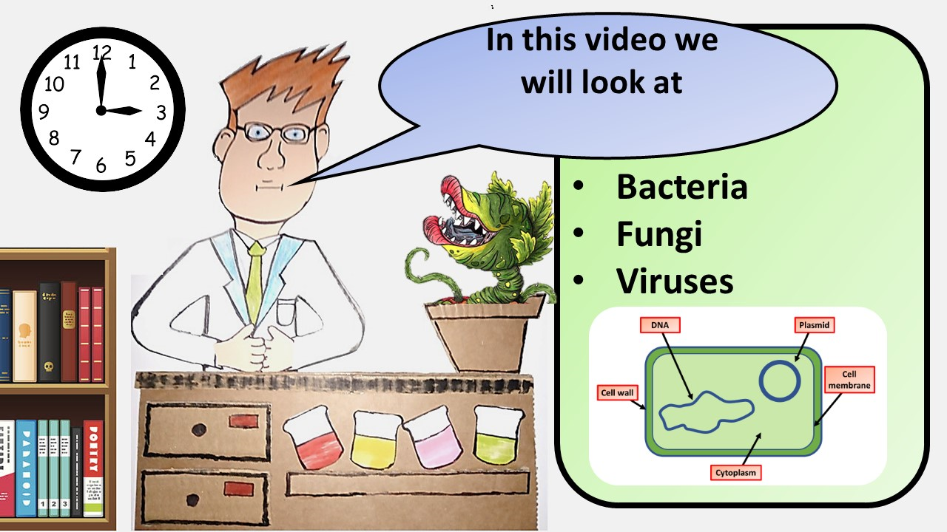


Click here to access my Pathogens youtube videos
Resources that this activity would work well with
Lesson on TES
Lesson on TPT
Follow me on social media to stay in touch
Keep up to date with my new content:

