Slide 1

Percentage Yield Calculation
In an experiment a scientist obtains 14.2 g of copper oxide. The percentage yield in this reaction is 84.0%.
What is the maximum theoretical mass of copper oxide produced in this reaction?
% Yield= Actual yield of product
Theoretical yield of product
Identify the actual yield
Rearrange the equation
Answer
Place the variables into the equation
Calculate the answer
Link to answer video

Slide 2
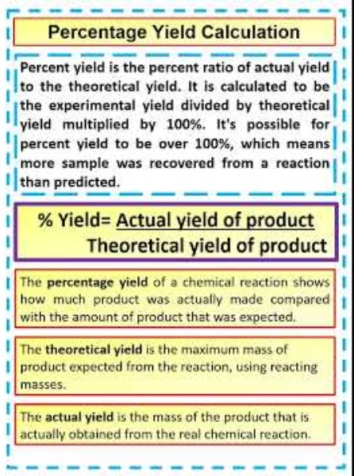
Percentage Yield Calculation

