Slide 1

Percentage Yield Calculation
A reaction produces a maximum theoretical mass of 400 kg of ethanol from 243 kg of ethene and 157 kg of steam. A company produces 380 kg of ethanol from 243 kg of ethene and 157 kg of steam. The percentage yield of ethanol is less than 100% Calculate the percentage yield of ethanol.
% Yield= Actual yield of product
Theoretical yield of product
Identify the actual yield
Place the variables into the equation
Answer
Calculate yield
X by 100 to turn it into a percentage
Link to answer video

Slide 2
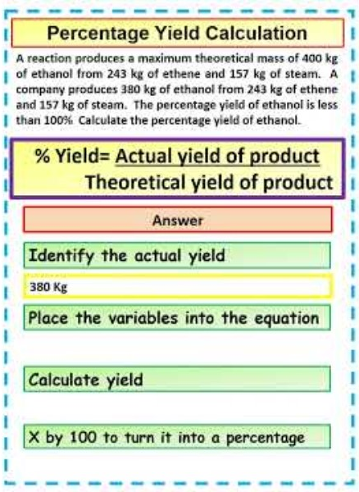
Percentage Yield Calculation

