Slide 1
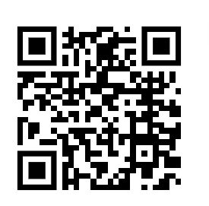
Percentage Yield Calculation
In a chemical reaction, 25.0 g of calcium carbonate (CaCO3) is heated to produce calcium oxide (CaO) and carbon dioxide (CO2). If 18.0 g of calcium oxide is obtained, calculate the percentage yield of the reaction.
% Yield= Actual yield of product
Theoretical yield of product
Identify the actual yield
Place the variables into the equation
Answer
Calculate yield
X by 100 to turn it into a percentage
Link to answer video

Slide 2
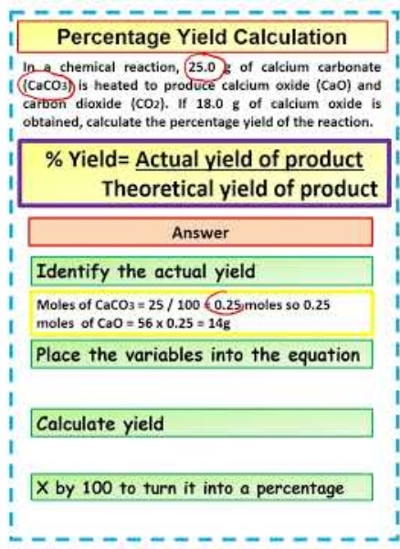
Percentage Yield Calculation

