Slide 1




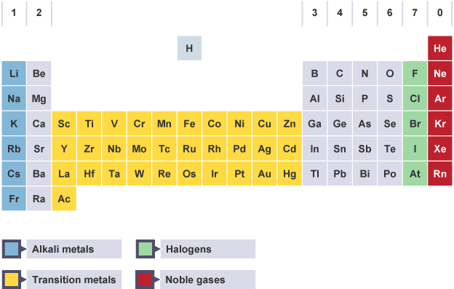

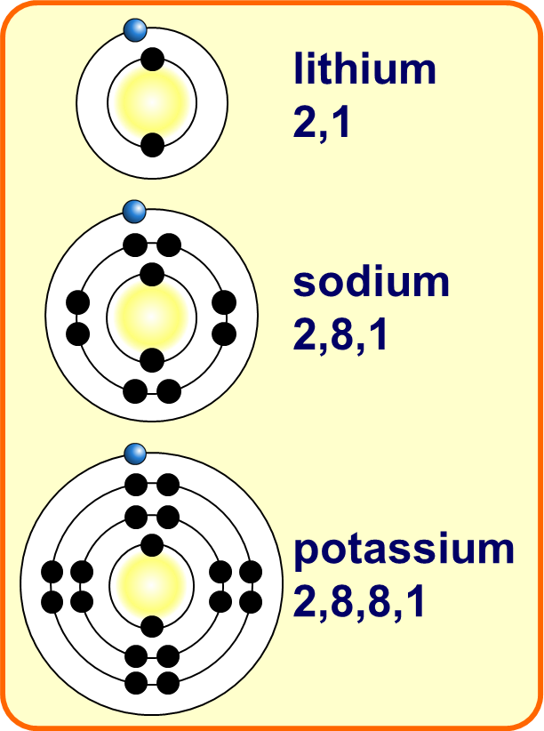
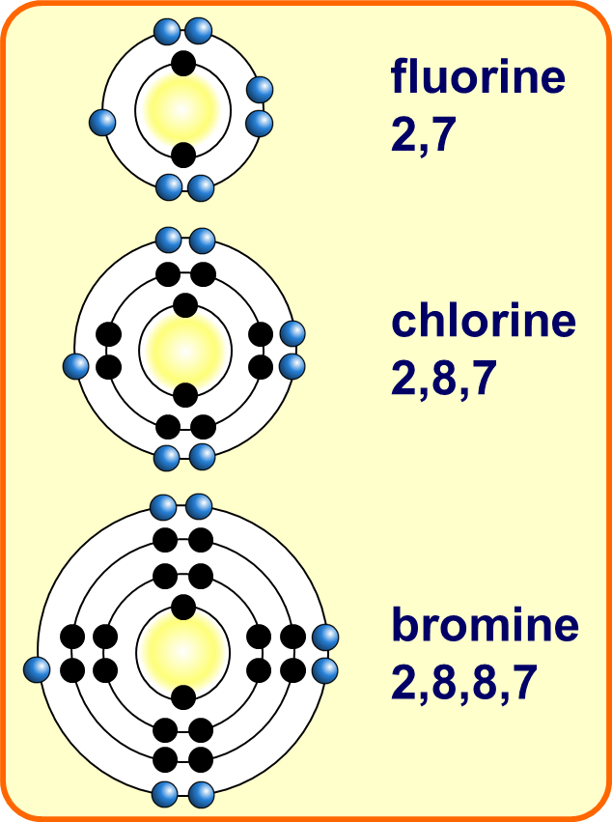
Periodic Table Notes
An element is a substance that cannot be broken down into any other substance. Every element is made up of its own type of atom. This is why the chemical elements are all very different from each other. Everything in the universe contains the atoms of at least one or more elements.
The periodic table is a chart showing all the elements arranged in order of increasing atomic number. The vertical columns in the periodic table are called groups. Each group contains elements that have similar properties .
Here are the main features of the table:
the horizontal rows are called periods
the vertical columns are called groups
elements in the same group are similar to each other
the metals are on the left and the non-metals are on the right
the main groups are numbered from 1 to 7 going from left to right, and the last group on the right is Group 0
the block in between Group 2 and Group 3 is where the transition metals are placed
Dmitri Mendeleev
Dmitri Mendeleev was a Russian chemist. He wrote chemistry books and was looking for ways to organise the known elements. He published his first periodic table of the elements in 1869. In it, he arranged the elements in order of increasing atomic weights. He also took into account the properties of the elements and their compounds. This meant that his table:
had gaps in it
showed elements with similar chemical properties lined up in groups
Group 0 Elements
The atoms of noble gases already have complete outer shells, so they have no tendency to lose, gain, or share electrons. This is why the noble gases are inert and do not take part in chemical reactions. Atoms of group 0 elements have complete outer shells (so they are unreactive)
Group 1 Elements
The reactivity of group 1 elements increases as you go down the group because: the atoms become larger. the outer electron becomes further from the nucleus. the force of attraction between the nucleus and the outer electron decreases.
The atoms of each element get larger going down the group.
The further an electron is from the positive nucleus, the easier it can be lost in reactions.
They can readily lose the outer shell electron to form positive ions with a +1 charge and a full outer shell.
Group 7 Elements
The Group 7 elements are called the halogens. They are placed in the vertical column, second from the right, in the periodic table . Chlorine, bromine and iodine are the three common Group 7 elements. Group 7 elements form salts when they react with metals.
They can easily obtain a full outer shell by gaining one electron.
They all gain an electron in reactions to form negative ions with a -1 charge.
The further the outer shell is from the positive attraction of the nucleus, the harder it is to attract another electron to complete the outer shell.

Slide 2



Click here to access my periodic table youtube videos
Resources that this activity would work well with
Lessons on TES
Lessons on TPT
Follow me on social media to stay in touch
Keep up to date with my new content:

