Slide 1
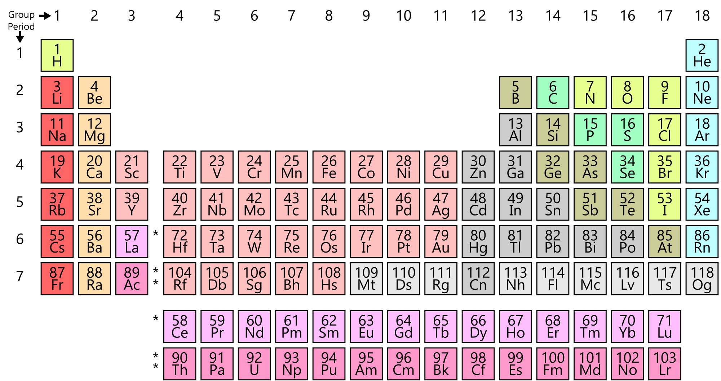
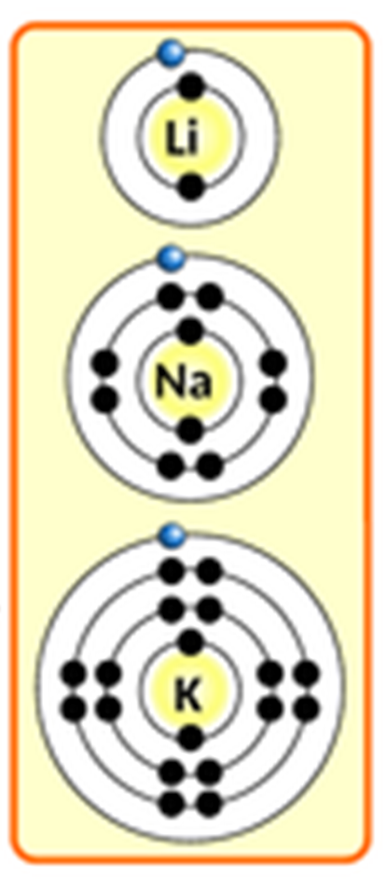
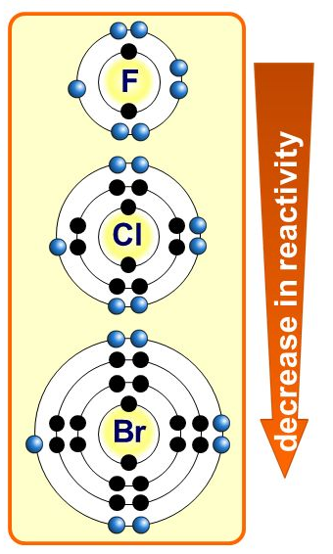
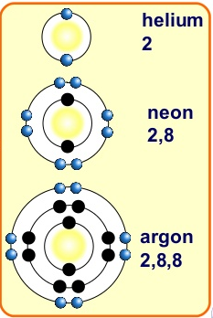
The Periodic Table
Specification Link:
Atoms & the Periodic Table
Highlight key words in the information below:
To read the periodic table, start at the top left with the elements with the lowest atomic numbers, which tells you how many protons each atom has. Then, as you move right across the chart, make note that the atomic weight, shown at the bottom of the square, also increases
Describe how Mendeleev developed the modern periodic table
__________________________________________________________________________________________________________________________________________________________________________________________________________________________________________________________________________________________________________________________________________________________________________________________________________________________________________
The group 1 elements are all soft, reactive metals with low melting points. They react with water to produce an alkaline metal hydroxide solution and hydrogen. Reactivity increases down the group.
Explain why the reactivity increases as we move down group 1
____________________________________________________________________________________________________________________________________________________________________________________________________________________________________________________________________________________________
The Group 7 elements are called the halogens. They are placed in the vertical column, second from the right, in the periodic table . Chlorine, bromine and iodine are the three common Group 7 elements. Group 7 elements form salts when they react with metals.
Explain why the reactivity decreases as we move down group 7
___________________________________________________________________________________________________________________________________________________________________________________________________________________________________________________________________________________________________________________________
The group 0 elements, the noble gases, are all unreactive non-metal gases. They show trends in their physical properties. Their uses depend on their inertness, low density and non-flammability.

