Slide 1

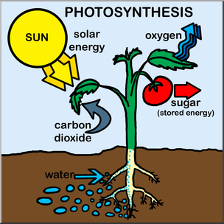
Photosynthesis Article
Have you ever wondered how plants make their own food? It's all thanks to a magical process called photosynthesis! Plants are like nature's chefs, cooking up their meals using just sunlight, water, and carbon dioxide from the air.
Here's how it works: Plants have special parts called chloroplasts that act like tiny kitchens. Inside these chloroplasts, there are green pigments called chlorophyll that trap sunlight. When sunlight hits the chlorophyll, it gives the plant energy, just like how a chef gets energy from food. But that's not all! Plants also need carbon dioxide, which they get from the air through tiny holes called stomata on their leaves. They also need water, which they absorb through their roots from the soil.
Once the plant has sunlight, carbon dioxide, and water, it's time for the magic to happen! Using the energy from sunlight, the plant combines carbon dioxide and water to make a special kind of sugar called glucose. Glucose is like the plant's favourite meal—it gives them energy to grow, make new leaves, and even produce flowers and fruits!
And here's the best part: When plants make glucose, they also give off oxygen as a waste product. That's right, the same oxygen we need to breathe! So every time you take a deep breath, remember to thank the plants for their green magic.
So there you have it—photosynthesis is nature's incredible way of turning sunlight, water, and carbon dioxide into food for plants and oxygen for us. It's like a magical recipe that keeps our planet green and full of life!
Questions
What do plants use for photosynthesis?
Where does photosynthesis take place?
What provides the energy for photosynthesis?
What do plants use glucose for?
Why do we need oxygen?

