Slide 1
Photosynthesis Practical Question
Specification Link:
Bioenergetics
A student investigated the effect of light intensity on the rate of photosynthesis.
The diagram shows the apparatus the student used.
What is the dependent variable?
___________________________________
What is the independent variable?
___________________________________
What is the control variable?
___________________________________
What is the independent variables interval?
___________________________________
This is the method used.
Set up the apparatus as shown in the diagram above.
Place the lamp 10 cm from the pondweed.
Turn the lamp on and count the number of bubbles produced in one minute.
Repeat with the lamp at different distances from the pondweed.
Why do we repeat the experiment?
___________________________________
What could cause errors in the results?
____________________________________________________________________________________________________________
Describe and explain what results you would expect to see from this experiment:
________________________________________________________________________________________________________________________________________________________________________________________________________________________________________________________________________________________________________________________________
Highlight key words in the information below:
Without enough light, a plant cannot photosynthesise very quickly - even if there is plenty of water and carbon dioxide and a suitable temperature. Increasing the light intensity increases the rate of photosynthesis, until some other factor – a limiting factor – becomes in short supply.
Describe how the equipment to the left could be used to measure the rate of photosynthesis:
_______________________________________________________________________________________________________________________________________________________________________________________________________________________________________________________________
Explain why your results would be more accurate:
_________________________________________________________________________________________________________________________________________________________

Slide 2
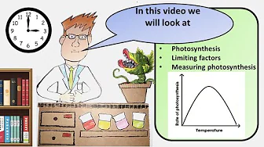
Click here to access my percentage composition youtube videos
Resources that this activity would work well with
Lessons on TES
Lesson on TPT
Follow me on social media to stay in touch
Keep up to date with my new content:

