Slide 1


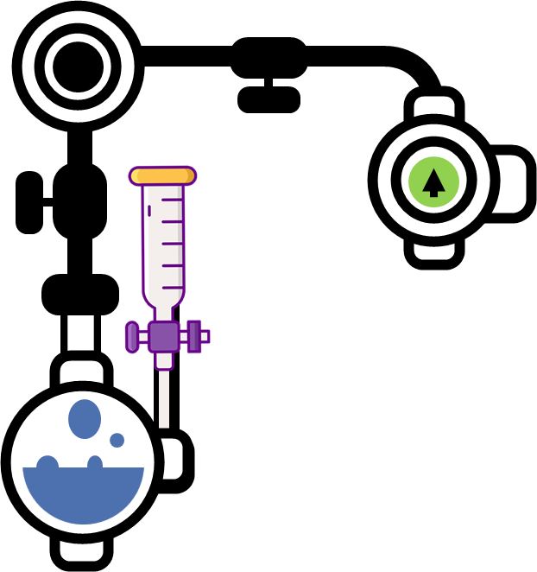

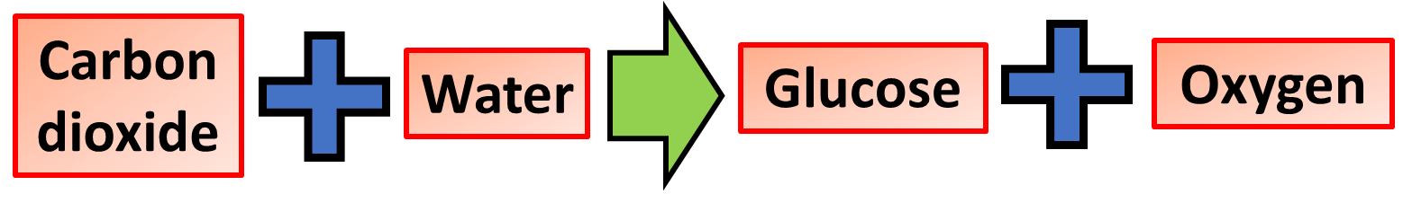
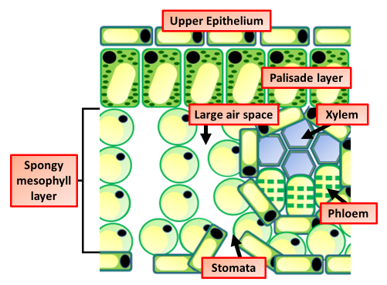
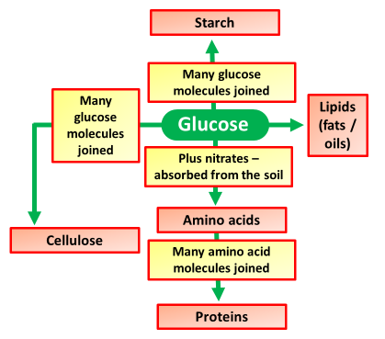
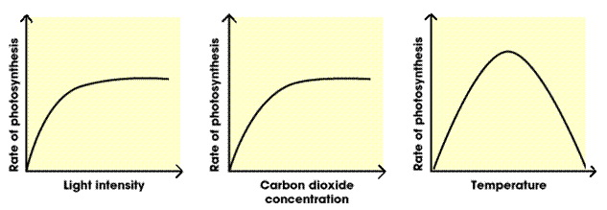
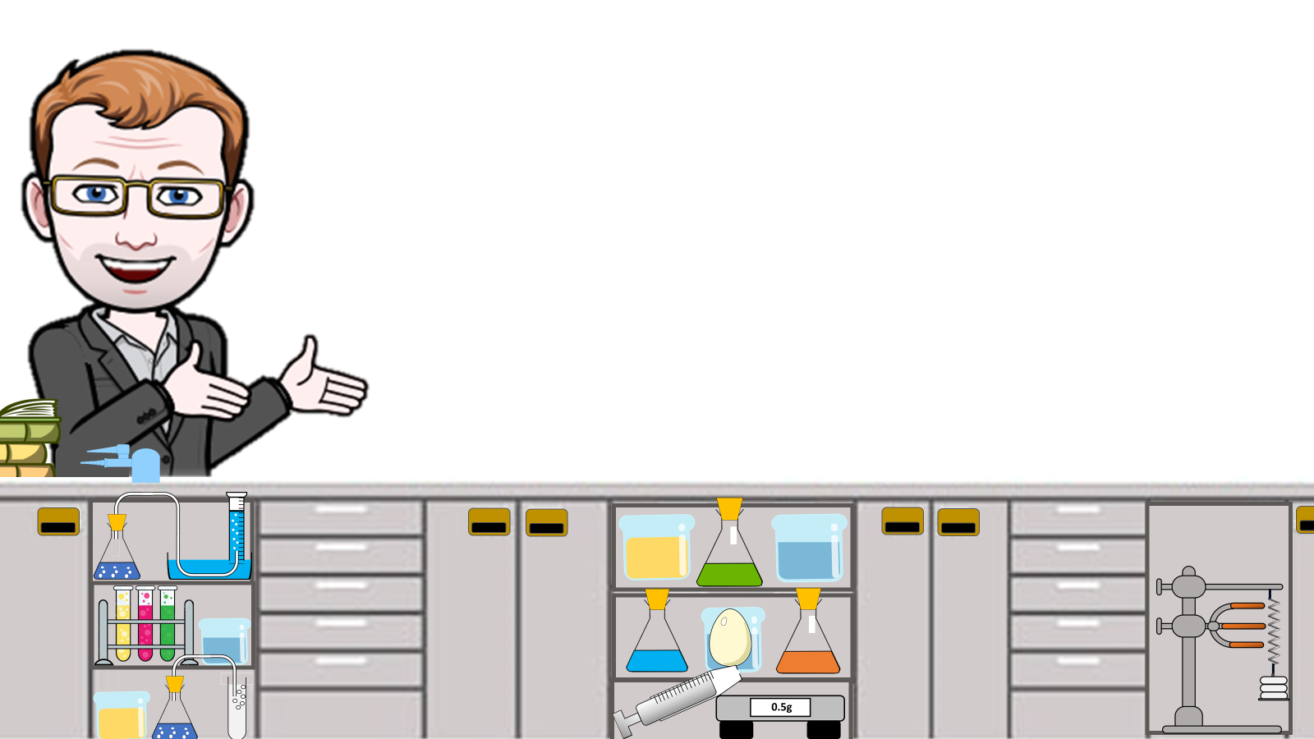
Photosynthesis Notes
Photosynthesis is a chemical reaction that takes place inside a plant, producing food for the plant to survive. Carbon dioxide, water and light are all needed for photosynthesis to take place. Photosynthesis happens in the leaves of a plant.
Waxy cuticle: See through layer which lets light through and stops the leaf from becoming water logged.
Palisade layer: Cells have lots of chloroplasts so can carry out lots of photosynthesis.
Spongy mesosphere layer: Rounded cells which, creates large air spaces within the leaf.
Guard cells: Open and close the air holes on the underside of the leaf so control the rate of transpiration.
There are three main factors light. intensity carbon dioxide concentration and also temperature these factors are called limiting factors light is essential for photosynthesis as it. provides the energy to split the water and therefore enable carbon dioxide and water to react no light. no photosynthesis increasing
Air spaces: Enable movement of carbon-dioxide into the leaf and oxygen out.
Phloem: Carries away glucose made in photosynthesis.
The light energy required is absorbed by a green pigment called chlorophyll in the leaves. Chlorophyll is located in chloroplasts in plant cells , particularly the palisade and spongy mesophyll cells
The glucose made in photosynthesis is transported around the plant as soluble sugars. Glucose is used in respiration to release energy for use by the plant's cells. However, glucose is converted into insoluble substances for storage.
The leaf of a variegated Pelargonium is dropped in boiling water to kill and preserve it
The leaf is left for 10 minutes in hot ethanol in a boiling tube. This removes the chlorophyll
The leaf is dipped in boiling water to soften it
The leaf is spread out in a Petri dish and covered with iodine solution
The areas that had the chlorophyll stain blue-black. The areas that had no chlorophyll remain pale
Testing Leaves for Starch

Slide 2
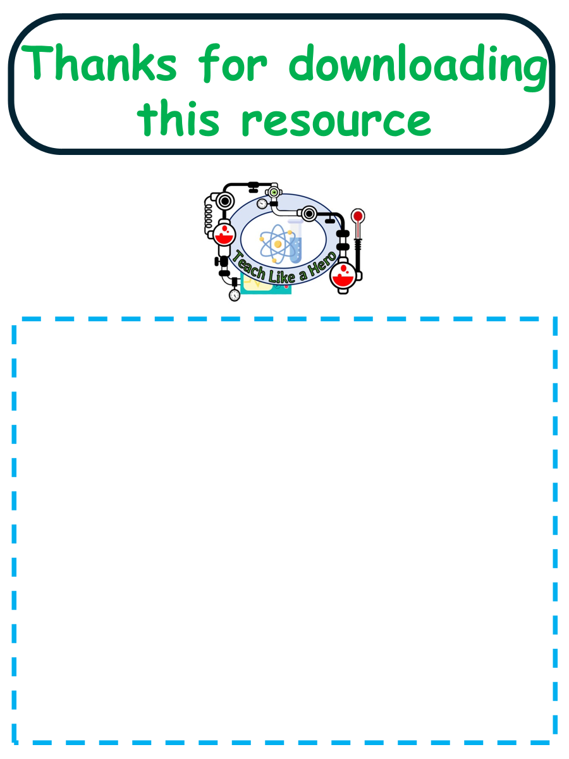
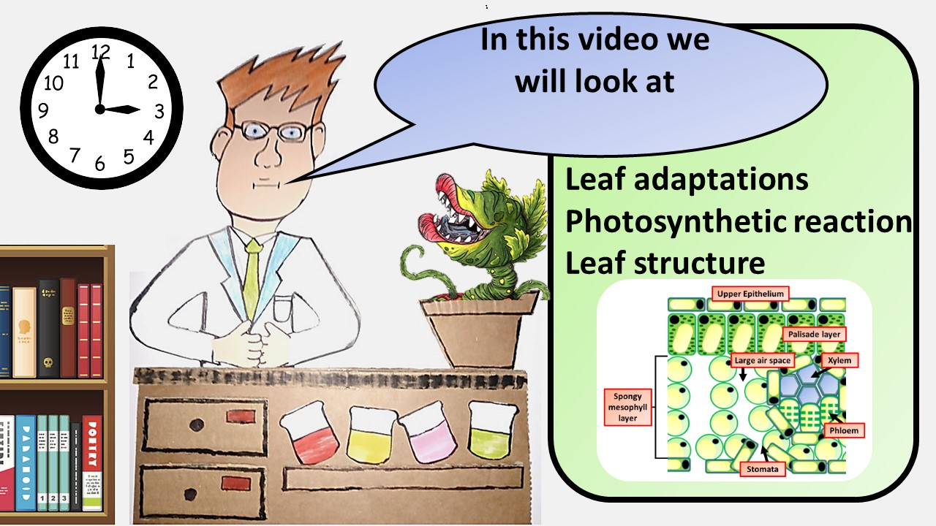


Click here to access my photosynthesis videos
Resources that this activity would work well with
Lessons on TES
Lessons on TPT
Follow me on social media to stay in touch
Keep up to date with my new content:

