Slide 1
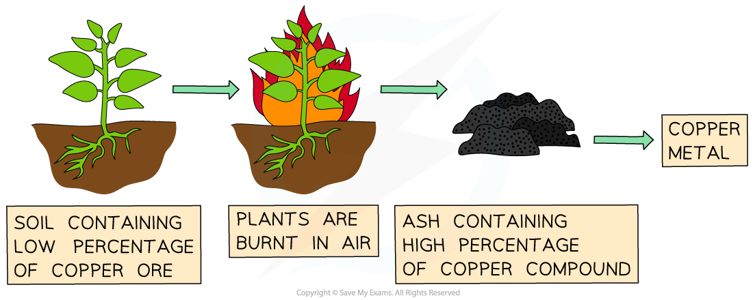
Phytomining Practice Question
Copper is extracted from low-grade ores by phytomining.
Describe how copper is extracted from low-grade ores by phytomining.
Key things to include:
What do we do to the plants
What do we react with the ash
How can electrolysis be used to extract the copper
Answer
________________________________________________________________________________________________________________________________________________________________________________________________________________________________________________________________________________________________________________________________________________________________________________________
Link to video

Slide 2
Phytomining Practice Question

