Slide 1
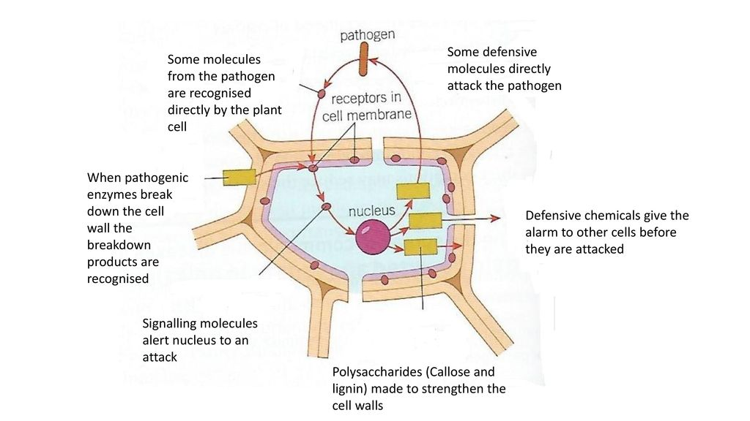
Plant Defences Question
Specification Link:
Infection & Response
Highlight key words in the information below:
Some plants, like stinging nettles and foxgloves, have developed poisons to deter herbivores from eating them. As a way of defending themselves against pathogens, some plants such as mint and witch hazel produce antibacterial chemicals . These kill bacteria that were not stopped by physical defences.
What structural adaptations do plants have to help protect themselves?
_________________________________________________________________________________________________________
Plant Defences
Stage 1: The plant is infected with a pathogen
Stage 2: Some molecules from the pathogen, are recognised by receptors I the cell membrane of the plant cell
Stage 3: When pathogenic enzymes break down the cell wall, the breakdown molecules can be recognised
Stage 4: Signalling molecules alert the nucleus to attack
Stage 5: Polysaccharides (callose & Lignin) are produced to help strengthen the cell wall
Stage 6: Defensive chemicals are produced which alert other cells to the pathogen before they are attacked
Stage 7: Some defence molecules are produced that directly attack the pathogen outside the cell
Describe how individual plant cells respond to infections:
_______________________________________________________________________________________________________________________________________________________________________________________________________________________________________________________________________________________________________________________________________________________________________________________________________________________________________________________________________
What is another name used for chemical responses?
__________________________________________________________________________________________
Plants have a variety of inducible defences in the presence of pathogens. In addition to secondary metabolites, plants produce antimicrobial chemicals, antimicrobial proteins, and antimicrobial enzymes that are able to fight the pathogens. Plants can close stomata to prevent the pathogen from entering the plant. A hypersensitive response, in which the plant experiences rapid cell death to fight off the infection, can be initiated by the plant; or it may use endophyte assistance: the roots release chemicals that attract other beneficial bacteria to fight the infection.
Name some of the chemicals used in plant defenses
__________________________________________________________________________________________
Describe what role the stomata can play in stopping pathogens spreading
_______________________________________________________________________________________________________________________________________

Slide 2



Click here to access my percentage composition youtube videos
Resources that this activity would work well with
Lesson on TES
Lesson on TPT
Follow me on social media to stay in touch
Keep up to date with my new content:

