Slide 1
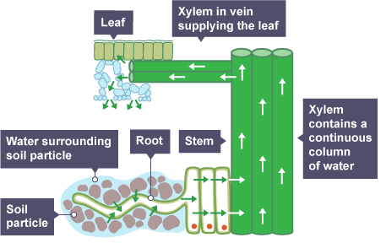
Plant Organisation Practice Question
Specification Link:
Biological Organisation
Describe the structure & function of phloem cells
____________________________________________________________________________________________________________________________________________________________
Describe the structure & function of xylem cells
____________________________________________________________________________________________________________________________________________________________
Highlight key words in the information below:
What is transpiration?
_____________________________________________________________________________________________________________________
When the plant opens its stomata to let in carbon dioxide, water on the surface of the cells of the spongy mesophyll and palisade mesophyll evaporates and diffuses out of the leaf. This process is called transpiration.
Water is drawn from the cells in the xylem to replace that which has been lost from the leaves.
Water molecules inside the xylem cells are strongly attracted to each other. There is strong cohesion between the molecules because of hydrogen bonding. A continuous column of water is therefore pulled up the stem in the transpiration stream by evaporation from the leaves.
As water travels through the xylem in the stem and leaf, it is being replaced by water taken up by the roots.
How does water enter the plant?
_____________________________________________________________________________________________________________________
How can the rate of transpiration be increased?
_____________________________________________________________________________________________________________________
How does water leave the plant?
_____________________________________________________________________________________________________________________
Transpiration is the evaporation of water at the surfaces of the spongy mesophyll cells in leaves, followed by loss of water vapour through the stomata . Transpiration produces a tension or 'pull' on the water in the xylem vessels by the leaves.
In plants, the transpiration stream is the uninterrupted stream of water and solutes which is taken up by the roots and transported via the xylem to the leaves where it evaporates into the air/apoplast-interface of the substomatal cavity.
Explain how water moves through the plant
____________________________________________________________________________________________________________________________________________________________________________________________________________________________________________________________________________________________________________________________________________________________________________________________________________________________________

Slide 2

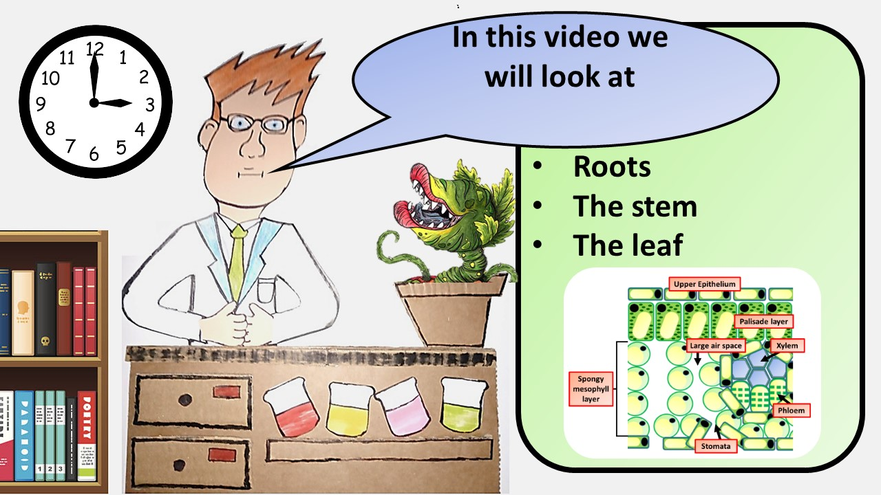


Click here to access my youtube videos
Resources that this activity would work well with
Lesson on TES
Lesson on TPT
Follow me on social media to stay in touch
Keep up to date with my new content:

