Slide 1
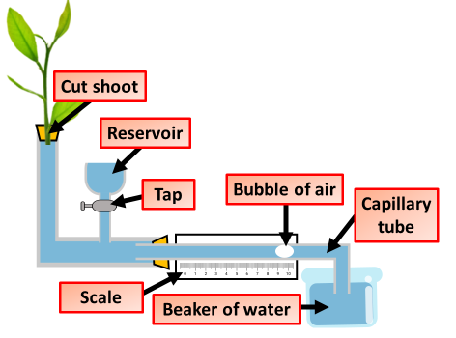

Potometer Investigation Question
Specification Link:
Organisation
Transpiration is the process by which moisture is carried through plants from roots to small pores on the underside of leaves, where it changes to vapor and is released to the atmosphere. Transpiration is essentially evaporation of water from plant leaves.
A potometer is a device used for measuring the rate of water uptake of a leafy plant shoot. The main reason for water uptake by a cut shoot is transpiration (evaporation in plants) and is affected by the transpiration stream.
The diagram shows the apparatus a student used to investigate transpiration in plants
What is being used to measure the rate of transpiration?
_____________________________
Why is the investigation repeated 3 times?
__________________________________________________________
Time in minutes | 0 | 2 | 4 | 6 | 8 | 10
Level of water (on scale) in capillary tube in mm | 2.5 | 3.6 | 4.4 | 5.4 | 6.5 | 7.5
The table above shows the results of a transpiration investigation. Using what you know about transpiration, explain these results
____________________________________________________________________________________________________________________________________________________________________________________________________________
What could cause errors in the investigation
_______________________________________________________________________________________
The students repeated the investigation at different temperatures. The results are shown below. Draw a graph to show these results to the right
Temperature in °C | Rate of water uptake in mm³ per minute
10 | 0
15 | 0.4
20 | 1.0
25 | 2.1
30 | 3.2
35 | 4.0
40 | 4.4

