Slide 1
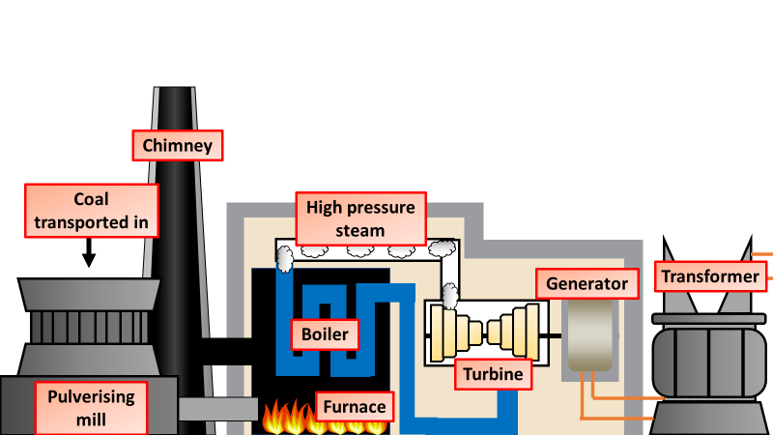

Welcome to your virtual tour of a power station

Slide 2

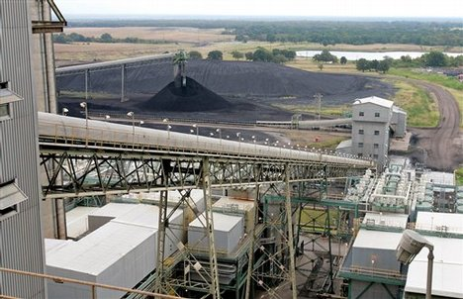

Coal is transported and stored at power stations before moving up a conveyer to the mill
Key questions
What energy is stored in coal?
Where does the coal come from?
What are the problems with using coal?

Slide 3

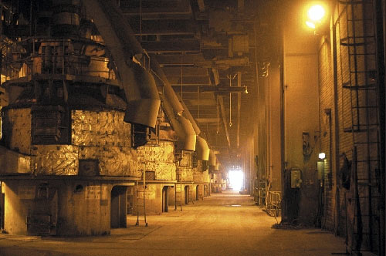
Then the coal is ground down into a fine powder. This increases surface area so it burns better
Key questions
Why does coal burn better when it’s ground down?
What problems might there be when grinding the coal down?

Slide 4
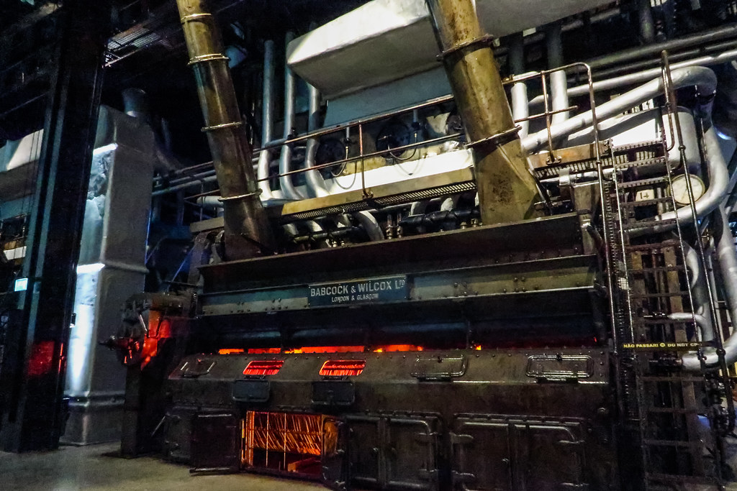
The coal dust is then blown into the furnace
Key questions
What energy change takes place when the coal is burnt?
What waste gases are produced?
What problems are caused by these waste gases?

Slide 5

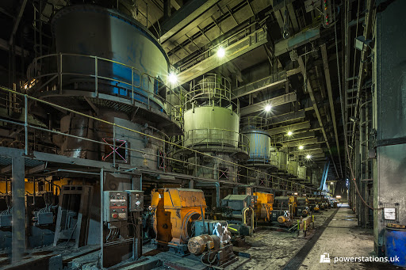
Water is boiled in the boiler to produce high pressure steam. The steam then turns the turbines
Key questions
What needs to happen to the water before it boils?
Why do we want high pressure steam?

Slide 6
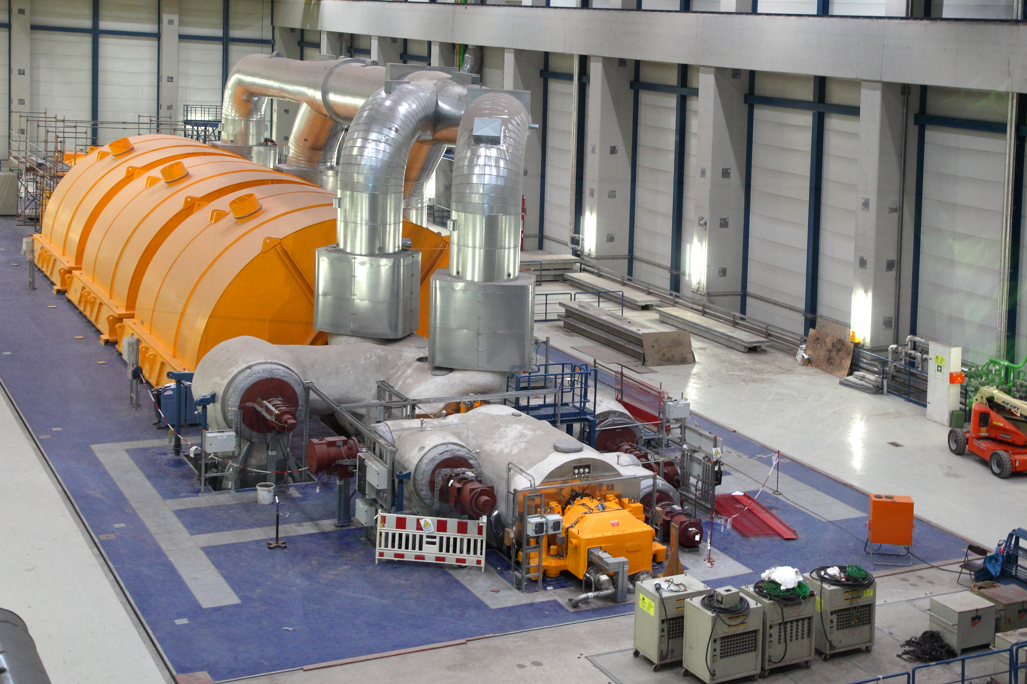

The high pressure steam is used to spin a turbine at a frequency of 50Hz
Key questions
How many times a second is the turbine turning?
What could the inside of the turbine be compared to?

Slide 7
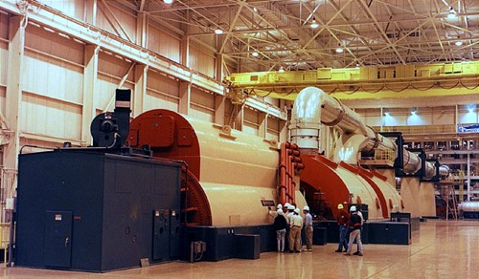

The turbines turn the generator which makes the electricity
Key questions
What sort of electricity is being generated?
What potential wasted energy might there be?

Slide 8
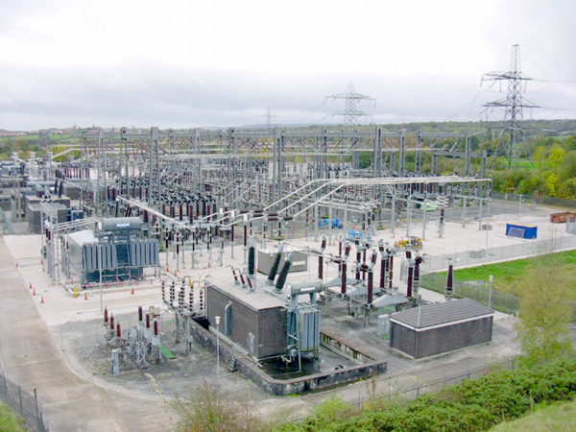

The electricity is stepped up and transmitted by the national grid
Key questions
Why is the voltage stepped up?
What is it stepped up to?
What is the national grid?

Slide 9
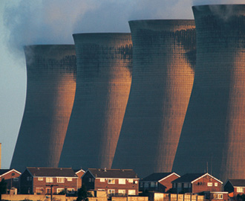

The steam is then condensed back into warm water and fed back into the boiler
Key questions
What energy is wasted in the steam?
Why is the steam condensed?
Why is it easier to boil warm water?

Slide 10
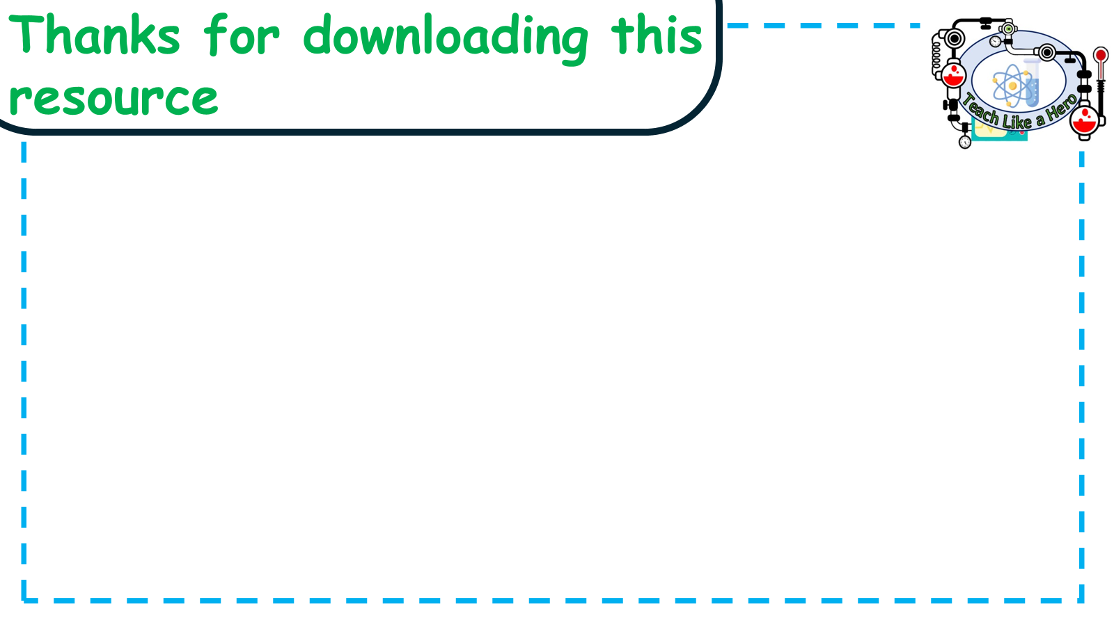
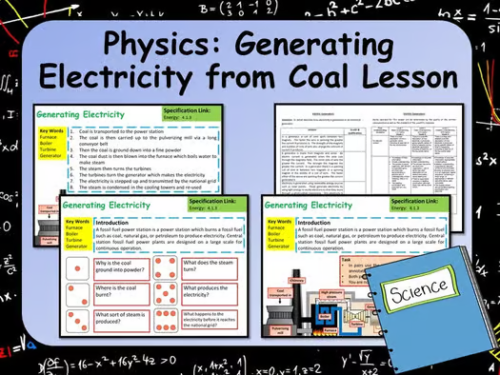
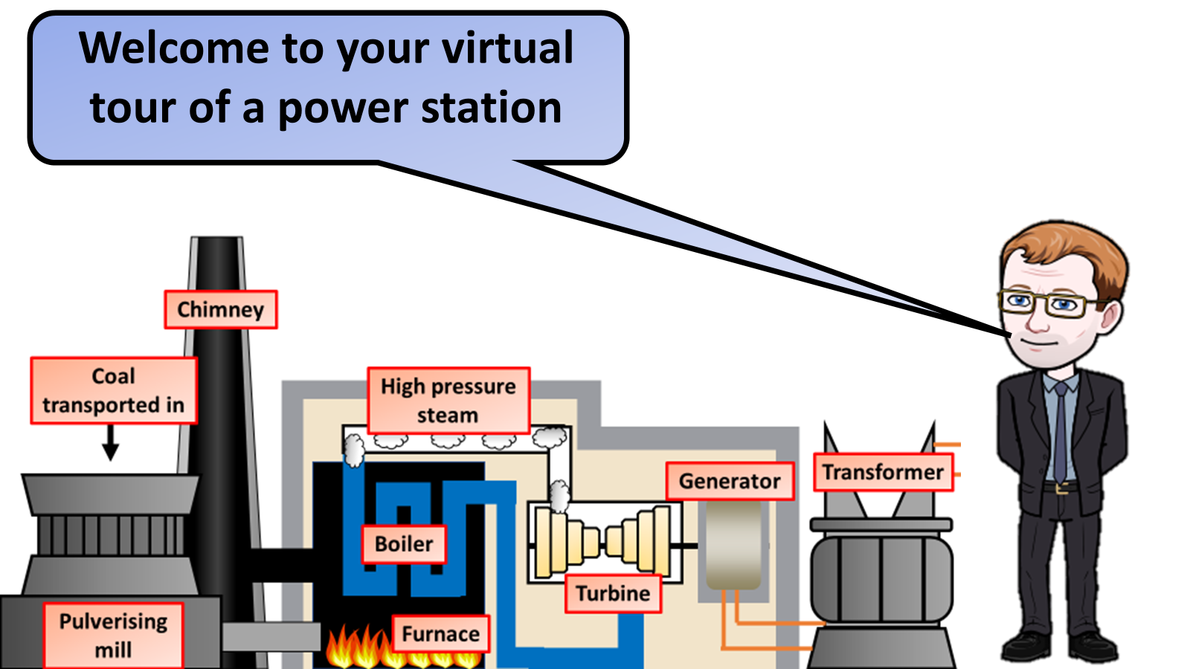


Click on the links below for lessons this resource can be used with
TPT lesson on power stations
TES lesson on power stations
Follow this link for a video running through this activity
Youtube video link
Follow me on social media to stay in touch
Keep up to date with my new content:

