Slide 1
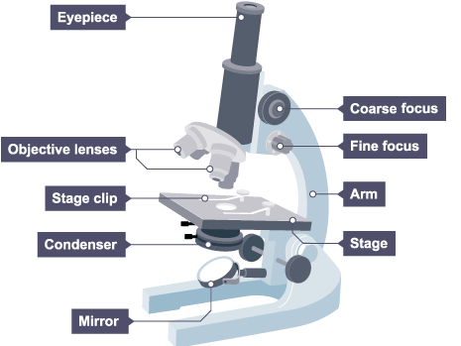
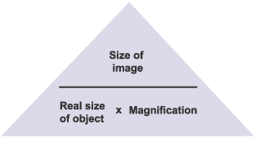
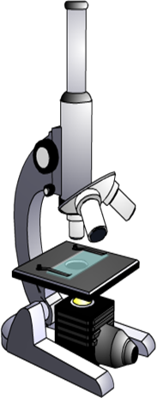
Practice Question (Microscopes)
Specification Link:
GCSE Biology (1-9)
Highlight key words or phrases in the method below
We need microscopes to study most cells. Microscopes are used to produce magnified images. There are two main types of microscope:
light microscopes are used to study living cells and for regular use when relatively low magnification and resolution is enough
electron microscopes provide higher magnifications and higher resolution images but cannot be used to view living cells
Image size =
Real size =
Magnification =
In this question you will be assessed on using good English, organising information clearly and using specialist terms where appropriate
The picture below shows a light microscope.
Explain in detail how you would look at a cell under the microscope using the highest magnification You must refer to the main parts of a light microscope in your answer.
_______________________________________________________________________________________________________________________________________________________________________________________________________________________________________________________________________________________________________________________________________________________________________________________

