Slide 1
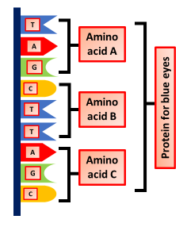
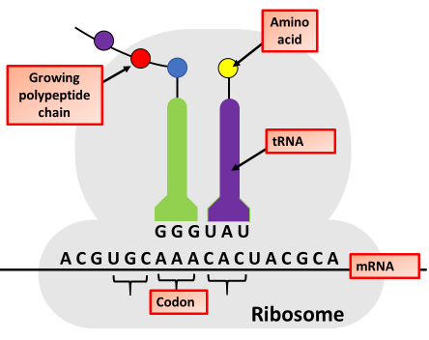
Protein Synthesis
Specification Link:
Inheritance: 4.6.1.2
Highlight key words in the information below:
A molecule of DNA contains four different bases, T, C, G and A.
The four bases are arranged in a long chain.
The chain of bases controls the synthesis of a protein.
The diagram shows a small section of a DNA molecule.
This section is responsible for synthesising the protein for blue eye colour.
The DNA code for the protein remains in the nucleus, but a copy, called mRNA, moves from the nucleus to the ribosomes where proteins are synthesised in the cytoplasm. The protein produced depends on the template used, and if this sequence changes a different protein will be made.
Carrier molecules bring specific amino acids to add to the growing protein in the correct order. There are only about 20 different naturally-occurring amino acids.
Each protein molecule has hundreds, or even thousands, of amino acids joined together in a unique sequence. It is then folded into the correct unique shape. This is very important, as it allows the protein to do its job. Some proteins are enzymes, others are hormones and others form structures within the body, such as collagen. Each of these proteins needs a different shape.
What word is used to describe ‘a small section of a DNA molecule that controls the synthesis of a protein’?
_______________________________________________
How many nucleotides code for a single amino acid’?
_______________________________________________
In the cell, where are proteins synthesised?’
_______________________________________________
Highlight key words in the information below:
The mRNA strand travels through the cytoplasm and attaches to the ribosome. The strand passes though the ribosome.
For every three mRNA bases the ribosome lines up one complementary molecule of tRNA. We call every three bases a codon.
tRNA molecules transport specific amino acids to the ribosome which they leave behind shortly after lining up opposite the DNA. Because there are three mRNA bases for each tRNA molecule, we call this the triplet code.
Used tRNA molecules exit the ribosome and collect another specific amino acid.
A chain of several hundred amino acids in the correct order according to the original DNA is then made. This is called a polypeptide.
Describe how the protein for blue eye colour is synthesised.
To gain full marks you must use information from the diagram.
____________________________________________________________________________________________________________________________________________________________________________________________________________________________________________________________________________________________________________________________________________________

Slide 2

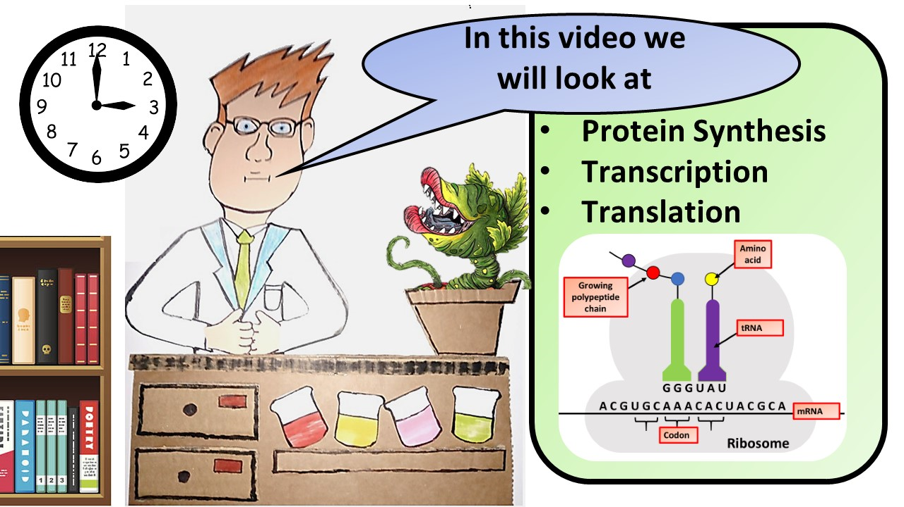


Click here to access my youtube videos
Resources that this activity would work well with
Lesson on TES
Lesson on TPT
Follow me on social media to stay in touch
Keep up to date with my new content:

