Slide 1
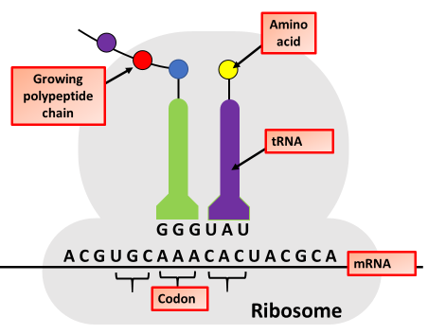
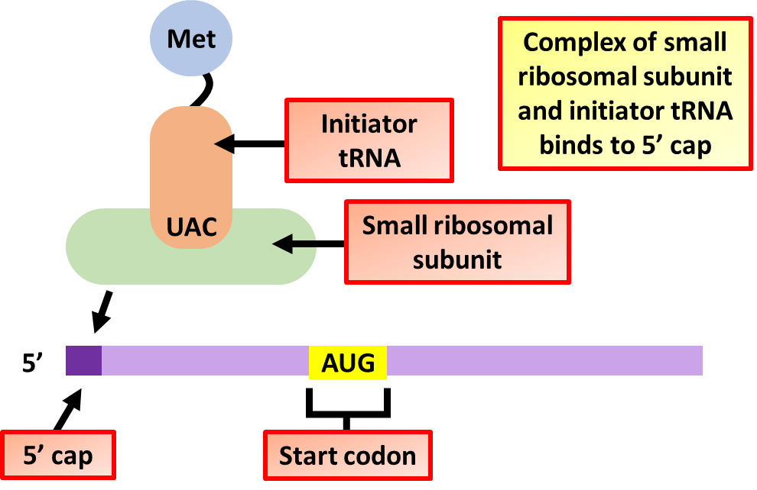
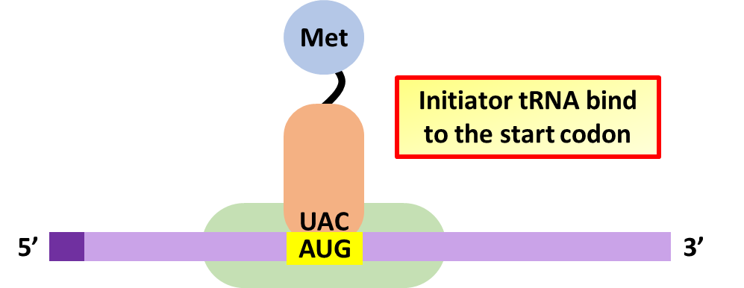
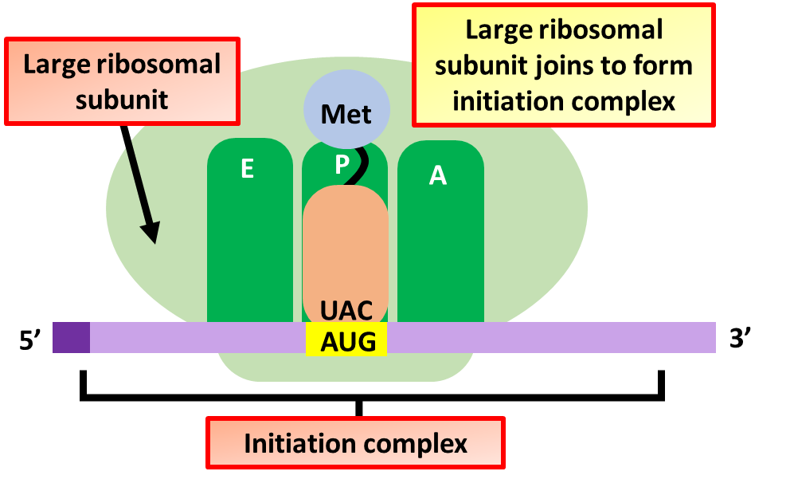
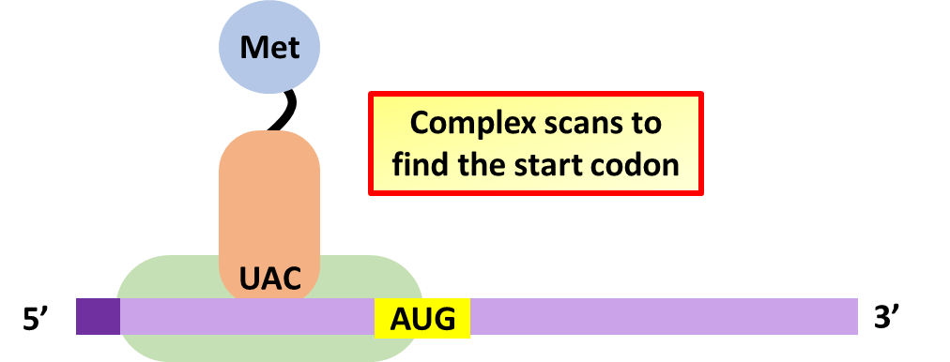
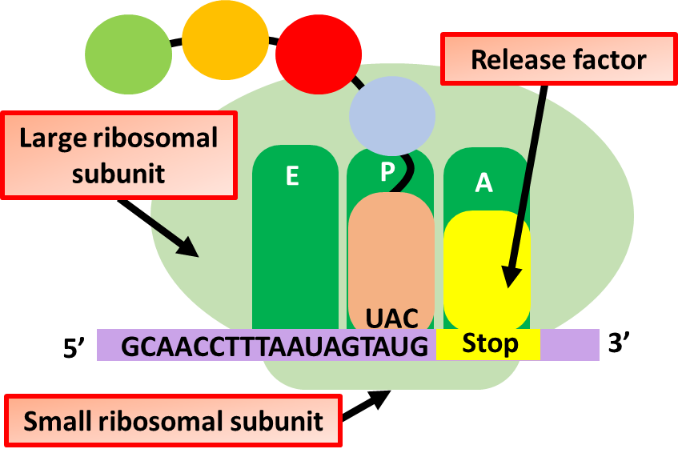
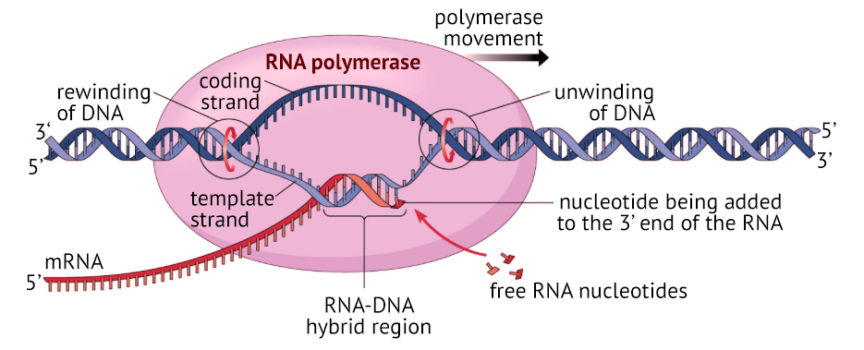
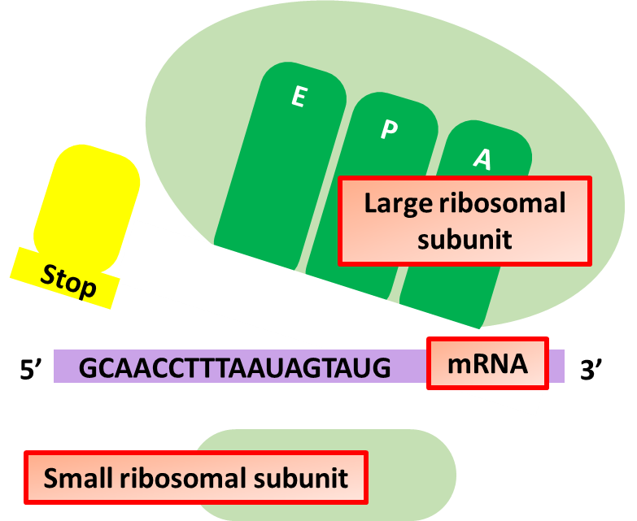
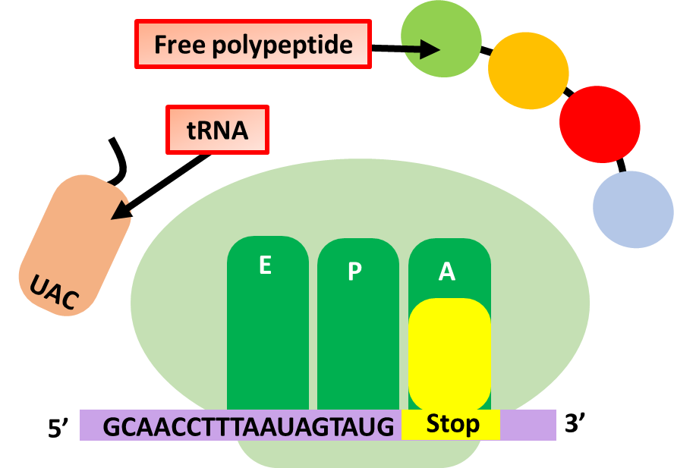
Describe the process of initiation of protein synthesis
Describe the process of elongation in protein synthesis
Key information to include:
How do the ribosomes bind to the mRNA
What is the initiator tRNA
Describe the process of translation initiation
Key information to include:
What elongation is
How polypeptide chains grow
What is a codon
What role is played by tRNA
Describe the process of termination in protein synthesis
Describe the process of transcription
Key information to include:
What is protein termination
What causes termination
What is a stop codon
What role is played by the mRNA
What happens to the ribosome after termination
Key information to include:
How is the DNA unwound
What is a template strand
How is mRNA formed
What is a transcription factor

Slide 2
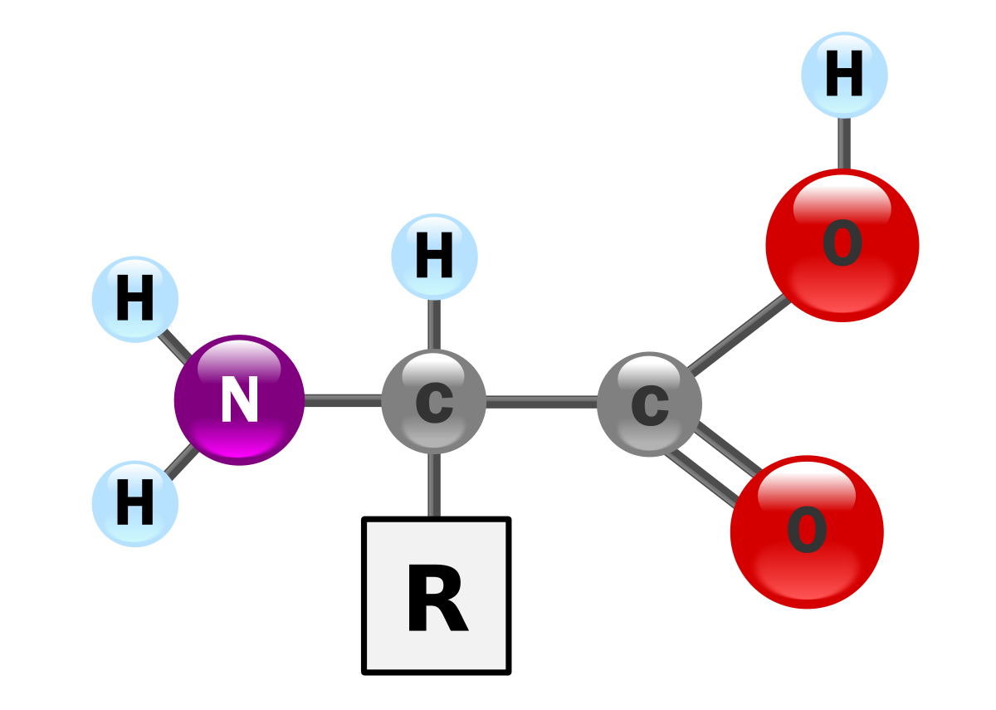
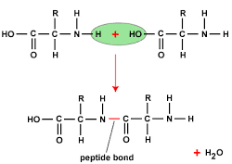
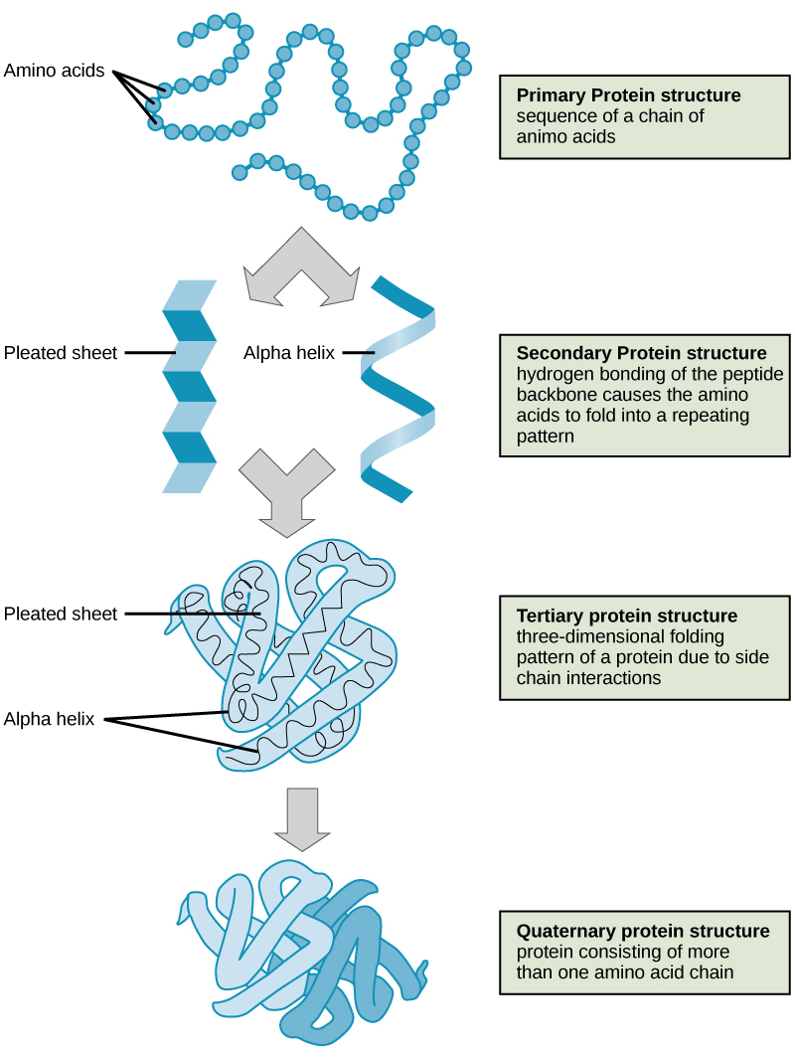
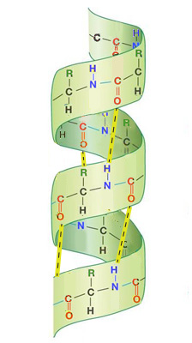
Describe the general structure of amino acids
Explain how peptide bonds form
Key information to include:
What is the general structure of an amino acid
How are amino acids formed
What is the R group
What are the roles of other groups
Key information to include:
How do 2 amino acids join
What is a dehydration reaction
What groups on amino acids join together to form a peptide bond
Describe the levels of protein structure
Describe alpha helix’s
Key information to include:
Primary protein structure
Secondary protein structure
Tertiary protein structure
Quaternary protein structure
Key information to include:
What is an alpha helix
How do alpha helixes form
What bonding do we find in alpha helixes
What is the structure of an alpha helix

Slide 3
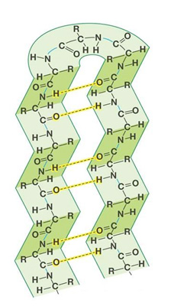
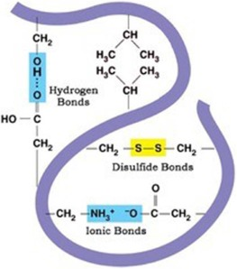
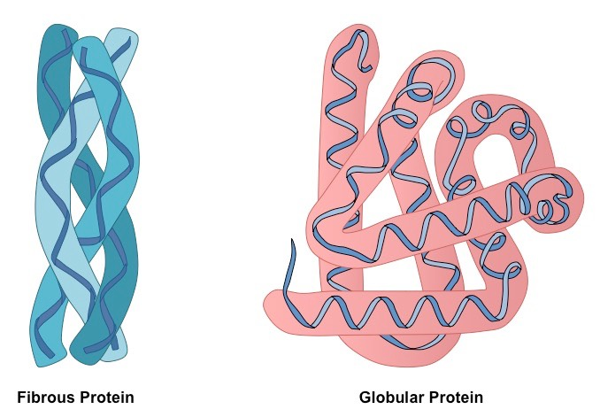
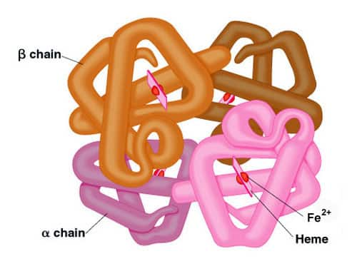
Describe beta pleated sheets
Explain the bonding in the tertiary structure of proteins
Key information to include:
What is the tertiary structure of proteins
What are hydrogen bonds
What are disulphide bridges
What are ionic bonds
How does the bonding change the shape of the molecule
Key information to include:
What is a beta pleated sheet
How do beta pleated sheets form
What sort of bonding to we find
Describe the shape of beta pleated sheets
Describe the structure & bonding in the quaternary structure of proteins
Describe the structure and properties of globular proteins
Key information to include:
What is the quaternary structure
How many peptide strands are involved
How are they held together
How does this structure help with the proteins function
Key information to include:
What globular proteins are
What properties they have
What are the general functions of globular proteins

Slide 4
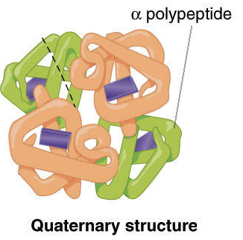
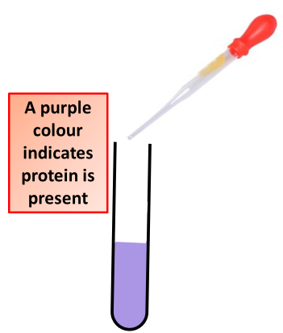
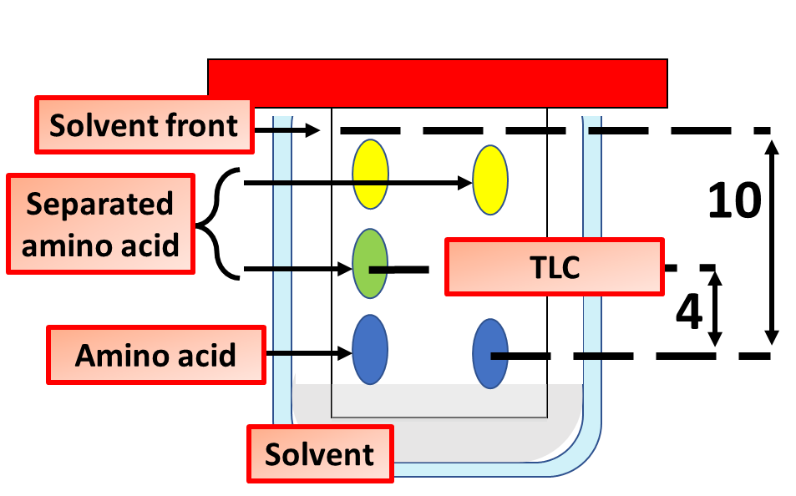
Describe the structure and properties of conjugated proteins
Describe the structure and properties of fibrous proteins
Key information to include:
What conjugated proteins are
What the properties of conjugated proteins are
Where do we find conjugated proteins
What are some examples
Key information to include:
What are fibrous proteins
What are the properties of fibrous proteins
What are some examples of fibrous proteins
Describe how amino acids can be separated using chromatography
Describe how protein can be identified
Key information to include:
What chromatography is
How chromatography works
Why different amino acids can be separated
How Rf value is calculated
Key information to include:
What is the biuret experiment
How is it carried out
What sort of results would you expect to see

