Slide 1
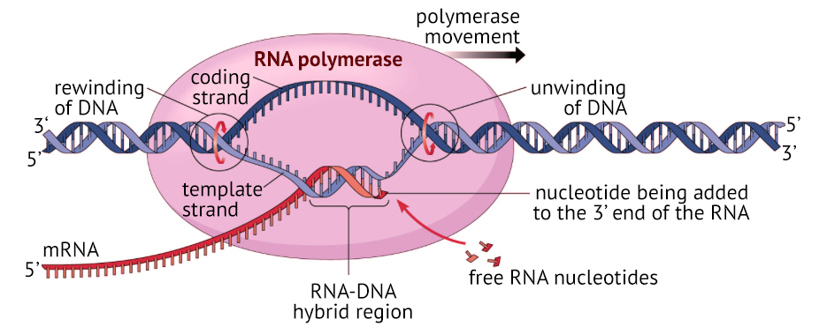
Protein Synthesis: Transcription
Specification Link:
Biological Molecules
Highlight key words in the information below:
Transcription is the first step in gene expression. It involves copying a gene's DNA sequence to make an RNA molecule. Transcription is performed by enzymes called RNA polymerases, which link nucleotides to form an RNA strand (using a DNA strand as a template). Transcription has three stages: initiation, elongation, and termination. In eukaryotes, RNA molecules must be processed after transcription: they are spliced and have a 5' cap and poly-A tail put on their ends. Transcription is controlled separately for each gene in your genome.
Describe the role played by mRNA in the cell
________________________________________________________________________________________________________________________________________________________________
Highlight key words in the information below:
Initiation. RNA polymerase binds to a sequence of DNA called the promoter, found near the beginning of a gene. Each gene (or group of co-transcribed genes, in bacteria) has its own promoter. Once bound, RNA polymerase separates the DNA strands, providing the single-stranded template needed for transcription.
Describe the key function of helicases during transcription?
________________________________________________________________________________________________________________________________________________________________
Highlight key words in the information below:
What do the 5’ and 3’ mean?
________________________________________________________________________________________________________________________________________________________________________________________________________
Elongation. One strand of DNA, the template strand, acts as a template for RNA polymerase. As it "reads" this template one base at a time, the polymerase builds an RNA molecule out of complementary nucleotides, making a chain that grows from 5' to 3'. The RNA transcript carries the same information as the non-template (coding) strand of DNA, but it contains the base uracil (U) instead of thymine (T)
Highlight key words in the information below:
Termination
Sequences called terminators signal that the RNA transcript is complete. Once they are transcribed, they cause the transcript to be released from the RNA polymerase.
How is transcription terminated?
________________________________________________________________________________________________________________________________________________________________

Slide 2
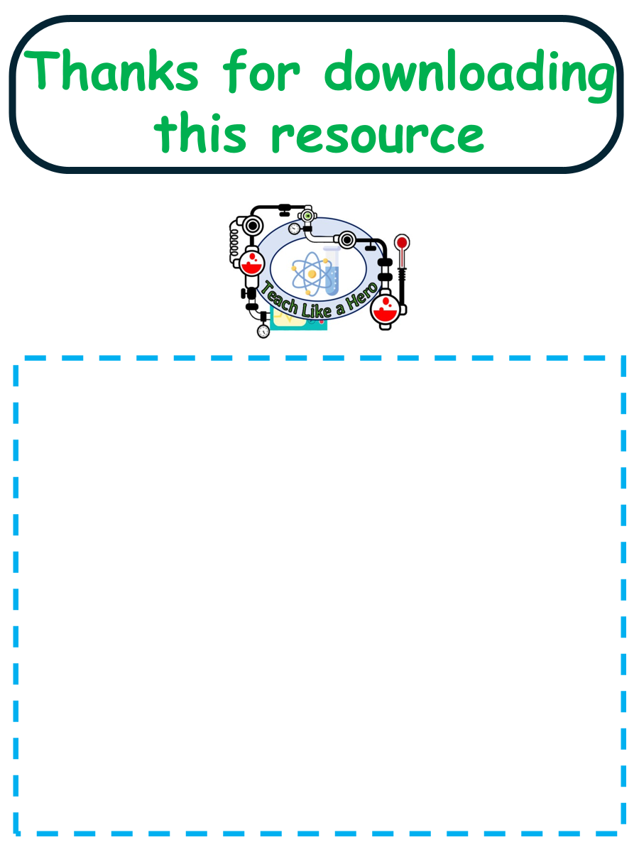
Click here to access my percentage composition youtube videos
Resources that this activity would work well with
Lesson on TES
Lesson on TPT
Follow me on social media to stay in touch
Keep up to date with my new content:

