Slide 1
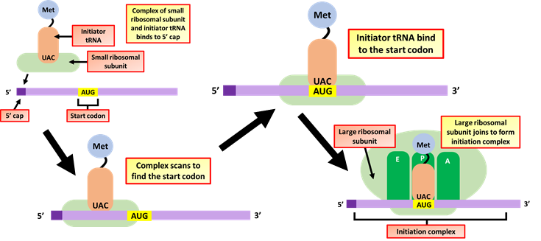
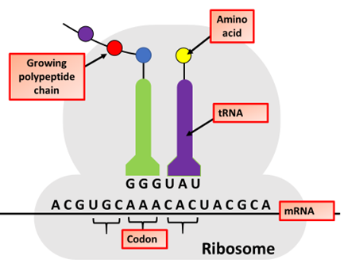
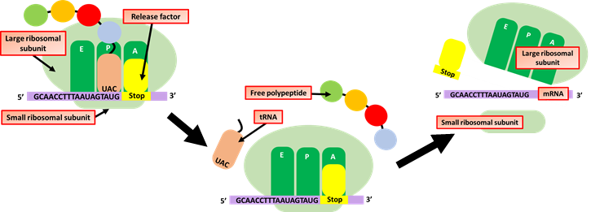
Protein Synthesis: Translation
Specification Link:
Biological Molecules
Highlight key words in the information below:
Initiation
In order for translation to start, we need a few key ingredients. These include:
A ribosome (which comes in two pieces, large and small)
An mRNA with instructions for the protein we'll build
An "initiator" tRNA carrying the first amino acid in the protein, which is almost always methionine (Met)
During initiation, these pieces must come together in just the right way. Together, they form the initiation complex, the molecular setup needed to start making a new protein.
Describe how mRNA translation is initiated
____________________________________________________________________________________________________________________________________________________________________________________________
Highlight key words in the information below:
Elongation
Elongation is when the polypeptide chain gets longer. After the initiation complex has formed, but before any amino acids have been linked to make a chain. Our first, methionine-carrying tRNA starts out in the middle slot of the ribosome, called the P site. Next to it, a fresh codon is exposed in another slot, called the A site. The A site will be the "landing site" for the next tRNA, one whose anticodon is a perfect match for the exposed codon.
What are anticodons?
____________________________________________________________________________________________________________________________
How does a polypeptide grow?
________________________________________________________________________________________________________________________________________________________________
Highlight key words in the information below:
Translation ends in a process called termination. Termination happens when a stop codon in the mRNA (UAA, UAG, or UGA) enters the A site. Stop codons are recognized by proteins called release factors, which fit neatly into the P site. Release factors mess with the enzyme that normally forms peptide bonds: they make it add a water molecule to the last amino acid of the chain. This reaction separates the chain from the tRNA, and the newly made protein is released.
What causes termination of transcription?
________________________________________________________________________________________________________________________________________________________________________________________________________

Slide 2
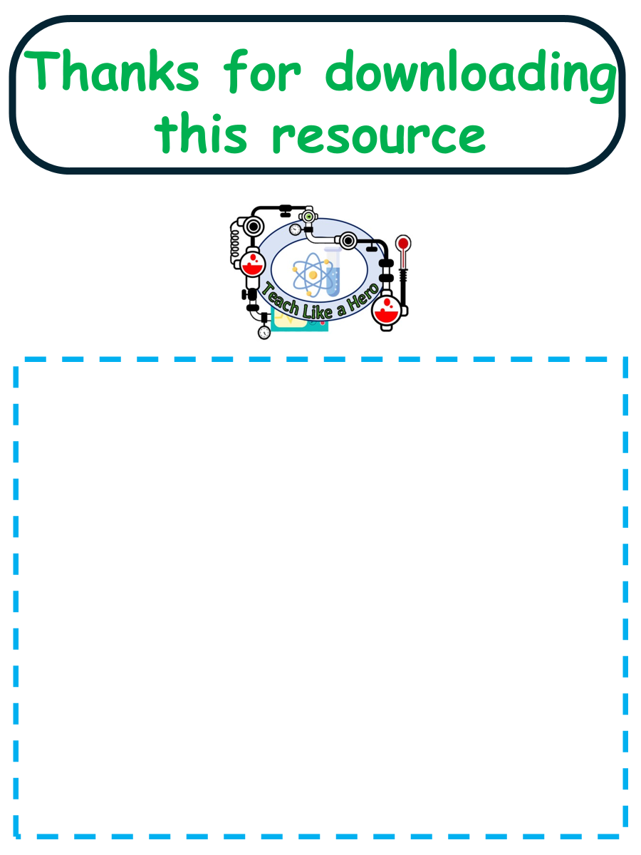
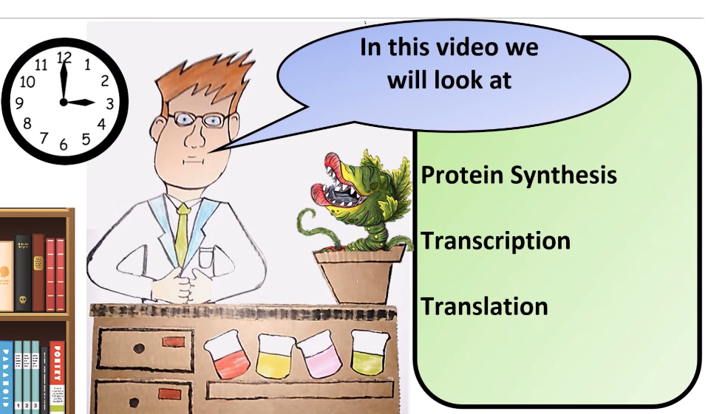


Click here to access my percentage composition youtube videos
Resources that this activity would work well with
Lesson on TES
Lesson on TPT
Follow me on social media to stay in touch
Keep up to date with my new content:

